Slide 1
BOLD Science Meeting 4-28-2021
Dr. Patricia (Pat) Thomas

Slide 2
Gap Assessments
I have a gap assessment test (30 questions) that I can place on our BOLD site for science.
https://ocps.instructure.com/courses/1383959
Middle School

Slide 3
Last Meeting for this year
DBA’s
Ideas of your best way to accomplish this.

Slide 4
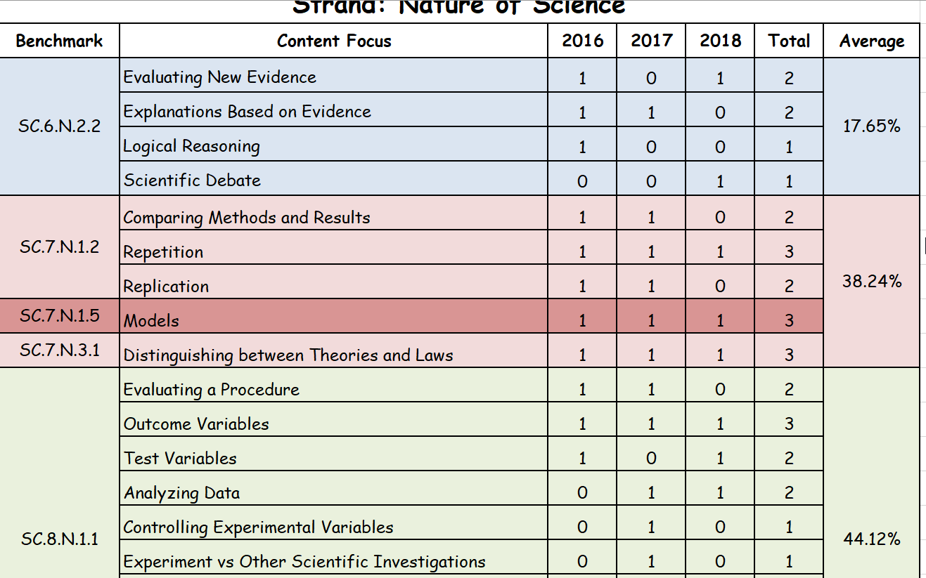
8th Grade FCAT Content Focus
Nature of Science

Slide 5
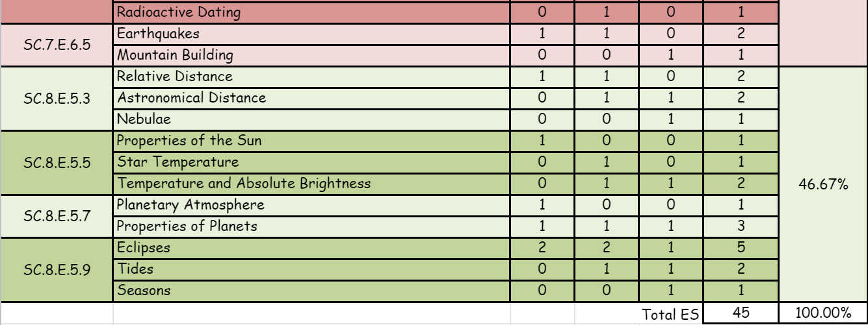
8th Grade FCAT Content Focus
Earth Science

Slide 6
8th Grade FCAT Content Focus
Physical Science

Slide 7
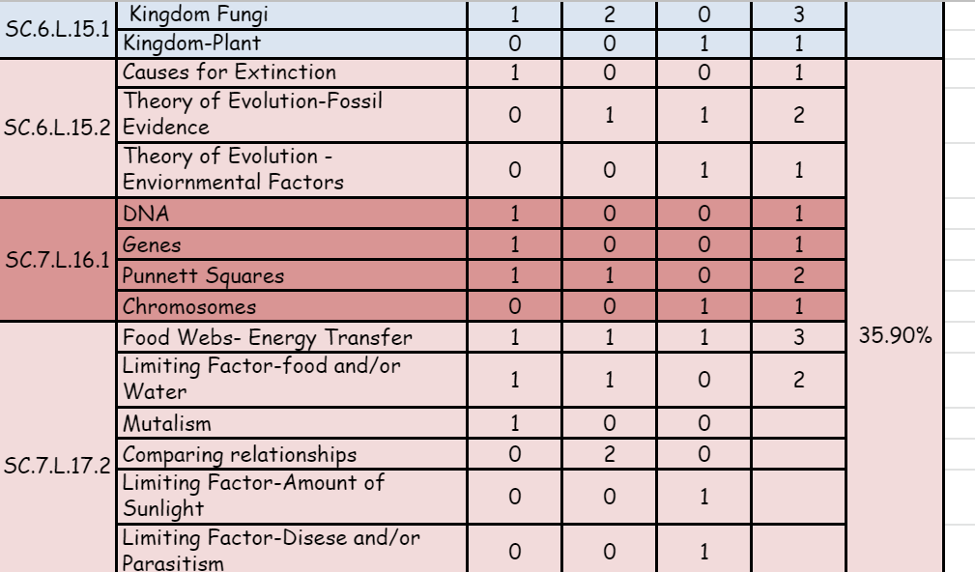
8th Grade FCAT Content Focus
Life Science

