Slide 1
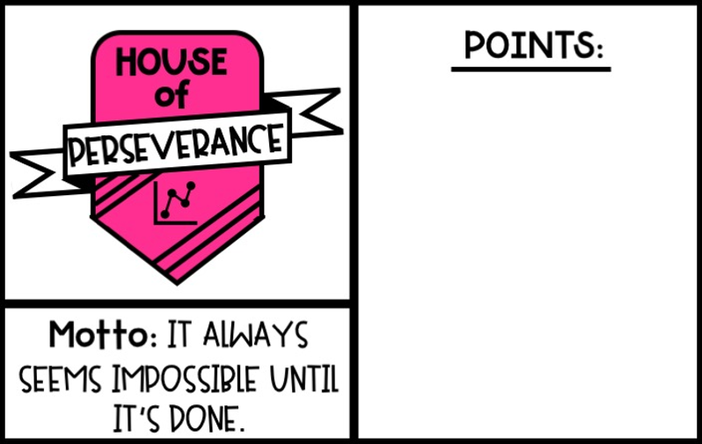
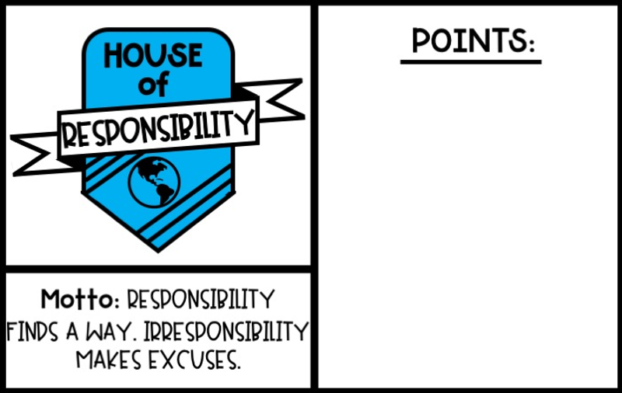
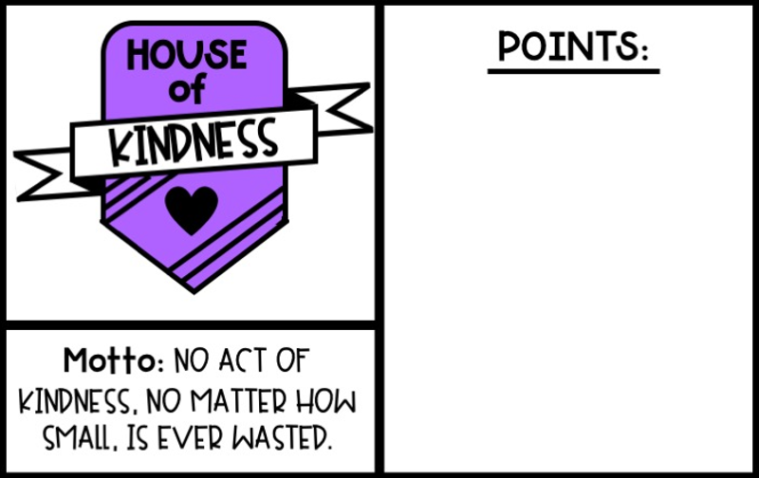
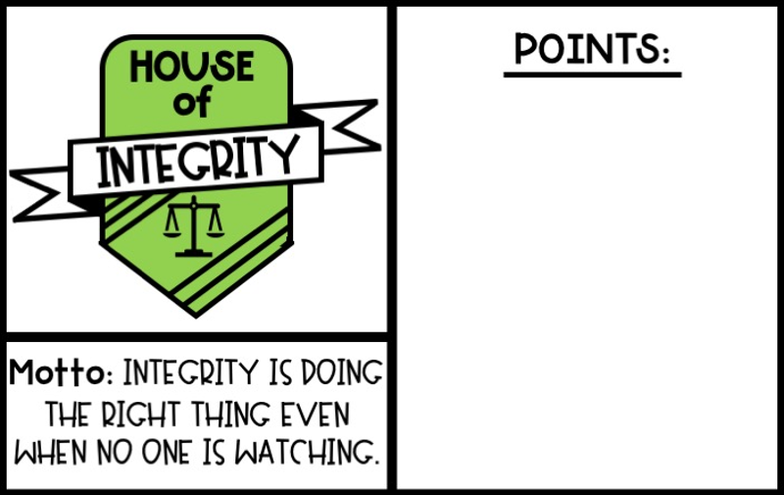
Ms. Garsh’s Student House Points
Rosters
This Week:
Total:
This Week:
Total:
Points
Prizes
Rules
This Week:
Total:
This Week:
Total:
Home

Slide 2
House Rosters
Serenity Ronondo Dariel Azalea Salamah Za’nia Davion Micah Alyssa Sadie Giovanni Marshall Connor Raleigh | David Bryce Karmen Samantha Elisabelle Emilie Joey H. Isabella L. Sophia Raphael Jeriely Teresa Jack Colby | Bridget Maram Victoria Sage Teagan Ana Emma Maci Zoe Angeliz Grace Gabriela Isabella S. | Aliyah Jaelah Jahliyah Joey D. Angelina Brixton Keylan Tanzie Richie Solomon Alexis Jaiden Gian
Back
Home

Slide 3
House Points
+5 Points |  | +3 Points
Earn Star Student Complete a course (+5 per course!) Complete a DBA before the due date Attend an ELA Live Lesson Attend an ELA Intervention Lesson |  | Attend Fun Friday Complete 45 minutes on i-Ready Reading (weekly) Complete your iReady MOY Diagnostic
+1 Point
Weekly Participation: Earn 1 point (up to 2 weekly) for each class that you actively participate in. Active participation means completing one assignment or quiz in ELA or SS. Weekly Pacing: Earn 1 point (up to 2 weekly) for each class that you are on or ahead of pace in. Pass an i-Ready Reading Lesson (67% or higher score on an individual lesson - no weekly limit!) Display any of the house traits (kindness, perseverance, integrity, or responsibility
Back
Home

Slide 4
Prizes
Each Tuesday we will announce the Weekly House Winner! The team banner will be displayed on the Teacher Announcement Page for all to see! The House with the most points for the week will earn a special House Meeting on Friday. As a team you will get to vote on the activity you will complete during your House Meeting. Your team may come up with their own fun activity or choose from the following ideas: Scavenger Hunt Go Noodle Dance Party / Freeze Dance Show and Tell Kahoot Play Simon Says More prizes, including a Grand Prize, can be added at any time! :) Be on the lookout!
Back
Home

Slide 5
House Rules and Procedures
Points will be given out during the week for attending Live Lessons, completing DBA’s, or displaying house traits. Points for i-Ready, Weekly Participation, and Weekly Pacing will be given out on Mondays based on the previous week’s participation. This will be the day all points are calculated in preparation for the House Winner announcement on Tuesdays! Points can only be gained, not taken away. This is meant to be fun and encouraging! :) Showing kindness and encouraging others, including those not on your team, is a sure way to earn some extra points! Students can see how many points they are earning for their house through Class Dojo! (Information will be sent via email - using Class Dojo is totally optional!)
Back
Home

