Slide 1
Mail Merge Magic With Macros Video on https://www.youtube.com/watch?v=euHZy1jxWPw
Exporting Student Information from VSA
to set up spreadsheets for
Mail Merge with Macros!

Slide 2
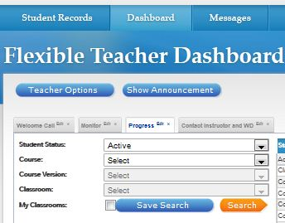
To export student information from VSA, first create a tab of all the information you want to include:
You can edit to fit your needs☺
My Current List:
Student email
Guardian email
Last assignment turned in date
Percent complete
Current course grade.
Number assignments turned in last seven days
Number assignments submitted.

Slide 3
From the Progress tab, export the information you’ve selected as an Excel Spread Sheet.
You will then get a message asking if you want to save or open, you can do either.

Slide 4
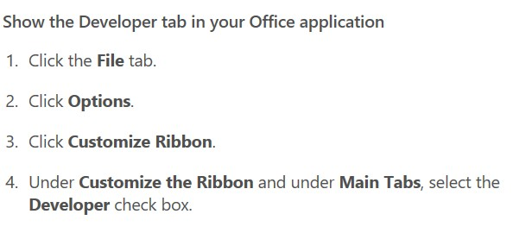
Once your excel file opens,
you are ready for the magic!!
Be sure you have Developer showing across the top ribbon.
If it is not, we will click on file to change your options.
We want a spreadsheet with
information in each column separated.

Slide 5
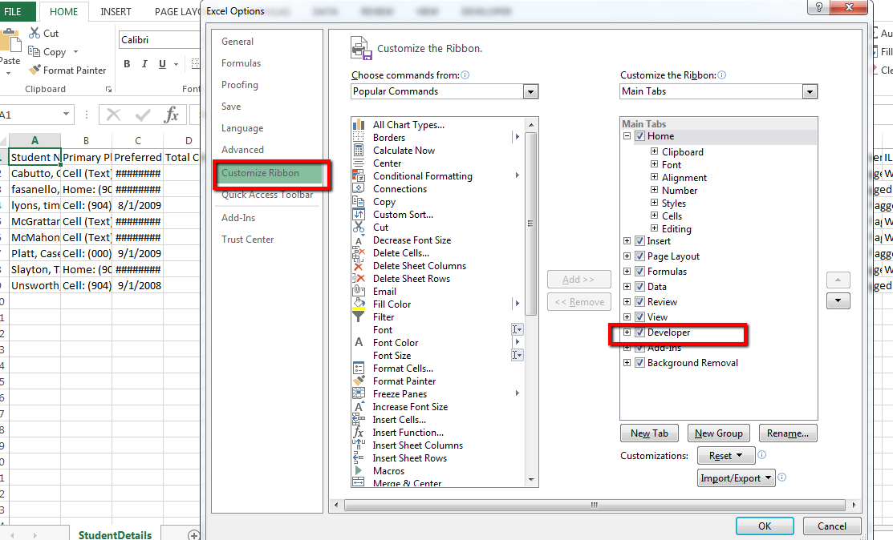
1
2
3

Slide 6
Adding Developer to Microsoft 2010 Excel
Adding Developer to MAC in Excel

Slide 7
This will now allow you to record each step and save the macro recording,
then you will never have to set it up again. Each time you export student information from
VSA, you run the macro, and it automatically goes through each
of your steps to set up the spreadsheet.
Just Like Magic!!!

Slide 8
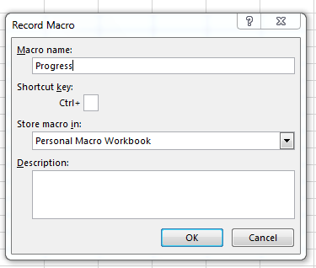
When finished, click save in Personal Macros Workbook,
then you can just run the macro for all your future exports.

Slide 9
Now let’s get started on those steps. It might seem a bit involved,
but you only have to do it once, then can forever enjoy the fruits of your labor!
Even if you teach more than one prep and more than one segment at a time,
the same macro will work for each one.
Ready– let’s do it!

Slide 10
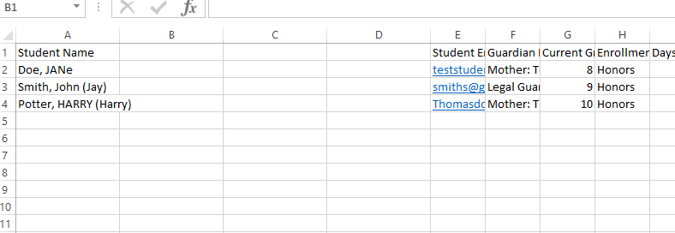
Insert three blank columns right after the student name column. ( Highlight a column by holding the mouse down as you scroll across the letter at the top of the column, then right click, and select insert.)
To insert the column after A, you must highlight B and right click to insert.
Before
After

Slide 11
You will now have a blank column directly after the student name. You also need several blank columns after guardian email address (10-12 at least). So select LOTS of blank columns at the end of the spreadsheet, then highlight column E to insert copied columns.
Now that you have blank columns, select column A (highlight), then click data tab, then Text to Columns. This is where you can separate column information like magic!

Slide 12
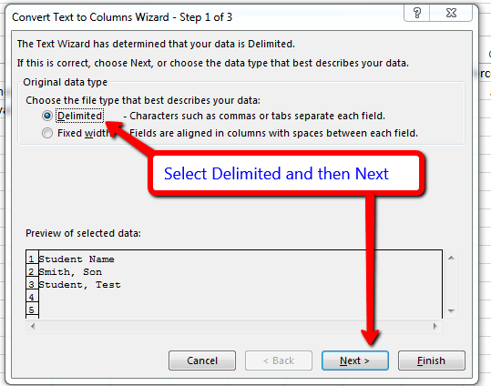
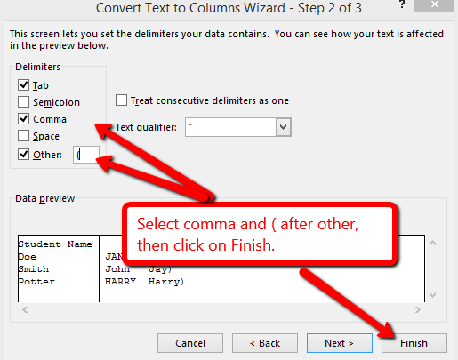
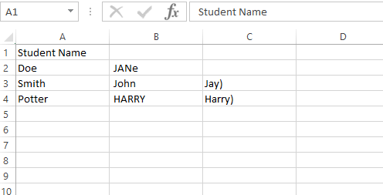
Notice how it now has the first and last name separated into two separate columns, with the nickname in the third.
Now you can re-label the first column as Last Name.

Slide 13
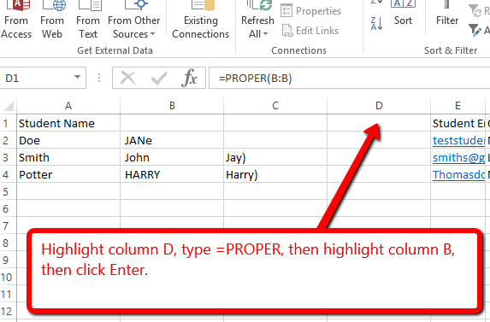
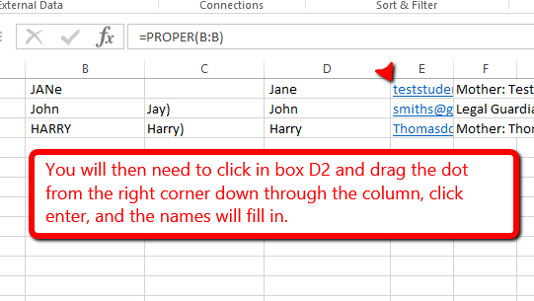
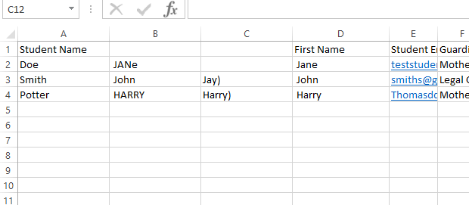
Lastly, label the column D as First Name.
Leave column B and C alone,
you will not need those for now.

Slide 14
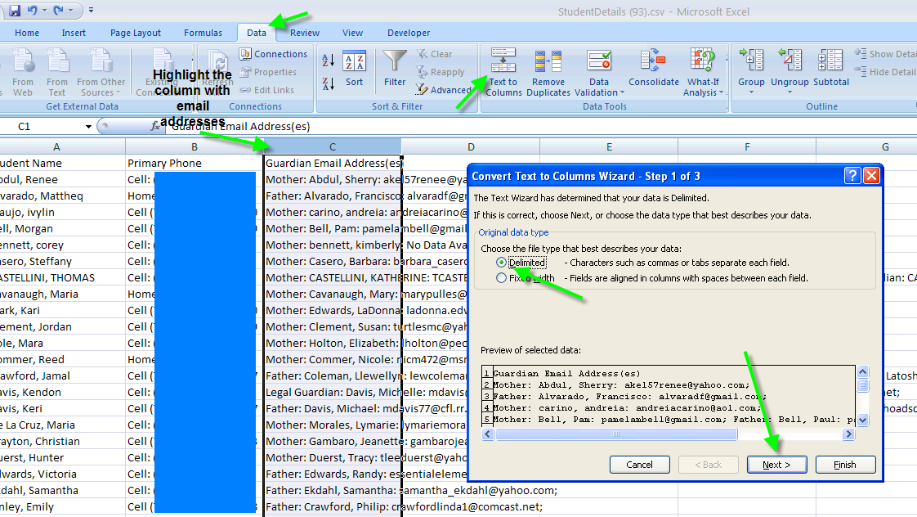
Now we will separate the Guardian Email column, so select the column,
Click Text to Column at the top again, Delimited, Next.

Slide 15
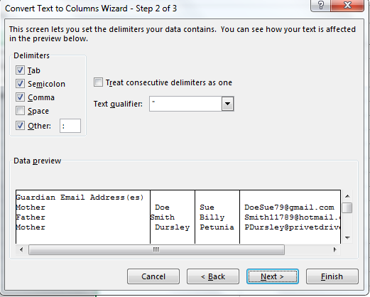
This time select both semicolon and colon to separate.

Slide 16
The email addresses are now separated from the names and titles as shown:

Slide 17
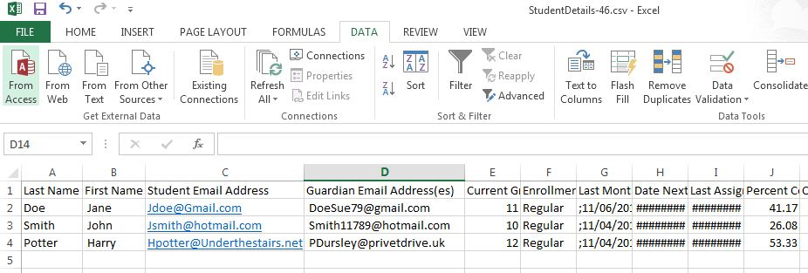
Finally, copy/delete (control X) the Guardian Email label and place it above the first column of emails, then delete the columns that do not have an email address. If there is a second column of emails, I call it email2, a third one would be email3, and so on:

Slide 18
Now that all the emails are separated,
you can stop the macro and save it.
Be sure to save as a Personal Macro Workbook.
Whew! You did it!!!
Or…. You can add more steps such as ….

Slide 19
If you happen to know how many total assignments there are in the segment, you can create another column called Total Left.
Select the column just right of the Number Assignments Submitted, right click, insert.
(If using the macro for more than one course, stop recording before going to the next step.)
Now type in a formula by first typing =, then the total assignments in the segment, then -, select the previous cell, then enter. It calculates for you!

Slide 21
You have finished recording your macro,
Every time you export from VSA,
just run your macro by clicking
Developer, Run Macro. Make sure the file you save is a CSV file.
you can stop the macro and save it.
Be sure to save as a Personal Macro Workbook.
Be sure to check the email addresses.
Sometimes it may say No Data Available
So needs to be deleted or changed.

Slide 22
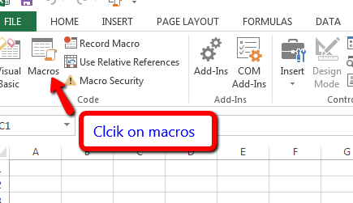
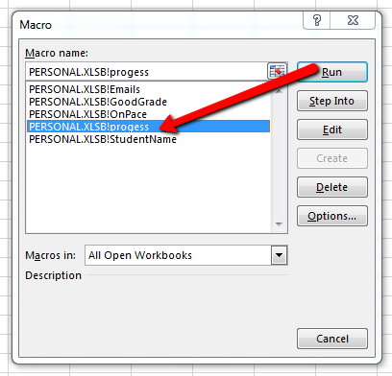
The next time you want to export from VSA, open up your macro to run and it will automatically do all the steps for you☺

Slide 23
You now have all the information on a spreadsheet that you need to send personalized progress reports by Mail Merge.

Slide 24
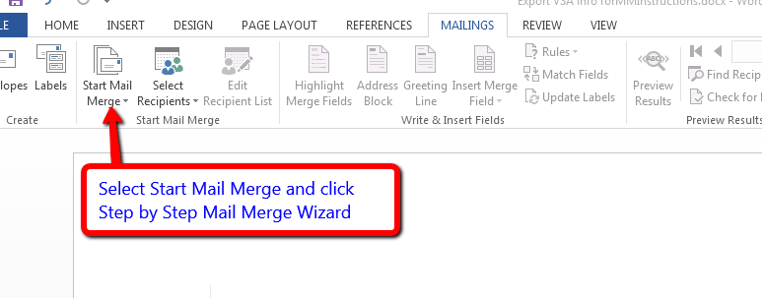
Let’s start the Mail Merge!
First of all, open up a blank word document.
Click on Mailings at the top

Slide 25
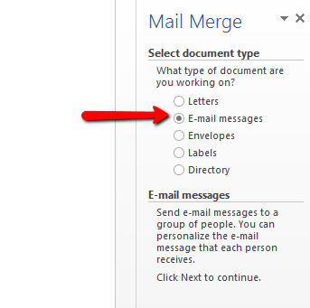
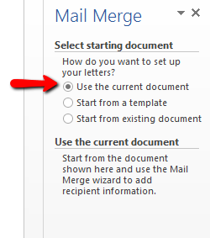
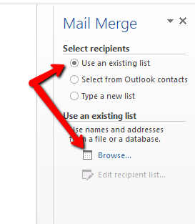
Keep selecting the item you want and
then next as you go through the wizard,

Slide 26
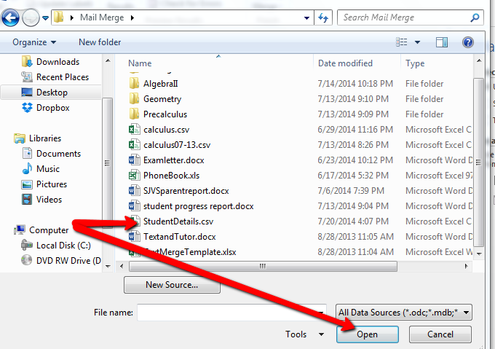
Click ok on the next screen and then you can write your letter or progress report. Type in what you want, then when you get to something you want to insert, click More Items on the wizard to bring up all the columns from your excel file.

Slide 27
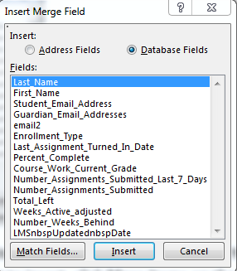
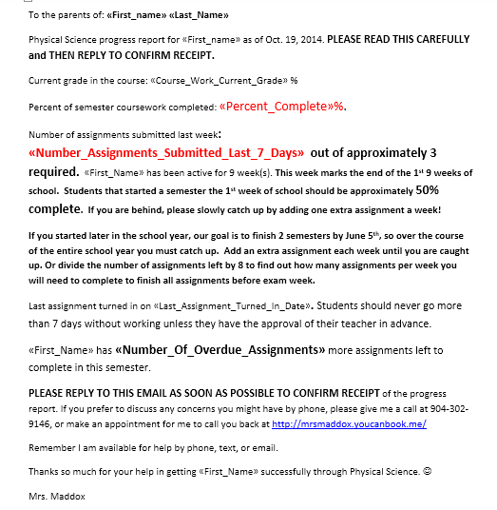
Select the item you want and insert.

Slide 28
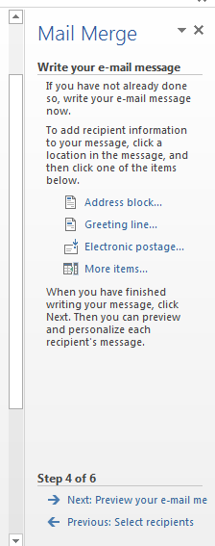
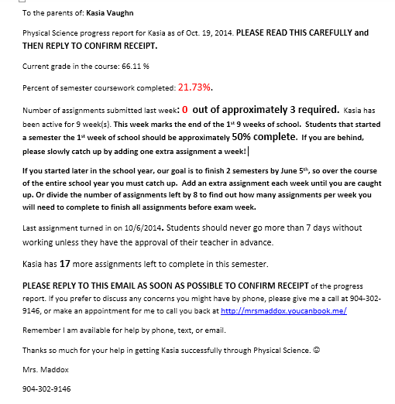
Here is an example of what my student progress report now looks like:

Slide 29
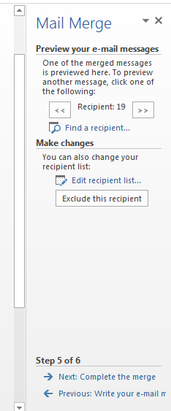
On this screen, you can choose to Exclude Recipient if there is a student on your list whom you do not want to email. Finally, click Complete the merge, Electronic mailing, select email column, type in subject, and select HTML to send.

Slide 30
If you are on a MAC -You still need to specify Outlook as your default email program in the Preferences for Apple's Mail.app in order for it to be recognized by Word... IOW, the fact that you use only Outlook does not automatically make it the default email program as far as your Mac is concerned.

Slide 31
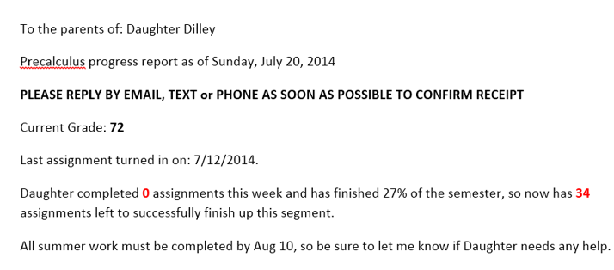
Sample parent progress report:
Notice I ask them to confirm receipt; once confirmed I can log as a monthly contact. This saves hours of trying to play phone tag while keeping parents up to date of their child’s progress.

Slide 32
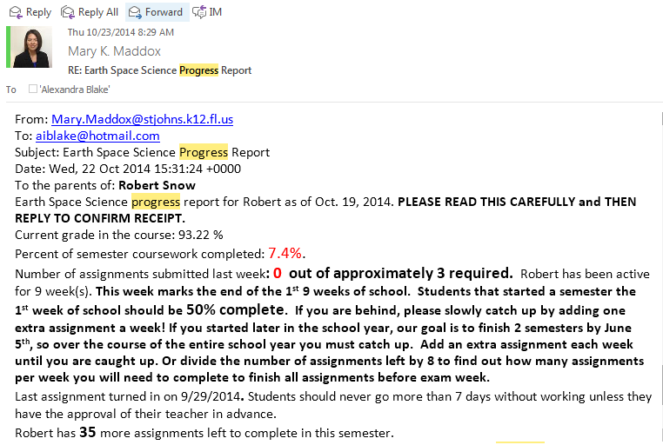
Here is another copy of a parent progress report:
Notice I ask them to confirm receipt, then as soon as confirmed I can log as a monthly contact.
This shows two way communication with stakeholders.

Slide 33
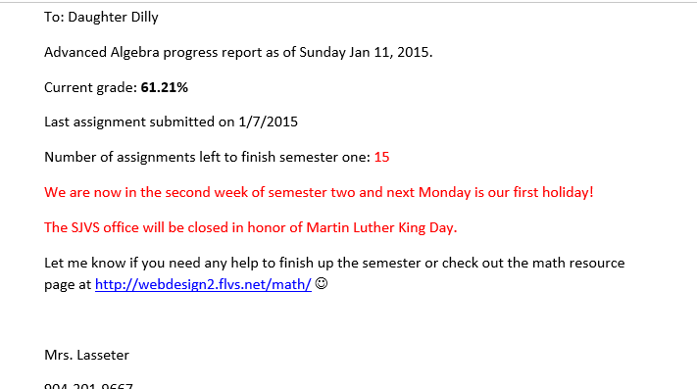
Example Student Progress Report

