Slide 1
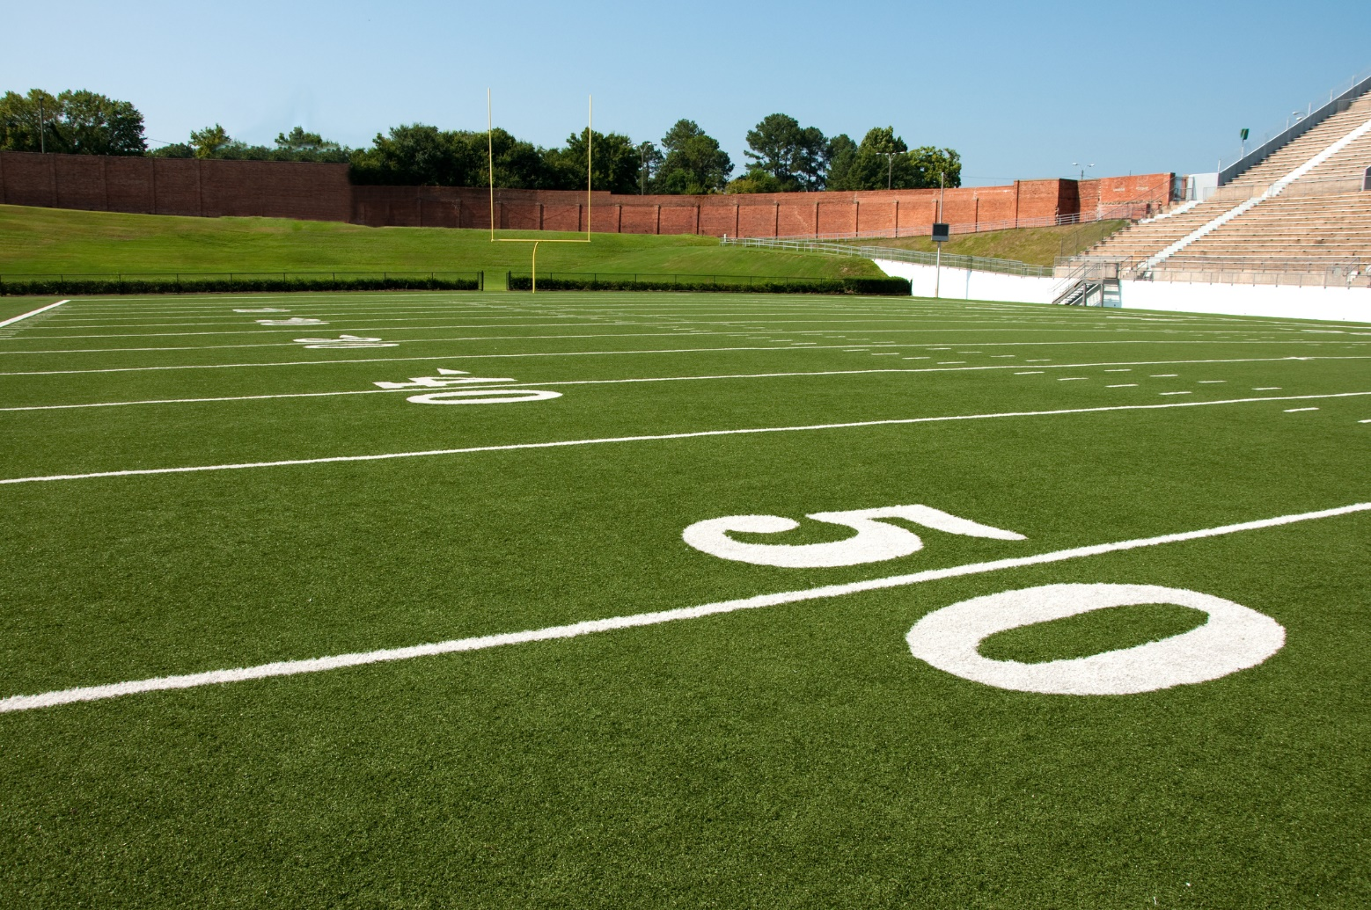
Elementary
PHYSICAL EDUCATION
1st, 3rd, 4th Grade
Module 01: Lesson 04
Throwing & Catching….

Slide 2
Let’s Get Moving……
PHYSICAL EDUCATION
Move In All Sorts Of Ways!!
You can be active in many different ways, from playing a simple game of tag with your friends to practicing your throwing skills with an adult. It does not matter what you do, as long as you are active and have fun!
Over the next few days, you will learn some new skills to help you stay active. You will learn the correct steps to throw, catch, and dribble an object with your hands and feet. Do not worry if you are not comfortable with these skills just yet. You will improve with a little practice. Let's get started!

Slide 3
Today we will learn/review: 1st, 3rd, and 4th
PHYSICAL EDUCATION
I can 1st grade:
list at least two ways I can be active during school
list at least two ways I can be active after school
count the number of ways I am active each day
throw a ball underhand using the correct steps
throw a ball underhand to my friend using the correct steps
throw a ball underhand with the hand that feels the best
move to underhand catch a self-tossed object using the correct steps
use the correct steps to throw an object overhand
use the correct steps to throw an object overhand for distance
dribble a ball with my hands or feet
dribble a ball with the hand or foot that feels best
I can 3rd grade:
throw overhand for accuracy and for distance
throw larger sized balls with a correct style for distance
catch various sized and shaped objects tossed from a stationary partner
dribble with control in an offensive situation and defend 'on-the-ball' in defensive situations

Slide 4
Today we will learn/review: 1st, 3rd, and 4th
PHYSICAL EDUCATION
I can 4th grade:
throw objects of different sizes and weights to a target from various distances
move into position to catch objects of different sizes and weights
dribble while moving and pass to a partner using my hands
identify proper positioning of offensive and defensive players in invasion games and net games
identify proper practice activities that can improve performance skills

Slide 5
Rate My Self SEL Learning Check In
PHYSICAL EDUCATION
Show Me How You Are Feeling??
Sad | Okay | Happy
I feel Sad today. | I feel OKAY today. | I feel HAPPY today.
SAD-THUMBS DOWN
OKAY-THUMB IN THE MIDDLE
HAPPY-THUMBS UP

Slide 6
Rate My Self Lesson Check In
PHYSICAL EDUCATION
What Do You Know About Throwing & Catching?
I AM A 1 | I AM A 2 | I AM A 3 | I AM A 4
I don’t understand much about throwing and catching! | I understand the concept of throwing and catching a little bit, but I need more help! | I understand how to practice throwing and catching and understand how to do it right! | I understand how to practice throwing and catching and can also teach a friend/partner!

Slide 7
3rd Grade Standards
PHYSICAL EDUCATION
1st Grade Standards
PE.1.L.3.4 - Identify opportunities for involvement in physical activities after the school day.
PE.1.M.1.8 - Demonstrate an underhand-throwing motion for accuracy using correct technique.
PE.1.M.1.9 - Demonstrate an overhand-throwing motion for distance using correct technique.
PE.1.M.1.7 - Move in different directions to catch a variety of self-tossed objects.
PE.1.M.1.5 - Dribble an object with hands or feet while demonstrating control in general space.
PE.1.C.2.7 - Identify dominant hand/foot for use with throwing/dribbling/striking/kicking skills.
PE.3.M.1.8 Throw balls of various sizes and weights to a stationary partner using a correct overhand motion.
PE.3.M.1.7 Move in different directions to catch objects of different sizes and weights thrown by a stationary partner.
PE.3.M.1.5 Maintain control while dribbling with hands or feet against a defender.
PE.3.C.2.8 Describe basic offensive and defensive tactics.
PE.3.M.1.9 Perform a teacher-designed sequence using manipulatives.
4th Grade Standards
PE.4.M.1.8 Throw balls of various sizes and weights to a stationary partner from varying distances using a correct overhand motion.
PE.4.M.1.7 Move in different directions to catch objects of different sizes and weights thrown by a stationary partner from varying distances.
PE.4.L.3.3 Identify opportunities for involvement in physical activities during the school day.
PE.4.L.3.4 Identify opportunities for involvement in physical activities after the school day.
PE.4.M.1.5 Dribble and pass to a moving partner.
PE.4.C.2.9 Identify basic offensive and defensive tactics for modified invasion and net activities.

Slide 8
Get a Jump Start…..
PHYSICAL EDUCATION
Our lesson covered a lot this week:
We learned we should move our body every day to stay active.
We learned underhand throw, arm hangs low and swing back and forth! Tick Tock, Step, Rock
We learned self tossed object, throwing up in the air and catching it
We learned to start catching we need to look move, reach, and chest
Overhead throw, is when an object is thrown from above the shoulder. Try throwing with whichever hand that feels easiest. Keep arm straight!
Watch out for catching cues!
Throwing overhand sports include baseball, shot put, football, cricket.
Small ball you can throw with one hand, large ball use 2 hands.
Keep your eyes on the ball-use eye hand coordination-3rd grade
We learned how to dribble away-you can dribble in soccer, the pool, or basketball, and hockey too.
We learned to keep calm and dribble, use offense and defense to move the ball. Defense requires us to get low!
Let’s Practice And Have Some Fun!

Slide 9
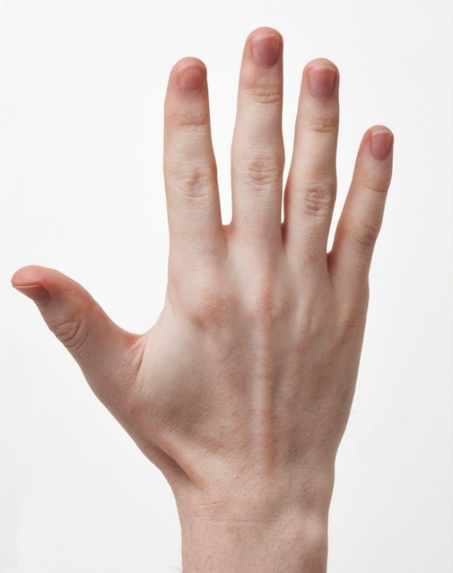
PHYSICAL EDUCATION
Throwing & Catching…. 1st grade
Which hand is your dominant hand?
Class Discussion- Warm Up….
Left
Right
Both
Module 01: Lesson 04
Notes:
Students will: Stamp their dominant hand, or identify that they like to use both hands for various tasks.
PE.1.C.2.7 - Identify dominant hand/foot for use with throwing/dribbling/striking/kicking skills.

Slide 10
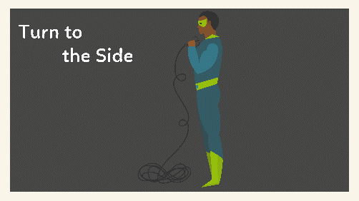
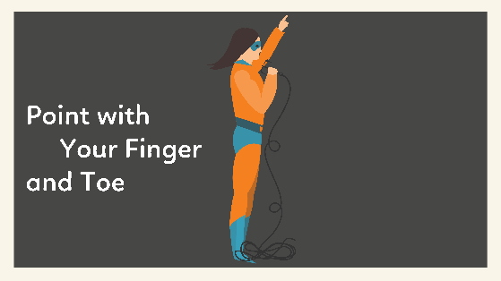
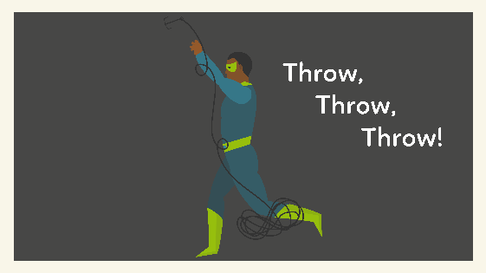
PHYSICAL EDUCATION
Throwing & Catching…. 1st grade
Can you put the superhero overhand throw rhyme in the correct order?
1
2
3
4
Module 01: Lesson 04
Notes:
Students will: Place the overhand throw pattern and rhyme into the correct order.
PE.1.M.1.9 - Demonstrate an overhand-throwing motion for distance using correct technique.

Slide 11
PHYSICAL EDUCATION
Throwing & Catching Fun…. 3rd grade
Which ball requires a two-handed throw?
Class Discussion- Warm Up….
Baseball
Football
Soccer ball
Beach ball
Basketball
Tennis ball
Dodge ball
Module 01: Lesson 04
Notes:
Students will stamp the balls that you would throw with two hands.
The teacher will remind students to think about all aspects of the game in which each type of ball is used (i.e., you dribble the basketball, but also throw the ball with two hands to a teammate).
PE.3.M.1.8 Throw balls of various sizes and weights to a stationary partner using a correct overhand motion.

Slide 12
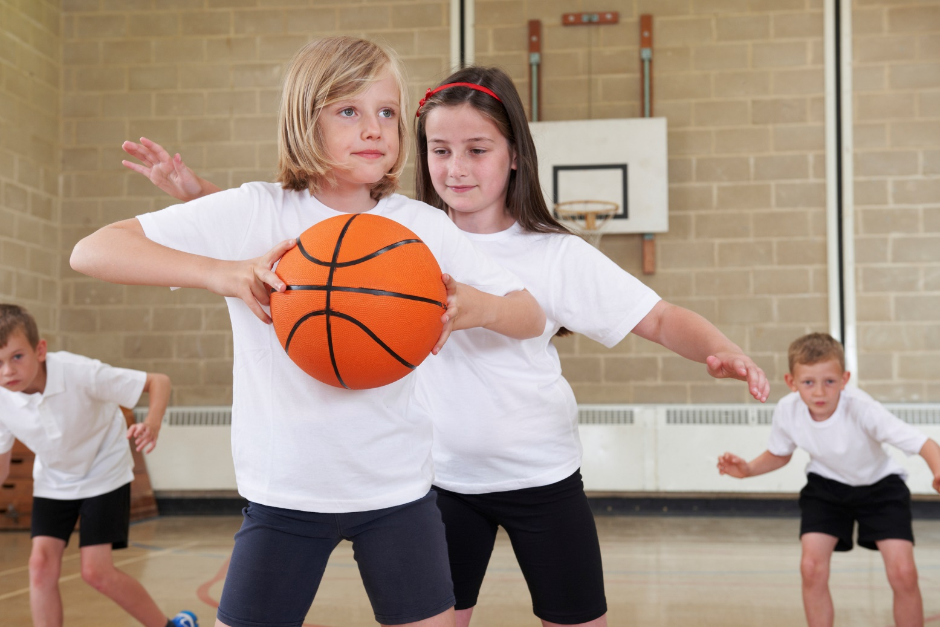
PHYSICAL EDUCATION
Throwing & Catching Fun…. 3rd grade
Offense and Defense
Module 01: Lesson 04
Notes:
Students will drag the square onto the player who is playing offense and drag the triangle onto the players who are playing defense.
The teacher will remind students of the difference between offense and defense and explain that players may switch quickly between the two throughout a game.
PE.3.C.2.8 Describe basic offensive and defensive tactics.

Slide 13
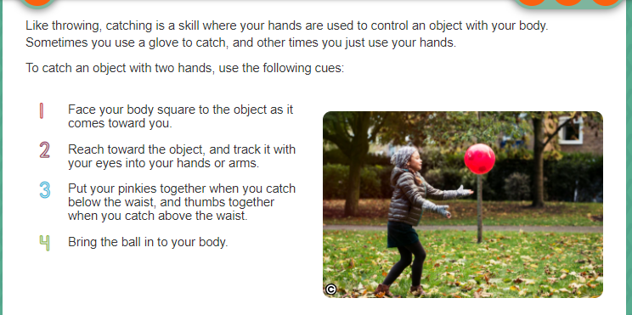
Get a Jump Start…..
PHYSICAL EDUCATION

Slide 14
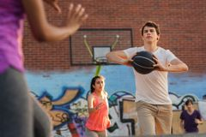
PHYSICAL EDUCATION
Throwing & Catching…. 4th grade
Get the Ball Moving
Bounce Pass
Chest Pass
Why is it good to be able to perform different types of passes? When would you use a bounce pass? When would you use a chest pass?
Module 01: Lesson 04
Notes:
Students will discuss the key cues of performing each type of pass.
Students will think strategically on why it is good to be able to perform different types of passes and when each type of pass may be used.
The teacher will stretch the conversation to reach beyond the sport of basketball (soccer, ice hockey).
PE.4.M.1.5 Dribble and pass to a moving partner.
PE.4.C.2.9 Identify basic offensive and defensive tactics for modified invasion and net activities.

Slide 15
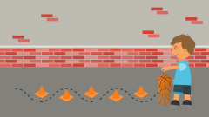
PHYSICAL EDUCATION
Throwing & Catching…. 4th grade
Get active!
Overhand Throwing
Catching and Throwing
Catching
Dribbling and Throwing
Catching, Dribbling, and Throwing
Catching and Dribbling
Dribbling
Module 01: Lesson 04
Notes:
Students will sort the games into the categories: overhand throwing, catching, and dribbling.
The teacher will discuss how these skills are commonly used together and can take place in many different settings.
The teacher will highlight the importance of getting 60 minutes of activity each day.
PE.4.L.3.3 Identify opportunities for involvement in physical activities during the school day.
PE.4.L.3.4 Identify opportunities for involvement in physical activities after the school day.

Slide 16
Your Turn!! The next few slides will cover your 1.04 throwing and catching assignment. You will NEED TI turn them YOUR ASSIGNMENT IN TODAY for a GRADE!!! YAY…. But first…. Let’s stretch!!
PHYSICAL EDUCATION
Throwing & Catching…. 1st grade
While we are stretching….
Mom/Dad clear the area for some fun and go grab:
TURN ON YOUR CAMERA/ PHONE TO RECORD IF YOU DO NOT TURN ON YOUR CAMERA
BALL
PARTNER

Slide 17
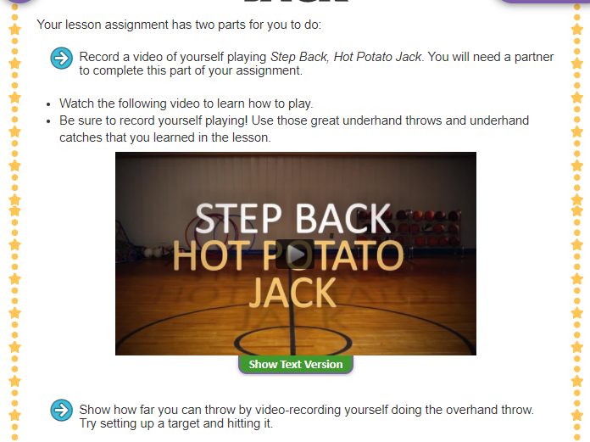
Throwing & Catching…. 1st grade...
PHYSICAL EDUCATION
Ready…Set GO..CAMERA ON…. Get your partner..
We will do hot potato jack AND THROW BALL AS FAR AS WE CAN

Slide 18
Your Turn!! The next few slides will cover your 1.04 throwing and catching assignment. You will NEED TI turn them YOUR ASSIGNMENT IN TODAY for a GRADE!!! YAY…. But first…. Let’s stretch!!
PHYSICAL EDUCATION
Throwing & Catching…. 3rd grade
While we are stretching….
Mom/Dad clear the area for some fun and go grab:
TURN ON YOUR CAMERA/ PHONE TO RECORD IF YOU DO NOT TURN ON YOUR CAMERA
Basketball BALL
PARTNER

Slide 19
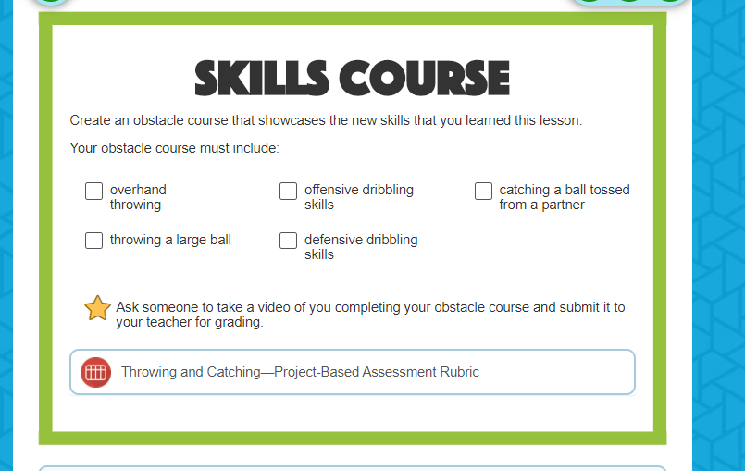
Throwing & Catching…. 3rd grade...
PHYSICAL EDUCATION
Ready…Set GO..CAMERA ON…. Get your partner..
Only one ball is needed.

Slide 20
Your Turn!! The next few slides will cover your 1.04 throwing and catching assignment. You will NEED TI turn them YOUR ASSIGNMENT IN TODAY for a GRADE!!! YAY…. But first…. Let’s stretch!!
PHYSICAL EDUCATION
Throwing & Catching…. 4th grade
While we are stretching….
Mom/Dad clear the area for some fun and go grab:
TURN ON YOUR CAMERA/ PHONE TO RECORD IF YOU DO NOT TURN ON YOUR CAMERA
Basketball BALL
PARTNER

Slide 21
Reminder…..
PHYSICAL EDUCATION

Slide 22
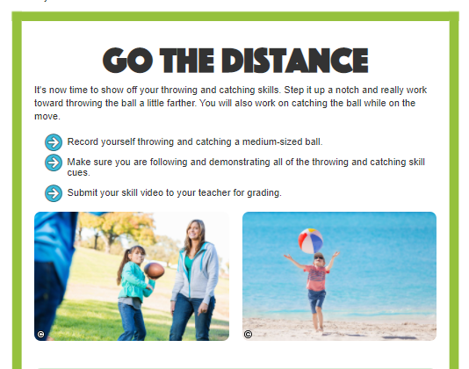
Throwing & Catching…. 4th grade...
PHYSICAL EDUCATION
Ready…Set GO..CAMERA ON…. Get your partner..
Only one ball is needed.

Slide 23
Assignment…..
PHYSICAL EDUCATION
Let’s turn in our assignment together!
If you recorded: video should be 30 seconds, no longer than 1 minute. File mp4 or mov
Go to www.flvs.net and log in (use student credentials to log in) on the device you recorded the video on (phone or computer)
Go to gradebook
Click 1.04 throwing and catching and click add files OR IF YOU TURNED ON YOUR CAMERA…IN STUDENT COMMENTS TYPE: DID IN LIVE WITH COACH JONE AND PARTNER!
When the dialog box opens go to your photo library if on your phone, or video on computer and, click on the file/video, click open, 1 video should be qued
Put the checkmark in the box above the “Save for Later” blue button
Click the blue “Submit for Grading” Button
You should get a thank you for submitting message and the assignment should show blue in the gradebook

Slide 24
All Done!!! Together We Can!
PHYSICAL EDUCATION

Slide 25
Today we will learn/review: 1st, 3rd, and 4th
PHYSICAL EDUCATION
I can 1st grade:
remember the critical elements of different locomotor skills
name and use different moving concepts to jump, hop, and leap as a takeoff
use different techniques to dodge or catch others
show how using my hands can change the motion of an object
I can 3rd grade:
use locomotor skills in a variety of different movement settings
jump a rope that I am turning by myself
recognize opportunities that happen around me each day to become active
use feedback to help improve performance

Slide 26
Today we will learn/review: 1st, 3rd, and 4th
PHYSICAL EDUCATION
I can 4th grade:
use locomotor skills in a variety of activities
run and hurdle a succession of obstacles
recognize similar movement patterns in various sports

Slide 27
Rate My Self Lesson Check In
PHYSICAL EDUCATION
What Do You Know About Throwing & Catching?
I AM A 1 | I AM A 2 | I AM A 3 | I AM A 4
I don’t understand much about throwing and catching! | I understand the concept of throwing and catching a little bit, but I need more help! | I understand how to practice throwing and catching and understand how to do it right! | I understand how to practice throwing and catching and can also teach a friend/partner!

Slide 28
Bye See You Next Week Tuesday! Same Time, Same Place Time!
PHYSICAL EDUCATION
Next week we will be doing the 1.05 DBA During Class Time!!
Be Prepared To Get Ready To Let Me See What you have learned!!!
K- 9:30-10:00 PE
1st- 11:15-11:45 PE
2nd- 10:15-10:45 PE
3rd- 1:00-1:30 PE
4th- 1:45-2:15 PE
5th- 2:30-3:00 PE
Don’t Forget To Join….. By clicking on the remind link for your class on the class announcement page!

