Slide 1
PHYSICAL EDUCATION
01
02
Fitness Assessment
Click On ME to download the presentation….
Notes:
PE.5.L.4.4 Analyze one's own physical fitness assessment results and develop strategies to enhance performance.
PE.5.L.3.5 Formulate a plan to increase the amount of time spent in physical activity.
PE.5.C.2.7 Identify basic practice and conditioning principles that enhance performance.
PE.5.L.3.1 Identify a moderate physical activity. PE.5.L.3.2 Identify a vigorous physical activity.

Slide 2
Be Fit, Have Fun
PHYSICAL EDUCATION
Fitness Assessment….
“Warm it up and work it out. Test your flexibility and show your strength. Try exercises from each fitness component and see which you like best. Engage your arms, core, and legs, and your whole body will feel great.”

Slide 3
Today we will learn/review:
PHYSICAL EDUCATION
I can
analyze my current physical fitness level and develop strategies to make improvements
develop a plan to ensure I get a minimum of 60 minutes a day of physical activity
identify ways to enhance physical fitness performance
identify the health-related fitness components, and identify an appropriate exercise for each component

Slide 4
Rate My Self Lesson Check In
PHYSICAL EDUCATION
What Do You Know About Being Fit?
I AM A 1 | I AM A 2 | I AM A 3 | I AM A 4
I don’t understand much about being fit! | I understand the concept of being fit a little bit, but I need more help! | I understand how to practice being fit and understand why being fit is important! | I understand how to practice safety and being fit all while having fun!

Slide 5
5th Grade Grade Standards
PHYSICAL EDUCATION
PE.4.C.2.7 Identify proper warm-up and cool-down techniques and reasons for using them.
PE.4.L.4.4 Identify ways to participate in selected physical activities for the purpose of improving physical fitness.
PE.4.L.4.5 Identify ways to participate in formal and informal fitness assessments.

Slide 6
Be Fit, Have Fun
PHYSICAL EDUCATION
Our lesson covered a lot this week:
We learned that fitness tests help you understand where to start out and where you are heading when exercising.
We learned about different components of fitness such as muscular strength, muscular endurance, cardiovascular endurance, and flexibility.
We learned about warm up activities.
We learned that measuring your fitness helps you make decision about what you need to do in order to become more fit.
We learned we must start with a plan; make it a individual fitness plan. Know each level-flexibility, muscular strength. Then make a plan.
We learned the exercises we do depends on what you want to achieve. Exercise helps condition your body to be healthy and strong.
Warming up your body is important but also warming up your mind is important to with brain teasers, puzzles or riddles.
Continue…

Slide 7
Be Fit, Have Fun
PHYSICAL EDUCATION
Our lesson covered a lot this week:
We learned about the FITT formula-Frequency, Intensity, Time, and Type
We learned about your maximum heart rate (subtract your age from 220 ie. 220-10=210 beats per min)
We learned regular stretching helps improve flexibility. Flexibility shows your range of motion in muscle and joints
We learned about dynamic stretches (stretch muscles without holding a stretch) and static stretches (held for a period of time)
We learned about muscular strength-how much force you can apply against something. Athletes use muscular strength when they jump over or lift something. You can use heavy weight with a low number or reps
We learned about muscular endurance- when your muscles exert a force over a period of time, you can lift a lighter weight for many reps.
We learned cardiovascular endurance conditions our heart, lungs, and circulatory system (running fast, treading water),
Let’s Practice And Have Some Fun!

Slide 8
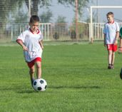
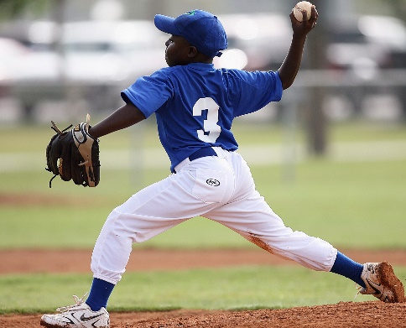
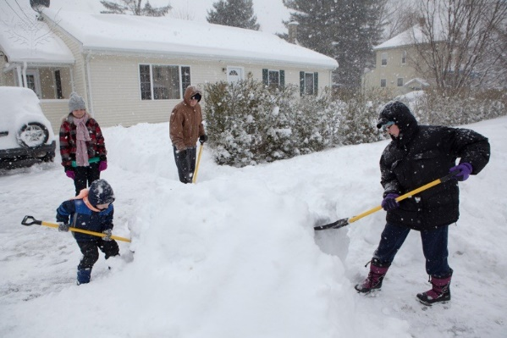
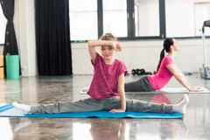
PHYSICAL EDUCATION
The Components of Fitness
Place each picture into the proper fitness component.
Muscular Endurance | Muscular Strength | Flexibility | Cardiovascular Endurance
Module 01: Lesson 02
Notes:
Teacher will review the four components of fitness--cardiovascular endurance, muscular strength, muscular endurance, and flexibility--by looking at definitions.
Teacher will encourage students to list other examples of the four components of fitness.
Teacher will provide examples in both sport and non-sport environments. For example, carrying laundry up the stairs is an example of muscular strength.
Teacher will discuss how components of fitness work together and how students will often use combinations of fitness components as they work through activities.
Teacher will provide an example of a sport and have students break down each fitness component. For example, figure skating combines all four fitness components; muscular strength (jumps), flexibility (leaps), muscular endurance and cardiovascular endurance are shown throughout the routine.
Students will sort and organize the given activities into the correct component categories.
Students will identify what fitness component is used by each of the fitness-assessment activities.
PE.5.L.4.4 Analyze one's own physical fitness assessment results and develop strategies to enhance performance.

Slide 9
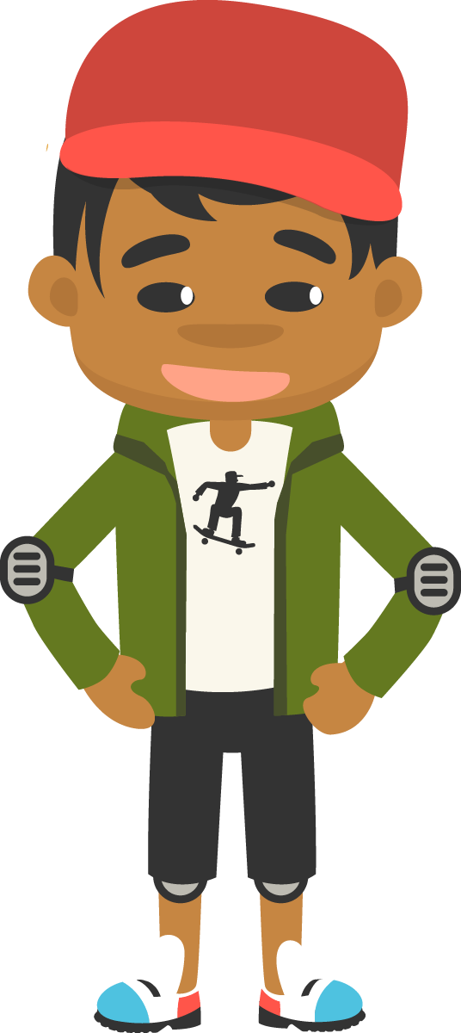
PHYSICAL EDUCATION
Plan Of Action
cool-down
Henry wants to be a champion skateboarder. Before he makes a ______________, he gets a ______________ of his current fitness level. Henry knows that skateboarding tricks require a lot of powerful jumps, so he wants to develop _____________________ in his legs. He decides to include ___________________ as part of his fitness plan. Henry knows to include a ____________ and _____________ as part of his fitness plan.
baseline
leg squat jumps
warm-up
fitness plan
muscular strength
Module 01: Lesson 02
Notes:
Teacher will start with a warm-up activity away from the desk (short jog on the spot and three stretches: arm stretch, shoulder stretch, leg stretch). Encourage students to think about the stretches they could do while sitting at their desk or at home.
Teacher will compare the concept of a fitness plan as a road map. There is a starting point (baseline) and an end point (goal). The road between those points is directed by students’ exercise plans.
Teacher will use students’ fitness assessments to determine their baseline and then encourage students to consider what their fitness goal is.
Teacher will emphasize the need to include a warm-up and cool-down as part of their daily fitness plan.
Students will fill in the blanks.
PE.5.L.3.5 Formulate a plan to increase the amount of time spent in physical activity.

Slide 10
PHYSICAL EDUCATION
FITT-ness…put the correct word with the meaning
I plan my workouts to last 45 minutes.
In order to make powerful skateboard jumps, I am going to add leg squats to my fitness plan.
Frequency
Intensity
I will vary my speed as I run so that I alternate running hard and running easily.
Time
I plan on running three days a week.
Type
Module 01: Lesson 02
Notes:
Teacher will review each of the FITT components (Frequency, Intensity, Time, Type) and determine how they can be used when developing a fitness plan.
Students will match the character clues with the correct part of the FITT formula.
Teacher will discuss how the FITT formula can be implemented into a personal fitness plans. What are the advantages of following a FITT formula? (Keeps the plan focused, provides direction and a starting place.)
Students will consider using the FITT formula as they develop their own personal fitness plan.
PE.5.L.3.5 Formulate a plan to increase the amount of time spent in physical activity.

Slide 11
Your Turn!! The next few slides will cover 1.02 fitness assessment. You will turn them IN TODAY for a GRADE!!! YAY…. But first…. Be ready to take a picture with your phone or the snipping tool. Or grab mom/dad to help you out!!
PHYSICAL EDUCATION

Slide 12
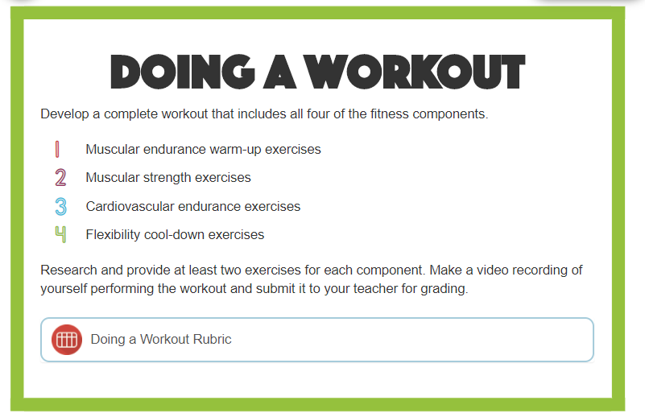
Be Fit, Have Fun!
PHYSICAL EDUCATION

Slide 13
Be Fit, Have Fun!
PHYSICAL EDUCATION
Parent can record you and you can upload your video….
Lets get some mood music
Muscular Endurance
5 Jumping Jacks
5 Arm Circles
Muscular Strength
5 Leg Squats
5 Sit Ups
3. Cardiovascular Endurance
5 Jump Ropes in place
5 Run In Place Movements
4. Flexibility Cool-Down
5 Torso Twist
5 Knee To Chest
Now, if you have a gmail account, log in to Youtube with your gmail account. Upload this video as UNLISTED. Once uploaded copy the link.
aaaa

Slide 14
Assignment…..
PHYSICAL EDUCATION
Let’s turn in our assignment together!
Copy the youtube link
Go to www.flvs.net and log in (use student credentials to log in)
Go to gradebook
Click 1.02 fitness assessment
In the student comments paste (Ctrl +V) the link
Put the checkmark in the box above the “Save for Later” blue button
Click the blue “Submit for Grading” Button
You should get a thank you for submitting message and the assignment should show blue in the gradebook

Slide 15
All Done!!! Together We Can!
PHYSICAL EDUCATION

Slide 16
Today we will learn/review:
PHYSICAL EDUCATION
I can
analyze my current physical fitness level and develop strategies to make improvements
develop a plan to ensure I get a minimum of 60 minutes a day of physical activity
identify ways to enhance physical fitness performance
identify the health-related fitness components, and identify an appropriate exercise for each component

Slide 17
Rate My Self Lesson Check In
PHYSICAL EDUCATION
What Do You Know About Being Fit?
I AM A 1 | I AM A 2 | I AM A 3 | I AM A 4
I don’t understand much about being fit! | I understand the concept of being fit a little bit, but I need more help! | I understand how to practice being fit and understand why being fit is important! | I understand how to practice safety and being fit all while having fun!

Slide 18
Bye See You Next Week At Our Regularly Scheduled Time!
PHYSICAL EDUCATION
Next week we will be discussing Locomotor Movement!!
Be Prepared To Get Fit With Us!!!
K- 9:30-10:00 PE
1st- 11:15-11:45 PE
2nd- 10:15-10:45 PE
3rd- 1:00-1:30 PE
4th- 1:45-2:15 PE
5th- 2:30-3:00 PE
Don’t Forget To Join….. By clicking on the remind link for your class on the class announcement page!

