Slide 1
PHYSICAL EDUCATION
01
02
Fitness Assessment
Click On ME to download the presentation….
Notes:
PE.4.C.2.7 Identify proper warm-up and cool-down techniques and reasons for using them.
PE.4.L.4.4 Identify ways to participate in selected physical activities for the purpose of improving physical fitness.
PE.4.L.4.5 Identify ways to participate in formal and informal fitness assessments.

Slide 2
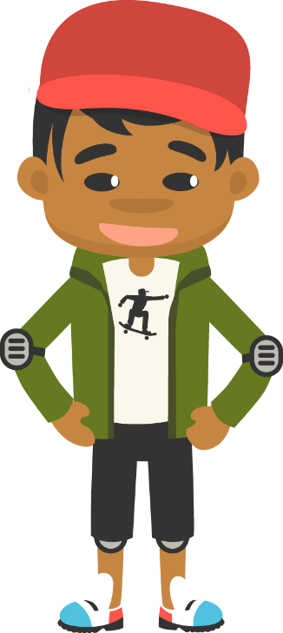
Be Fit, Have Fun
PHYSICAL EDUCATION
Fitness Assessment….
“Being active in different ways and challenging yourself to try something new can be difficult. Creating routines to better help you do these things can help. Remember that it can take time to learn new skills or sports, so do not get discouraged if you are not good at something right away. That is what practice is for!.”

Slide 3
Today we will learn/review:
PHYSICAL EDUCATION
I can
identify the importance of warm-up and cool-down activities and how they help me perform
improve my physical fitness by helping others improve their fitness
discover ways to improve my physical fitness by measuring my fitness levels
relate formal and informal assessments to how they help my body

Slide 4
Rate My Self Lesson Check In
PHYSICAL EDUCATION
What Do You Know About Being Fit?
I AM A 1 | I AM A 2 | I AM A 3 | I AM A 4
I don’t understand much about being fit! | I understand the concept of being fit a little bit, but I need more help! | I understand how to practice being fit and understand why being fit is important! | I understand how to practice safety and being fit all while having fun!

Slide 5
4th Grade Grade Standards
PHYSICAL EDUCATION
PE.4.C.2.7 Identify proper warm-up and cool-down techniques and reasons for using them.
PE.4.L.4.4 Identify ways to participate in selected physical activities for the purpose of improving physical fitness.
PE.4.L.4.5 Identify ways to participate in formal and informal fitness assessments.

Slide 6
Be Fit, Have Fun
PHYSICAL EDUCATION
Our lesson covered a lot this week:
We learned different warm up exercises like planks, crunches, step ups, mountain climbers helps reduce injuries.
We learned that we need to loosen up. When we measure our fitness levels, you can determine how fit you are, and then set goals to improve your personal fitness. predictions about their performance.
We learned about dynamic stretches (stretch muscles without holding a stretch) and static stretches (held for a period of time)
We learned to make sure to exercise with enough space to avoid injury.
We learned about muscular strength-how much force you can apply against something. Athletes use muscular strength when they jump over or lift something.
We learned about muscular endurance- when your muscles exert a force over a period of time, like a wall sit.
We learned we can also exercise our brains with puzzles or riddles and this is important for brain health
We learned about controlled breathing to get oxygen into the lungs (inhale and exhale).
We learned about the importance of cool down stretches which cools down the major muscles used during exercise.
Let’s Practice And Have Some Fun!

Slide 7
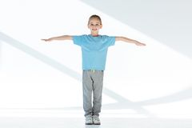
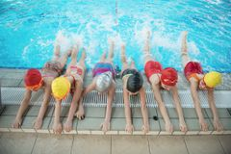
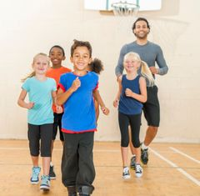
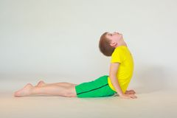
PHYSICAL EDUCATION
Which way to warm up?
Flutter kick—Activity
Specific Warm-Up
Arm Circles—Dynamic Stretching
Core Stretch—Static Stretching
Jog on the Spot—Whole-
body movement
Module 01: Lesson 02
Notes:
Students will identify different ways to warm up their muscles to be safe before being active.
The teacher will discuss various warm-up activities and the concept of warming up the muscles you are using.
PE.4.C.2.7 Identify proper warm-up and cool-down techniques and reasons for using them.

Slide 8
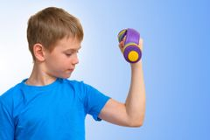
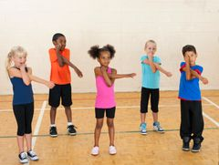
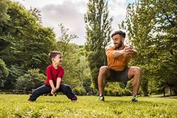
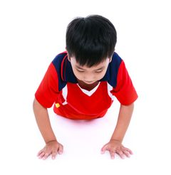
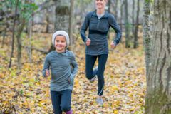
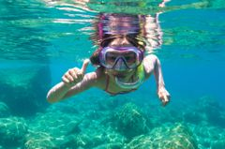
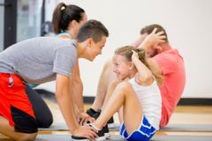
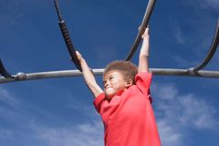
PHYSICAL EDUCATION
Building Strength-Muscular Strength Power
Helps to Build Strength
Helps to Build a Different Fitness Component
Module 01: Lesson 02
Notes:
Students will organize the given activities into strengthening or non-strengthening activities.
The teacher will review what strengthening activities are, or generally will look like, and discuss why some of the other activities were not strengthening activities.
The teacher will ask, “What is the role of strength in your muscles? What does it allow you to do when you are strong?”
PE.4.L.4.4 Identify ways to participate in selected physical activities for the purpose of improving physical fitness.

Slide 9
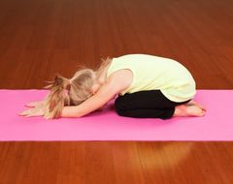
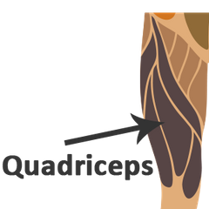
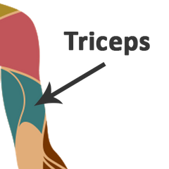
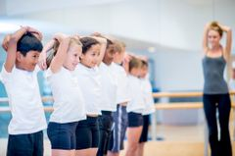
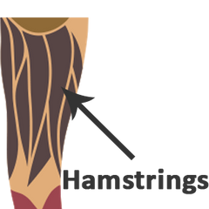
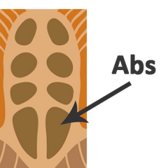
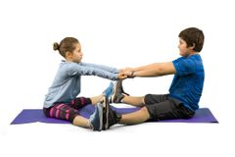
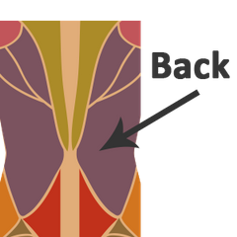
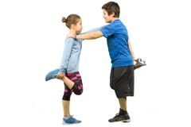
PHYSICAL EDUCATION
Match the correct exercise: Long Lean Machine
Module 01: Lesson 02
Notes:
Students will match the stretches with the body part they focus on.
Teacher will ask, “What is the role of flexibility in your muscles? What does it allow you to do when you are flexible?”
PE.4.L.4.4 Identify ways to participate in selected physical activities for the purpose of improving physical fitness.

Slide 10
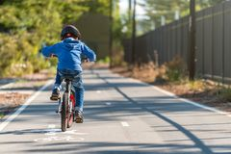
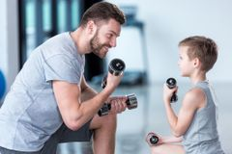
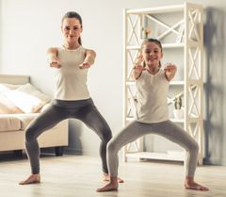
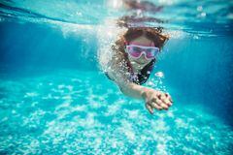
PHYSICAL EDUCATION
Cardio Connoisseur –Muscular Endurance
Improves Cardio- Time
Helps to Build a Different Fitness Component
Module 01: Lesson 02
Notes:
Students will sort the activity images into the two given categories.
The teacher will ask, “What body parts, muscles, or systems do cardio activities impact mostly?”
PE.4.L.4.4 Identify ways to participate in selected physical activities for the purpose of improving physical fitness.

Slide 11
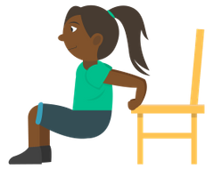
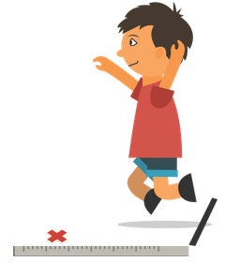
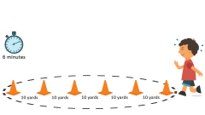
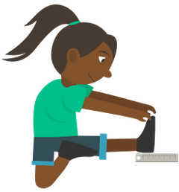
PHYSICAL EDUCATION
This Test, That Test
Muscular Endurance
Muscular Strength
Cardiovascular Endurance
Flexibility
Module 01: Lesson 02
Notes:
Students will match each test with the fitness component it tests.
The teacher will discuss each test, explain how to complete it, and give hints to students trying to understand each graphic.
PE.4.L.4.5 Identify ways to participate in formal and informal fitness assessments.

Slide 12
Your Turn!! The next few slides will cover 1.02 fitness assessment. You will turn them IN TODAY for a GRADE!!! YAY…. But first…. Be ready to take a picture with your phone or the snipping tool. Or grab mom/dad to help you out!!
PHYSICAL EDUCATION

Slide 13
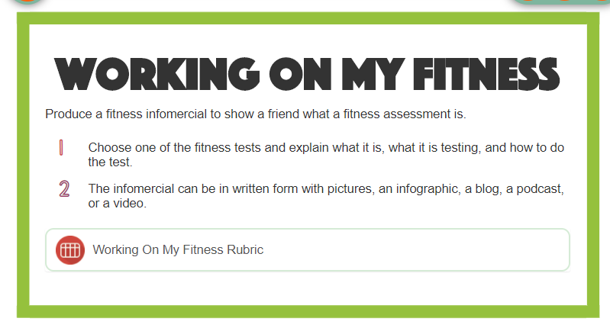
Be Fit, Have Fun!
PHYSICAL EDUCATION

Slide 14
PHYSICAL EDUCATION
Take a picture!! To Turn In…
This Test, That Test… The Test For Muscular ……..
Chair Dips
Muscular Strength
Six Minute Run
Cardiovascular Endurance
Which Directions is correct?
Using a sturdy chair, grip the edge of the seat with your legs bent at a 90-degree angle.
Lower your body down toward the ground, keeping your back close to the chair edge. Bend your elbows until they are at a 90-degree angle.
Straighten your elbows as you bring your body back up to the starting position.
Count how many you can do in one minute and record that number
Place six cones 10 yards apart from each other in your yard.
Track how many times you can run around the cones in six minutes.
At the six-minute mark, stop where you are and determine the total distance covered and record it.
Let’s Do It……..
Module 01: Lesson 02
Notes:
Students will match each test with the fitness component it tests.
The teacher will discuss each test, explain how to complete it, and give hints to students trying to understand each graphic.
PE.4.L.4.5 Identify ways to participate in formal and informal fitness assessments.

Slide 15
Assignment…..
PHYSICAL EDUCATION
Let’s turn in our assignment together!
Take a picture of your assignment or download slide 14 to turn in by clicking file, download, pdf
Go to www.flvs.net and log in (use student credentials to log in)
Go to gradebook
Click 1.02 fitness assessment
Click add file
When the dialog box opens go to your download folder, click on the file, click open
Put the checkmark in the box above the “Save for Later” blue button
Click the blue “Submit for Grading” Button
You should get a thank you for submitting message and the assignment should show blue in the gradebook

Slide 16
All Done!!! Together We Can!
PHYSICAL EDUCATION

Slide 17
Today we will learned/review:
PHYSICAL EDUCATION
I can
identify the importance of warm-up and cool-down activities and how they help me perform
improve my physical fitness by helping others improve their fitness
discover ways to improve my physical fitness by measuring my fitness levels
relate formal and informal assessments to how they help my body

Slide 18
Rate My Self Lesson Check In
PHYSICAL EDUCATION
What Do You Know About Being Fit?
I AM A 1 | I AM A 2 | I AM A 3 | I AM A 4
I don’t understand much about being fit! | I understand the concept of being fit a little bit, but I need more help! | I understand how to practice being fit and understand why being fit is important! | I understand how to practice safety and being fit all while having fun!

Slide 19
Bye See You Next Week At Our Regularly Scheduled Time!
PHYSICAL EDUCATION
Next week we will be discussing Locomotor Movement!!
Be Prepared To Get Fit With Us!!!
K- 9:30-10:00 PE
1st- 11:15-11:45 PE
2nd- 10:15-10:45 PE
3rd- 1:00-1:30 PE
4th- 1:45-2:15 PE
5th- 2:30-3:00 PE
Don’t Forget To Join….. By clicking on the remind link for your class on the class announcement page!

