Slide 1
PHYSICAL EDUCATION
01
02
Fitness Assessment
Click ON ME to download the presentation…
Notes:
PE.2.C.2.8 Explain the importance of warm-up and cool-down activities.
PE.2.L.4.6 Identify benefits of participation in informal physical fitness assessment.
PE.2.L.3.7 Identify healthful benefits that result from regular participation in physical activity.
PE.2.L.3.5 Set and meet physical activity goals.

Slide 2
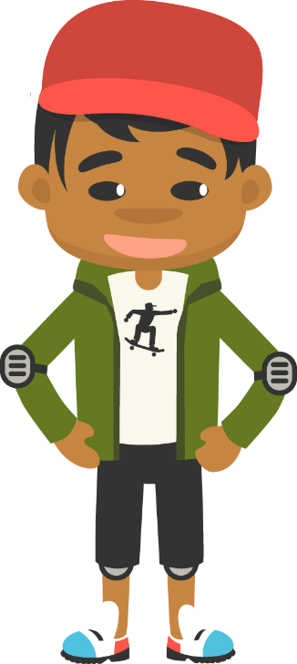
Be Fit, Have Fun
PHYSICAL EDUCATION
Fitness Assessment….
“You do not have to be on the field or the court to be a good sport. Grab your bike, go for a hike, whatever you like. There are a million ways to be active, so choose something that makes you happy and stick to it!”

Slide 3
Today we will Learn:
PHYSICAL EDUCATION
I can
Discover how to use my dominant hand and foot
Tell when my body is participating in physical activity by how my body looks and feels
Tell when my body is at rest because my heart is not beating as fast
State the physical signs my body gives when I am participating in physical activity
List my physical activity goals

Slide 4
Rate My Self Lesson Check In
PHYSICAL EDUCATION
What Do You Know About Being Fit?
I AM A 1 | I AM A 2 | I AM A 3 | I AM A 4
I don’t understand much about being fit! | I understand the concept of being fit a little bit, but I need more help! | I understand how to practice being fit and understand why being fit is important! | I understand how to practice safety and being fit all while having fun!

Slide 5
2nd Grade Standards
PHYSICAL EDUCATION
PE.2.C.2.8 Explain the importance of warm-up and cool-down activities.
PE.2.L.4.6 Identify benefits of participation in informal physical fitness assessment.
PE.2.L.3.7 Identify healthful benefits that result from regular participation in physical activity.
PE.2.L.3.5 Set and meet physical activity goals.

Slide 6
PHYSICAL EDUCATION
Stretch It Out
What’s your favorite stretch? Put these stretches in order of your most to least favorite.
Arm circles
Side bends
2.
3.
1.
Toe touches
Module 01 : Lesson 2
Notes:
Students put their favorite stretches in order from most (1) to least (3) favorite.
Teacher can ask if there are any other stretches that the students would include as their favorite or least favorite.
Teacher can ask if the students use these stretches as part of their warm-ups and cool-downs, and if they can give examples of the stretches they do use.
PE.2.C.2.8 Explain the importance of warm-up and cool-down activities.

Slide 7
PHYSICAL EDUCATION
Warm Up, Cool Down
Which activities are a warm up and which are a cool down?
Jogging
Jumping jacks
Stretching
Walking
March on the spot
Deep breathing
Warm Up
Cool Down
A good warm should take about 8-15 minutes and it gets the blood flowing into the muscles in the body.
Module 01 : Lesson 2
Notes:
Students drag each activity a warm up or cool down section.
Students give an example of their own warm-up and cool-down activities that are not listed
Teacher reviews the difference between warming up and cooling down, and how they can be very similar. Teacher script: When would you do a warm up and when would you do a cool down?
Teacher uncovers that many cool-down movements are warm-up movements, and vice versa.
PE.2.C.2.8 Explain the importance of warm-up and cool-down activities.

Slide 8
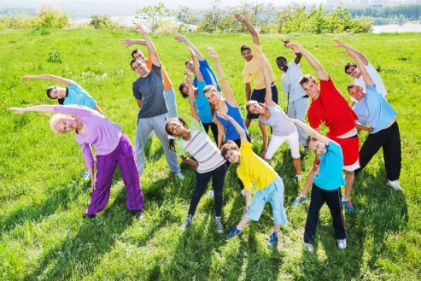
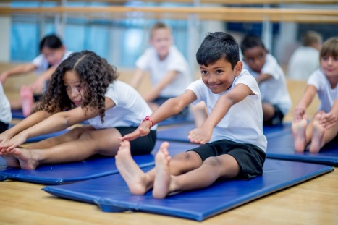
PHYSICAL EDUCATION
Being Flexible Is Important! Stretching has a lot of benefits like: relaxing your body and mind, preventing injuries, and makes your muscles less sore after you exercise.
Match the picture to the stretch.
Side stretch
Toe touch
Body twist
Try out each stretch on your own.
Module 01 : Lesson 2
Notes:
Students match each picture to the stretch. They can try each stretch out themselves.
Teacher reminds students that when we stretch we are getting our muscles ready for the activity we are about to do.
PE.2.C.2.8 Explain the importance of warm-up and cool-down activities.

Slide 9
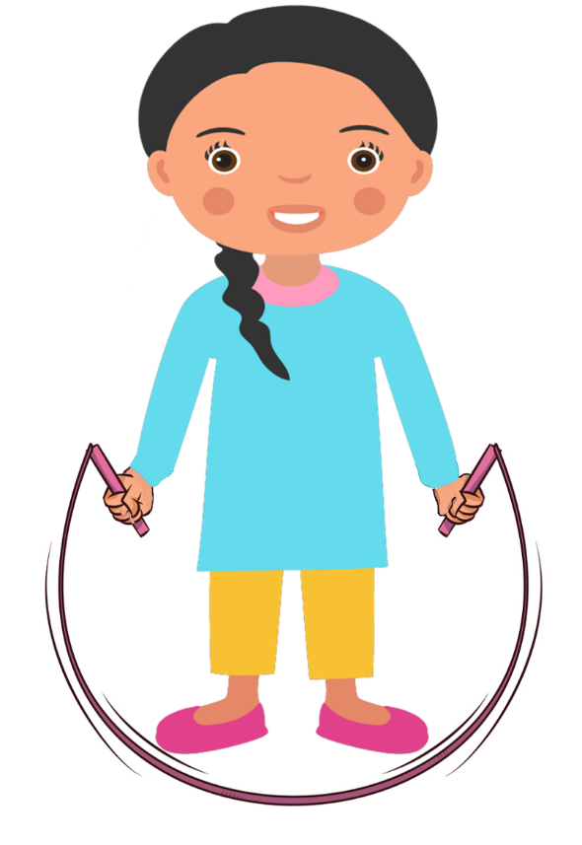
PHYSICAL EDUCATION
We can get physically active using formal or informal rules. Formal rules are done in a proper way for everyone to follow. Informal rules has less instructions. Which of these activities is a great way to get physically active?
Tag
Watching TV
Soccer
Hockey
Playing computer games
Which is an example of informal game?
Module 01 : Lesson 2
Notes:
Students circle the correct answers (soccer, tag, hockey).
Teacher expands on why watching TV and playing computer games is a fun activity sometimes, but not great for getting active.
Teacher engages the students in discussion about how the two activity types (physical and non-physical) feel different. Teacher script: Think about how you feel after physical activity.
PE.2.L.4.6 Identify benefits of participation in informal physical fitness assessment.

Slide 10
PHYSICAL EDUCATION
Which informal activity would you like to play?
Hopscotch | Biking
Module 01 : Lesson 2
Notes:
Students vote on which activity they would prefer to do.
Teacher reviews what an informal activity is (an activity that does not have many rules) and why they are beneficial.
Teacher allows time for students to offer suggestions of other informal activities they like to do.
PE.2.L.4.6 Identify benefits of participation in informal physical fitness assessment.

Slide 11
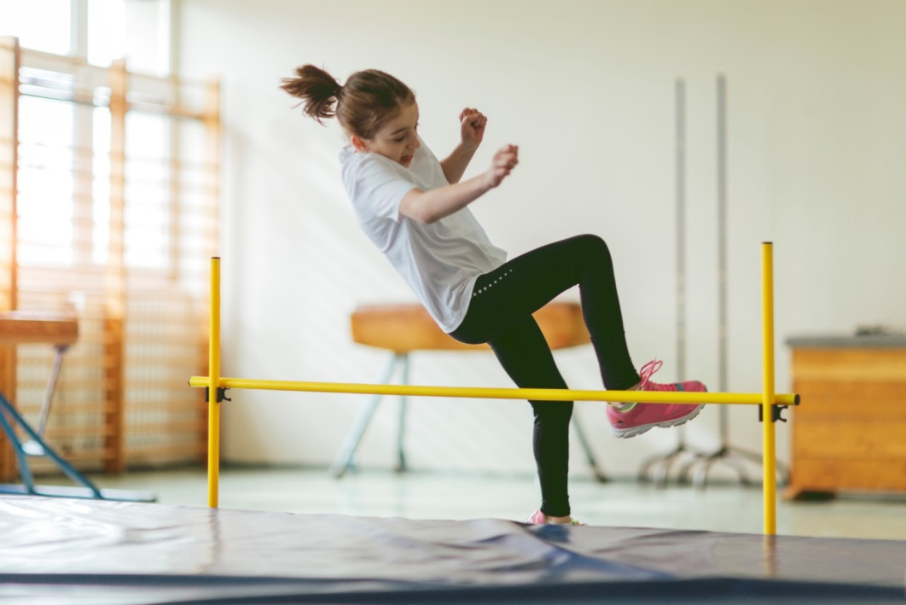
PHYSICAL EDUCATION
Class Discussion
When setting goals we must remember to make all goals in ARMS reach (Achievable, Rewarding, Meaningful, and Safe)
Why is setting goals important?
What kind of goals can you set for yourself?
1.
2.
3.
Module 01 : Lesson 2
Notes:
Teacher facilitates discussion around goal making and how that can mean different things for different people.
PE.2.L.3.5 Set and meet physical activity goals.

Slide 12
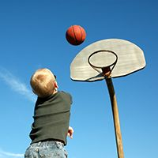
PHYSICAL EDUCATION
Setting Good Goals
Keeping your goals in ARMS reach will help you be successful.
Achievable
Meaningful
Rewarding
Safe
Keep ARMS in mind. Joel wants to improve his jumping, this is his ARMS goal.
A – I want to jump 1 inch higher.
R – It will help me be a better basketball player.
M – Basketball is my favorite sport, and I want to improve.
S – I will practice with squats at home and jumps on the court.
What does ARMS stand for?
A -
R -
M -
S -
Module 01 : Lesson 2
Notes:
Students drag in the ARMS words.
Teacher reads through the ARMS goal for Joel. Explains how each step is used.
Teacher may ask students for goals they have made and help them make them ARMS goals.
PE.2.L.3.5 Set and meet physical activity goals.

Slide 13
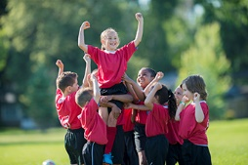
PHYSICAL EDUCATION
Activity Ready
To get ready for a soccer game I should do some stretching and a ______________ to quicken my heart rate.
After my soccer game I should do a _______________
to slow my heart rate.
warm up
cool down
Module 01 : Lesson 2
Notes:
Students drag the correct words to fill in the blanks. (To get ready for a soccer game I should do some stretching and a warm up to quicken my heart rate.) (After my soccer game I should do a cool down to slow my heart rate.)
Teacher either has students drag words in, or challenges students to write words in themselves. There could be many different correct answers, and depending on teacher preference either style could be used.
PE.2.C.2.8 Explain the importance of warm-up and cool-down activities.

Slide 14
Your Turn!! The next few slides will cover 1.02 fitness assessment. You will turn them IN TODAY for a GRADE!!! YAY…. But first…. Grab Mom or Dad!!
PHYSICAL EDUCATION

Slide 15
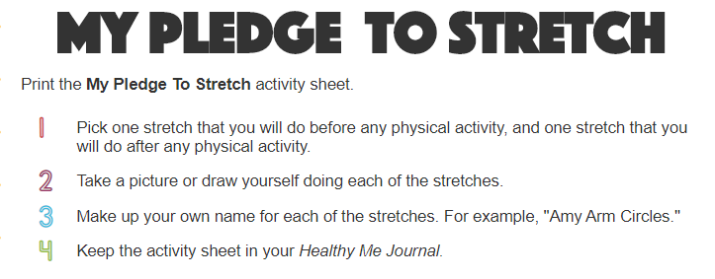
Safe Play, Be Fit, Have Fun
PHYSICAL EDUCATION

Slide 16
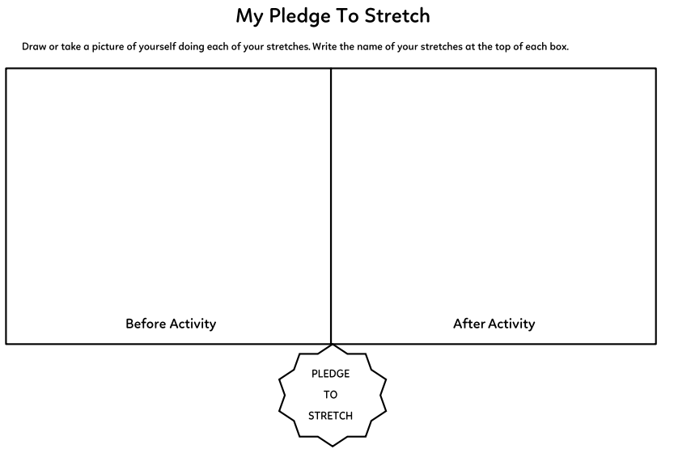
Safe Play, Be Fit, Have Fun
PHYSICAL EDUCATION
Take a picture!! To Turn In…
Have mom or dad take a before & after picture of you….
Let’s stretch!!
Title:
Title:

Slide 17
Assignment…..
PHYSICAL EDUCATION
Let’s turn in our assignment together!
Take a picture of your assignment or download slide 16 to turn in by clicking file, download, pdf
Go to www.flvs.net and log in (use student credentials to log in)
Go to gradebook
Click 1.02 fitness assessment
Click add file
When the dialog box opens go to your download folder, click on the file, click open
Put the checkmark in the box above the “Save for Later” blue button
Click the blue “Submit for Grading” Button
You should get a thank you for submitting message and the assignment should show blue in the gradebook

Slide 18
All Done!!! Together We Can!
PHYSICAL EDUCATION

Slide 19
Today we learned:
PHYSICAL EDUCATION
I can
Discover how to use my dominant hand and foot
Tell when my body is participating in physical activity by how my body looks and feels
Tell when my body is at rest because my heart is not beating as fast
State the physical signs my body gives when I am participating in physical activity
List my physical activity goals

Slide 20
Rate My Self Lesson Check In
PHYSICAL EDUCATION
What Do You Know About Being Fit?
I AM A 1 | I AM A 2 | I AM A 3 | I AM A 4
I don’t understand much about being fit! | I understand the concept of being fit a little bit, but I need more help! | I understand how to practice being fit and understand why being fit is important! | I understand how to practice safety and being fit all while having fun!

Slide 21
Bye See You Next Week At Our Regularly Scheduled Time!
PHYSICAL EDUCATION
Next week we will be discussing Locomotor Movement!!
Be Prepared To Get Fit With Us!!!
K- 9:30-10:00 PE
1st- 11:15-11:45 PE
2nd- 10:15-10:45 PE
3rd- 1:00-1:30 PE
4th- 1:45-2:15 PE
5th- 2:30-3:00 PE
Don’t Forget To Join….. By clicking on the remind link for your class on the class announcement page!

