Slide 1
PHYSICAL EDUCATION
01
02
Fitness Assessment
Click On ME to download the presentation….
Notes:
PE.1.C.2.7 - Identify dominant hand/foot for use with throwing/dribbling/striking/kicking skills.
PE.1.L.4.4 - Identify the difference in the activity of the heart during rest and while physically active.
PE.1.L.4.5 - Discuss the physiological signs of physical activity.
PE.1.L.3.5 - Set physical activity goals.

Slide 2
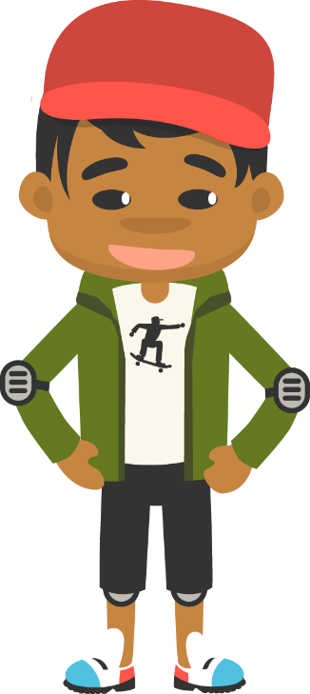
Be Fit, Have Fun
PHYSICAL EDUCATION
Fitness Assessment….
“Do you eat, throw a ball, and color with the same hand? Do you like to kick with one foot verses the other? When we are physically active, you will notice different signs and change in your body.”

Slide 3
Today we will Learn:
PHYSICAL EDUCATION
I can
Discover how to use my dominant hand and foot
Tell when my body is participating in physical activity by how my body looks and feels
Tell when my body is at rest because my heart is not beating as fast
State the physical signs my body gives when I am participating in physical activity
List my physical activity goals

Slide 4
Rate My Self Lesson Check In
PHYSICAL EDUCATION
What Do You Know About Being Fit?
I AM A 1 | I AM A 2 | I AM A 3 | I AM A 4
I don’t understand much about being fit! | I understand the concept of being fit a little bit, but I need more help! | I understand how to practice being fit and understand why being fit is important! | I understand how to practice safety and being fit all while having fun!

Slide 5
1st Grade Standards
PHYSICAL EDUCATION
PE.1.C.2.7 - Identify dominant hand/foot for use with throwing/dribbling/striking/kicking skills.
PE.1.L.4.4 - Identify the difference in the activity of the heart during rest and while physically active.
PE.1.L.4.5 - Discuss the physiological signs of physical activity.
PE.1.L.3.5 - Set physical activity goals.

Slide 6
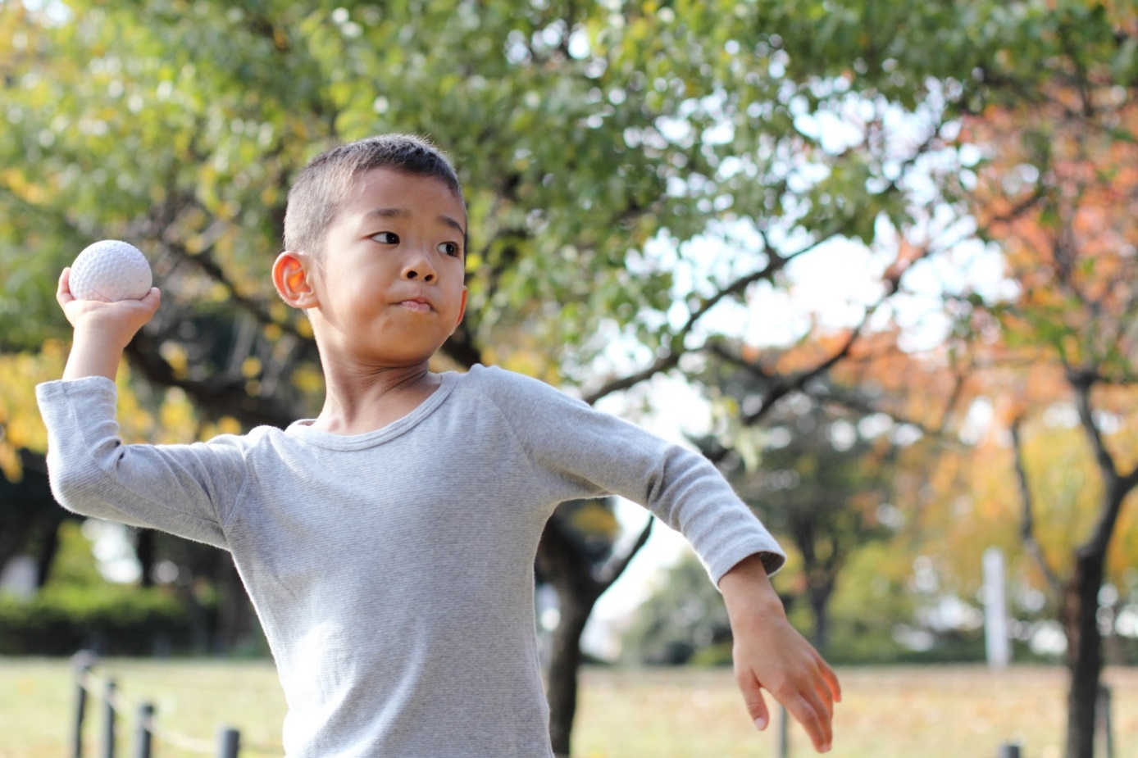
PHYSICAL EDUCATION
Left or right?
Which is your dominant hand? This is the hand or foot we use most of the time, or often lead with!
Left
Right
Both
Module 01: Lesson 02
Notes:
Students will: vote (by stamping) on what they observed to be their dominant hand.
Teacher will: Discuss the role of a ‘dominant hand’ and how it is useful to know what yours is.
Teacher will: Clarify that not everyone is the same, and that you may like one hand (or foot) to do one thing and a different one to do another, and that is perfectly fine.
PE.1.C.2.7 - Identify dominant hand/foot for use with throwing/dribbling/striking/kicking skills.

Slide 7
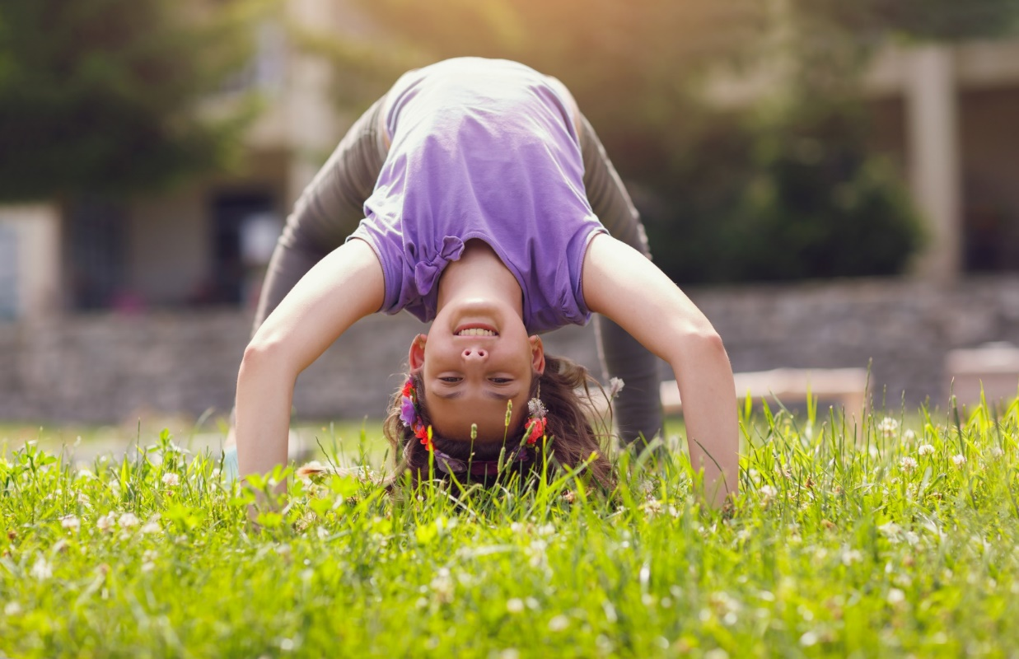
Be Fit, Have Fun
PHYSICAL EDUCATION
Being Active Can Change You
When we are physically active, our body get:
Hot-skin temperature changes
Sweaty- sweat is water from your body because it is working hard. Sweat also helps you to cool down too.
Heart rate increases- means your heart beats faster
Breathing rate increase-lungs carrying more oxygen to your muscles so they can work harder and longer
Our bodies are happy when you are active, it gives you more energy. Energy comes from the food we eat. Remember sometimes we may get tired and need a break. Our bodies will tell us that too! Always remember to drink lots of _______________ too!

Slide 8
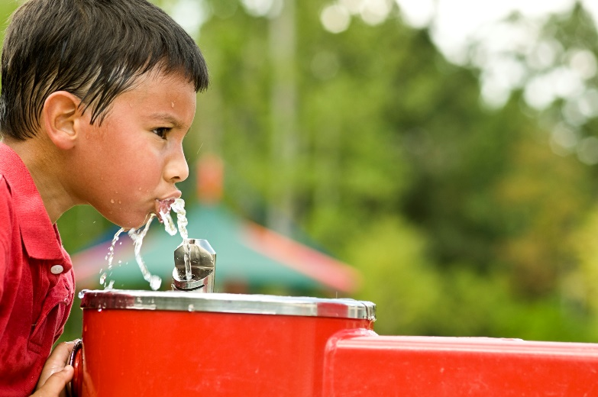
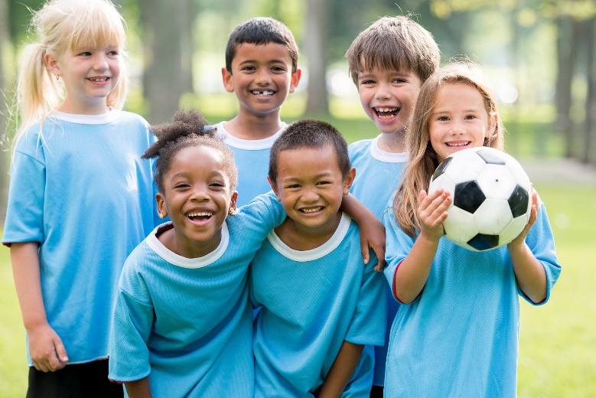
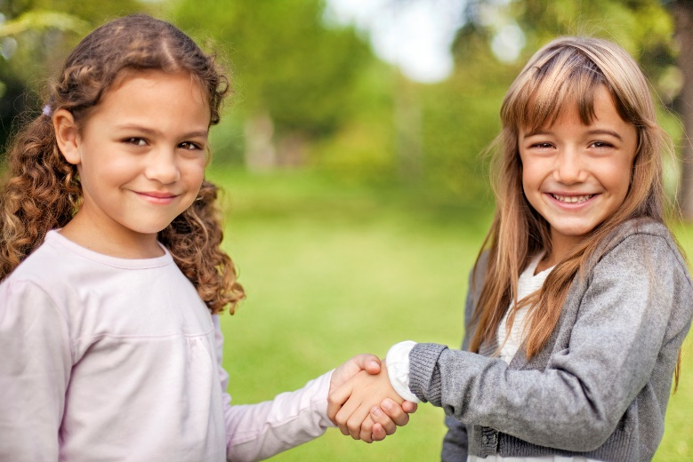
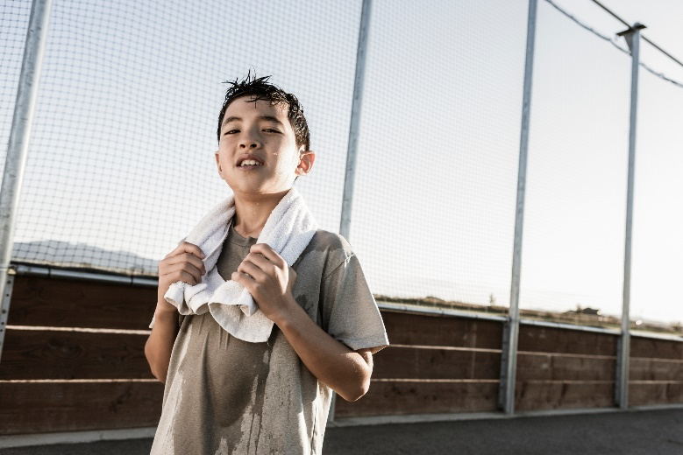
PHYSICAL EDUCATION
Active or not active?
Active
Not Active
Module 01: Lesson 02
Notes:
Students will: sort the images into the active and not active box. Active being for signs you may see when you have been physically active and Not Active being for signs you will see if someone has not been active.
PE.1.L.4.4 - Identify the difference in the activity of the heart during rest and while physically active.
PE.1.L.4.5 - Discuss the physiological signs of physical activity.

Slide 9
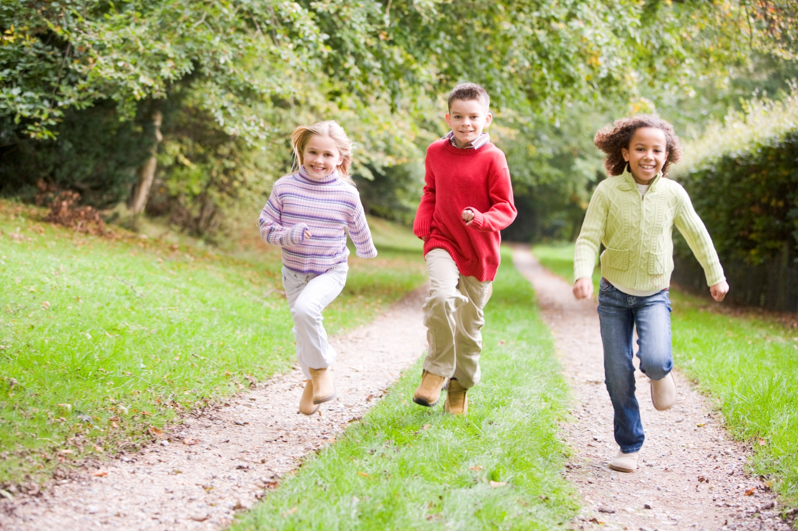
PHYSICAL EDUCATION
My Body at Rest
When I am at rest, my heart rate is _________ than when I am active.
Slower
The same
Faster
Module 01: Lesson 02
Notes:
Students will: circle or stamp the word that will correctly fill in the blank.
PE.1.L.4.4 - Identify the difference in the activity of the heart during rest and while physically active.
PE.1.L.4.5 - Discuss the physiological signs of physical activity.

Slide 10
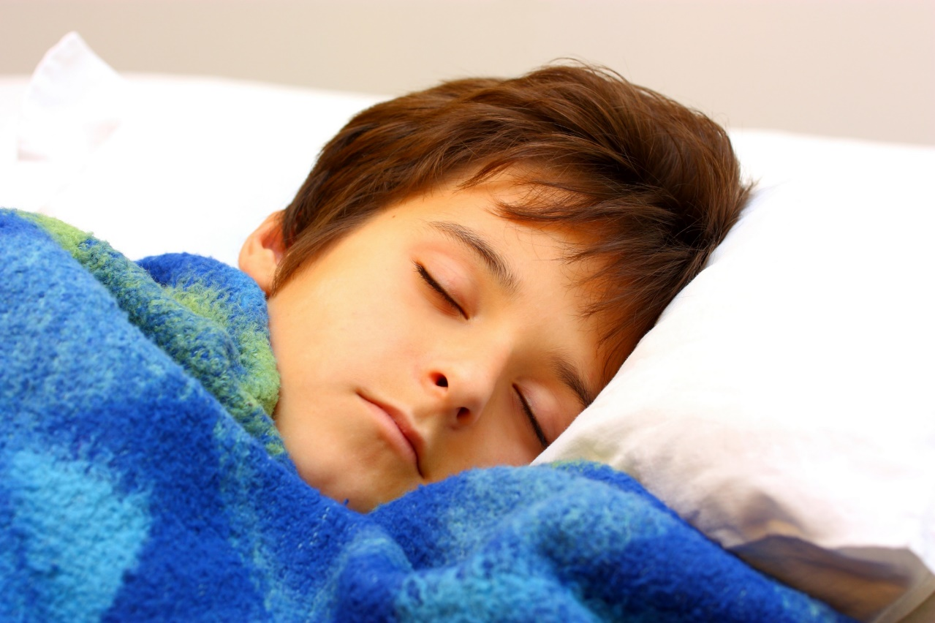
Be Fit, Have Fun
PHYSICAL EDUCATION
My Body At Rest
While you are asleep, your body is catching up from the day’s hard work! Sleep is VERY IMPORTANT to the body! It helps our bodies recover! Rest is important to allow your body to relax and grow.

Slide 11
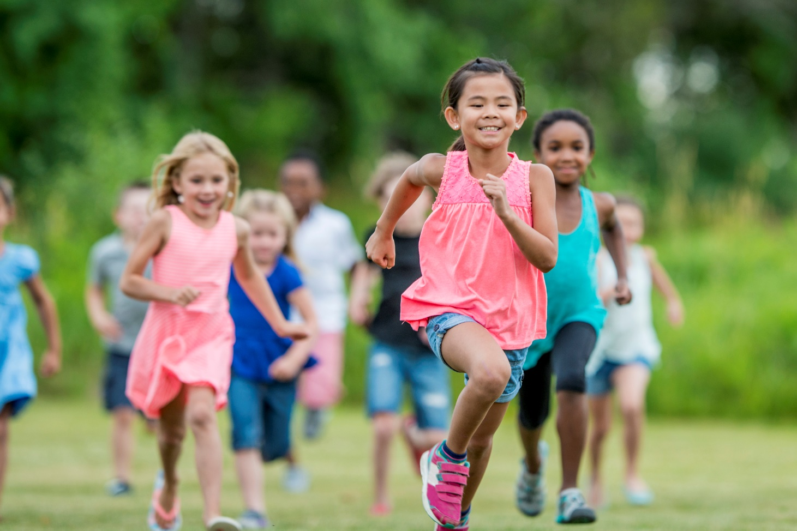
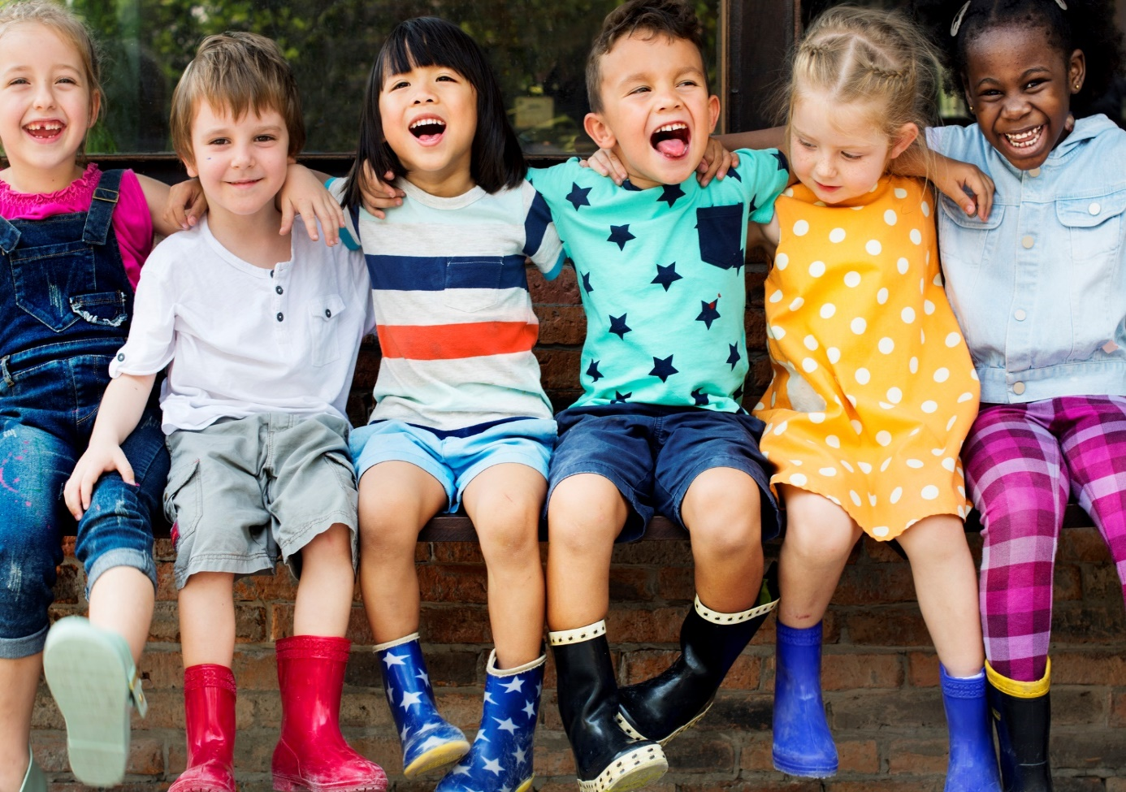
PHYSICAL EDUCATION
Class Discussion
What are the different signs your body shows when you are active versus at rest?
Heart beats slower
Breathing harder
Heart beats faster
Breathing normal
Body cools down
Sweaty & skin warmer
Module 01: Lesson 02
Notes:
Students will: Discuss the different signs that the body shows during activity (sweating, faster heartbeat, faster breathing, thirsty, warm) versus at rest (not sweating, slow heartbeat, slow breathing, normal temperature).
PE.1.L.4.4 - Identify the difference in the activity of the heart during rest and while physically active.
PE.1.L.4.5 - Discuss the physiological signs of physical activity.

Slide 12
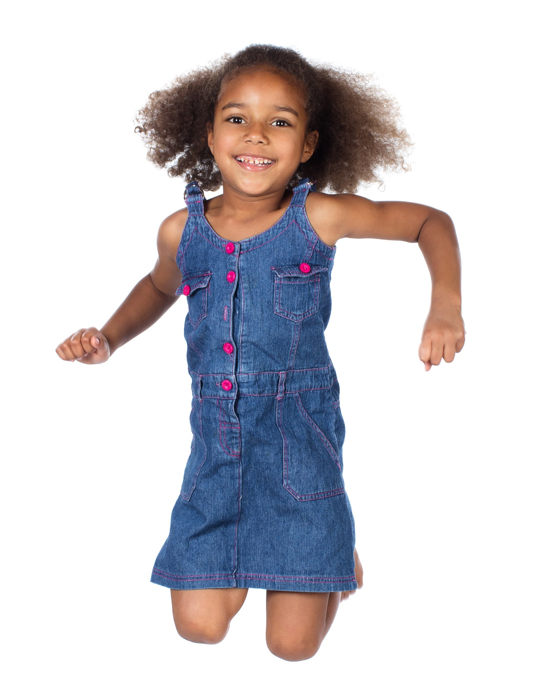
Be Fit, Have Fun
PHYSICAL EDUCATION
Set Up For Success
A Goal is something that you want to get better at and need to work at to achieve. Setting a good goal is not an easy task. Sometimes it may be easy to think of a goal, but it need to be a goal that you an achieve.
When you set a goal, you want it to be within ARMS reach
Let’s review…

Slide 13
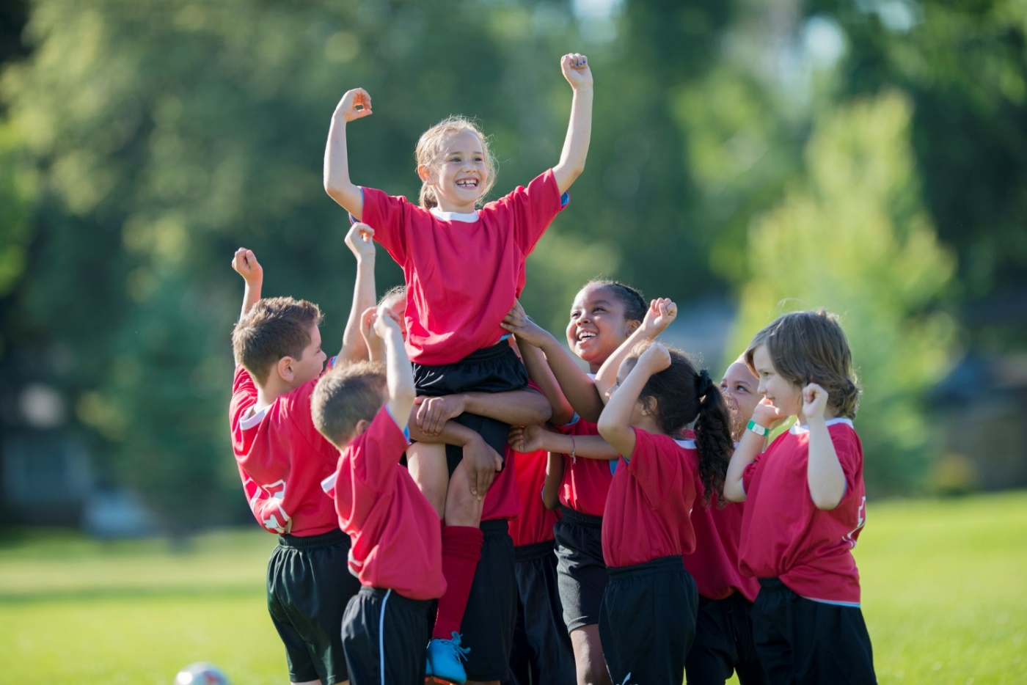
PHYSICAL EDUCATION
Setting Good Goals
A good goal is within ARMS reach. What does ARMS stand for?
Responsible
A - Achievable
Rewarding
R -
Safe
Silly
M - Meaningful
S -
Module 01: Lesson 02
Notes:
Students will: drag in the correct word to fill in the blanks.
A - achievable
R - rewarding M - meaningful
S - safe
PE.1.L.3.5 - Set physical activity goals.

Slide 14
PHYSICAL EDUCATION
Is this a good goal?
I want to be able to swim across the ocean.
Yes
No
Module 01: Lesson 02
Notes:
Students will: vote (by stamping) if they think this is a goal that is within ARMS (achievable, rewarding, meaningful, safe) reach.
Teacher will: explain this goal is not within ARMS reach. An ocean is far to big to be able to swam straight across.
PE.1.L.3.5 - Set physical activity goals.

Slide 15
Your Turn!! The next few slides will cover 1.02 fitness assessment. You will turn them IN TODAY for a GRADE!!! YAY…. But first…. Let’s stretch!!
PHYSICAL EDUCATION
While we are stretching….
Mom/Dad go grab:
Some tape or 2 pillows to mark the spots
Small stuffed animal or soft squishy ball
Measuring Tape-dont have one? It’s ok…walk it out the results in parent feet ☺
Your pre-printed 1.02 worksheet or a piece of paper, or this google slides presentation

Slide 16
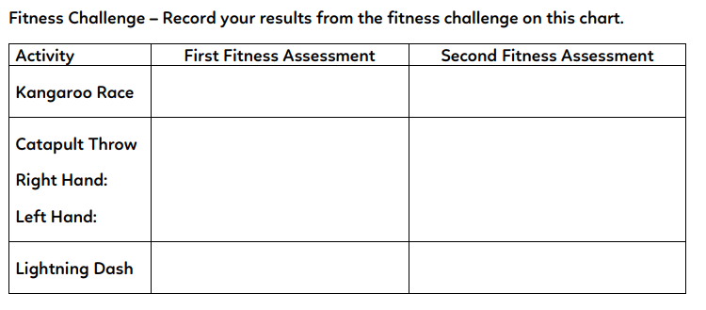
Safe Play, Be Fit, Have Fun
PHYSICAL EDUCATION
Fitness Challenge- Write your results in from the fitness challenge in the first Fitness Assessment Results….
Put number here…
For 2.05
Not This Time…

Slide 17
Safe Play, Be Fit, Have Fun
PHYSICAL EDUCATION
Take a picture!! To Turn In…

Slide 18
Safe Play, Be Fit, Have Fun
PHYSICAL EDUCATION
Take a picture!! To Turn In…
Fitness Challenge- Write your results in from the fitness challenge in the first Fitness Assessment Results….
Don’t have a measuring tape? Mom/dad use your feet to record the distance…one foot in front of the other, count your feet.
Hoping Challenge-spread out 2 pillow/tape on the floor walk out 20 feet. Jump on two feet from the first pillow/tape mark to the next as fast as you can. Have someone time you. Write your answer in the box.
Catapult Throw- Stand a the pillow/tape mark throw the squishy ball or stuff animal as far as you can. Measure the distance in feet. Write your answer in the box.
Lightning Dash- Spread out 2 pillows/tape mark on the floor 20 feet apart and sprint/jog as fast as you can to the other mark/pillow. Have someone time you. Write Your answer in the box.
Camel Marathon-Spread out 2 pillows on the floor 20 feet apart and jog back and forth and touch each cone for 4 minutes. Have someone count how many times you can touch the cones in that time. Write Your answer in the box.
Monkey Toe Touch-Sit on the floor with your legs straight out in front of you. Bend forward toward your toes. Reach as far as you can. Try not to bounce back and forth. Reach forward slowly and hold that stretch for 20 seconds. Have someone measure how far you can reach.
Put number here…
Put number here…
5 parent feet
Put number here…
Put number here…
Put number here…
3 parent feet
Mr. Timer https://youtu.be/C7XalMH7W-s

Slide 19
Assignment…..
PHYSICAL EDUCATION
Let’s turn in our assignment together!
Take a picture of your assignment or download slide 17 and 18 to turn in by clicking file, download, pdf
Go to www.flvs.net and log in (use student credentials to log in)
Go to gradebook
Click 1.02 fitness assessment
Click add file
When the dialog box opens go to your download folder, click on the file, click open
Put the checkmark in the box above the “Save for Later” blue button
Click the blue “Submit for Grading” Button
You should get a thank you for submitting message and the assignment should show blue in the gradebook

Slide 20
All Done!!! Together We Can!
PHYSICAL EDUCATION

Slide 21
Today we learned:
PHYSICAL EDUCATION
I can
Discover how to use my dominant hand and foot
Tell when my body is participating in physical activity by how my body looks and feels
Tell when my body is at rest because my heart is not beating as fast
State the physical signs my body gives when I am participating in physical activity
List my physical activity goals

Slide 22
Rate My Self Lesson Check In
PHYSICAL EDUCATION
What Do You Know About Being Fit?
I AM A 1 | I AM A 2 | I AM A 3 | I AM A 4
I don’t understand much about being fit! | I understand the concept of being fit a little bit, but I need more help! | I understand how to practice being fit and understand why being fit is important! | I understand how to practice safety and being fit all while having fun!

Slide 23
Bye See You Next Week At Our Regularly Scheduled Time!
PHYSICAL EDUCATION
Next week we will be discussing Locomotor Movement!!
Be Prepared To Get Fit With Us!!!
K- 9:30-10:00 PE
1st- 11:15-11:45 PE
2nd- 10:15-10:45 PE
3rd- 1:00-1:30 PE
4th- 1:45-2:15 PE
5th- 2:30-3:00 PE
Don’t Forget To Join….. By clicking on the remind link for your class on the class announcement page!

