Slide 1
PHYSICAL EDUCATION
01
02
Fitness Assessment
Click On ME to download the presentation….
Notes:
PE.3.C.2.7 Identify the reasons for warm-up and cool-down activities.
PE.3.L.4.5 Identify formal and informal physical fitness assessments.
PE.3.L.4.9 Identify individual strengths and weaknesses based upon results of a formal fitness assessment.
PE.3.L.3.5 Use an activity log to maintain a personal record of participation in physical activity during a period of time.

Slide 2
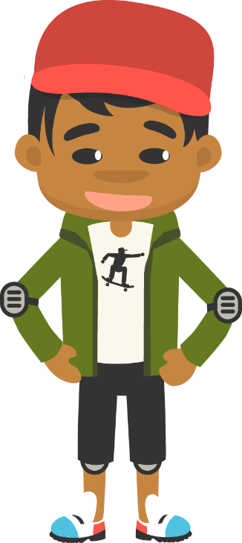
Be Fit, Have Fun
PHYSICAL EDUCATION
Fitness Assessment….
“Your body does a lot of important things. To keep your body in tip-top shape, you need to remember to keep it active, healthy, and strong. Identifying your strengths and weaknesses will help you improve and exceed your own expectations.”

Slide 3
Today we will learn/review:
PHYSICAL EDUCATION
I can
Identify the importance of warm-up and cool-down activities and how they help me perform
Use specific measurements to assess my performance in formal and informal fitness test
Relate formal and informal assessments to how they help my body

Slide 4
Rate My Self Lesson Check In
PHYSICAL EDUCATION
What Do You Know About Being Fit?
I AM A 1 | I AM A 2 | I AM A 3 | I AM A 4
I don’t understand much about being fit! | I understand the concept of being fit a little bit, but I need more help! | I understand how to practice being fit and understand why being fit is important! | I understand how to practice safety and being fit all while having fun!

Slide 5
3rd Grade Standards
PHYSICAL EDUCATION
PE.3.C.2.7 Identify the reasons for warm-up and cool-down activities.
PE.3.L.4.5 Identify formal and informal physical fitness assessments.
PE.3.L.4.9 Identify individual strengths and weaknesses based upon results of a formal fitness assessment.
PE.3.L.3.5 Use an activity log to maintain a personal record of participation in physical activity during a period of time.

Slide 6
Be Fit, Have Fun
PHYSICAL EDUCATION
Our lesson covered a lot this week:
We learned warming up, physical activity, and cooling down. Warm ups and Cool downs helps prevent injury.
We learned that athletes must also measure things to make predictions about their performance.
We learned that measuring our performance helps you set goals for the future.
We learned that goals should be SMART goals. Specific, Measurable, Achievable, Relevant, and Timely.
Let’s Practice And Have Some Fun!

Slide 7
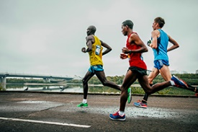
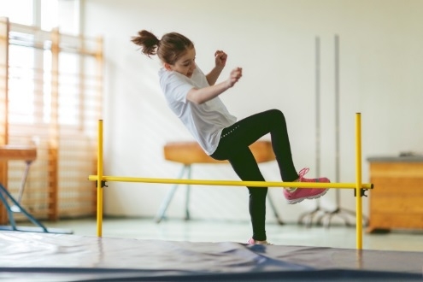
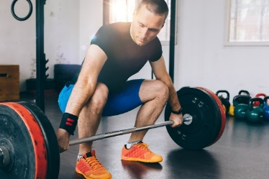
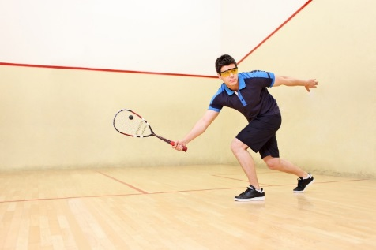
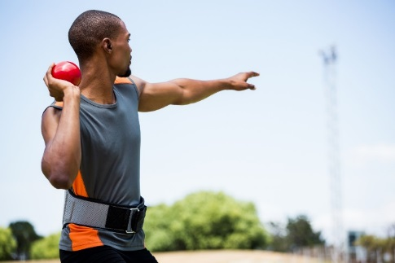
PHYSICAL EDUCATION
Weight
Distance
Time
Speed
Height
Marathon running
High jump
Squash
Weightlifting
Shot put
Module 01: Lesson 02
Notes:
Students will drag both the picture and the name of the activity that would use each form of measurement.
The teacher will encourage students to choose the most correct answer and describe the difference between activities that require speed and activities in which time is a factor.
PE.3.L.4.5 Identify formal and informal physical fitness assessments.
PE.3.L.4.9 Identify individual strengths and weaknesses.

Slide 8
PHYSICAL EDUCATION
SMART Goals
Specific
Measurable
Achievable
Relevant
Timely
The goal is something that you will be able to successfully complete and accomplish.
It is a goal that can be completed in a reasonable time.
The goal is connected to the activity you are doing or skill you are learning.
The goal can be measured by one of the units of measurement.
The goal is clearly set on one thing.
Module 01: Lesson 02
Notes:
Students will define each of the components of SMART goals by dragging the definition to the blank beside the word it defines.
The teacher will differentiate between short-term and long-term goals and review each step of the SMART goals process.
PE.3.L.4.9 Identify individual strengths and weaknesses based upon results of a formal fitness assessment.

Slide 9
PHYSICAL EDUCATION
Goals should be specific. Is it specific?
Do some stretches.
Drink three glasses of water per day for a week.
Finish in the top five at your final swim meet.
Walk down the street.
Complete 20 crunches in two minutes by the end of this lesson.
Jump rope for three minutes turning the rope on your own.
Go for a run.
Do some cardio activities.
Module 01: Lesson 02
Notes:
Students will stamp which are examples of specific goals and which are not.
The teacher will explain that specific goals are focused on a specific target area and should include a timeframe or deadline.
PE.3.L.4.9 Identify individual strengths and weaknesses based upon results of a formal fitness assessment.

Slide 10
PHYSICAL EDUCATION
Take your Pick
Checkout the exercise https://tinyurl.com/3rd-grade-lesson1-03
Step Over The Fence | Wring Out The Towel | Wave In A Parade | Dog Looking For Tail | Looking Under The Bed
Module 01: Lesson 02
Notes:
Students will vote on which dynamic stretch is their favorite to perform.
The teacher will aid in reminding the students of these dynamic stretches and compare votes for the favorite dynamic stretch.
PE.3.C.2.7 Identify the reasons for warm-up and cool-down activities.
PE.3.L.4.5 Identify formal and informal physical fitness assessments.

Slide 11
PHYSICAL EDUCATION
True or false?
Dog Looking For Tail is an example of a Dynamic Stretch. True or False
Our muscles do not need to be warmed up before physical activity. True or False
Cool-down activities can last 10–15 minutes after an activity to True or False
bring your body back to a resting state.
By not warming up and cooling down, we put ourselves at risk of injury. True or False
You can measure your physical activity by distance. True or False
You cannot beat your personal best. True or False
The goals you set should be realistic. True or False
Module 01: Lesson 02
Notes:
Students will answer each of the questions and discuss how they know the answer.
The teacher will guide students toward correct answers if many in the class feel they know the answer but it is the wrong answer. The teacher will settle disputes by correcting misinterpretations.
Circle true or false answer for each question.
Answers
Dog Looking For Tail is an example of a Dynamic Stretch. True
Our muscles do not need to be warmed up before physical activity. False
Cool-down activities can last 10–15 minutes after an activity to True
bring your body back to a resting state.
By not warming up and cooling down, we put ourselves at risk of injury. True
You can measure your physical activity by distance. True
You cannot beat your personal best. False
The goals you set should be realistic. True

Slide 12
Your Turn!! The next few slides will cover 1.02 fitness assessment. You will turn them IN TODAY for a GRADE!!! YAY…. But first…. Be ready to take a picture with your phone or the snipping tool. Or grab mom/dad to help you out!!
PHYSICAL EDUCATION

Slide 13
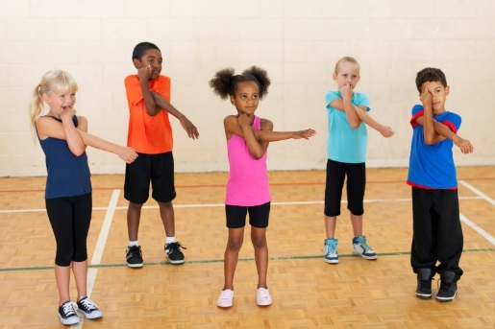
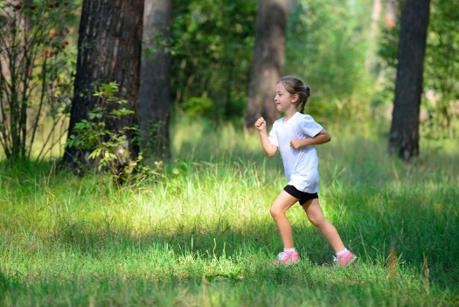
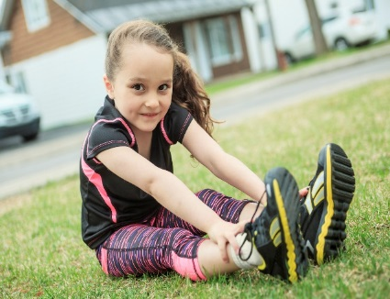
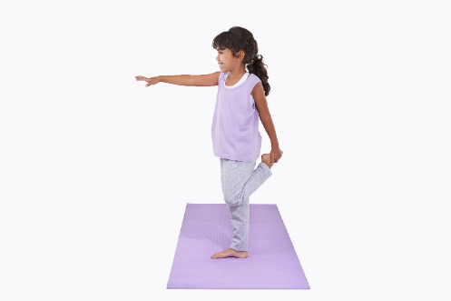
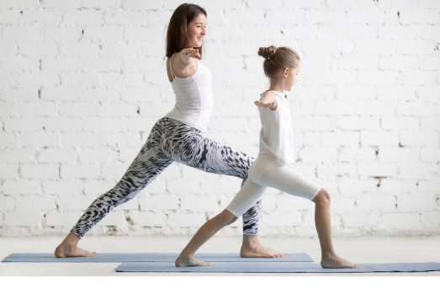
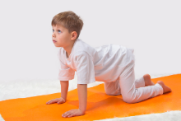
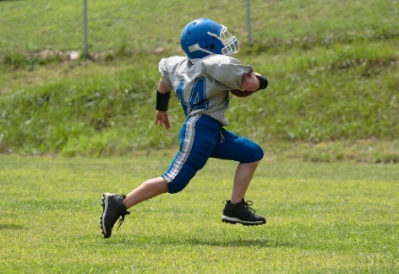
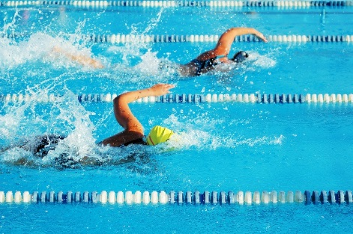
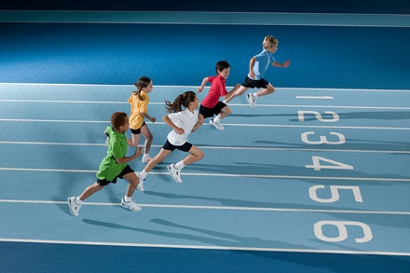
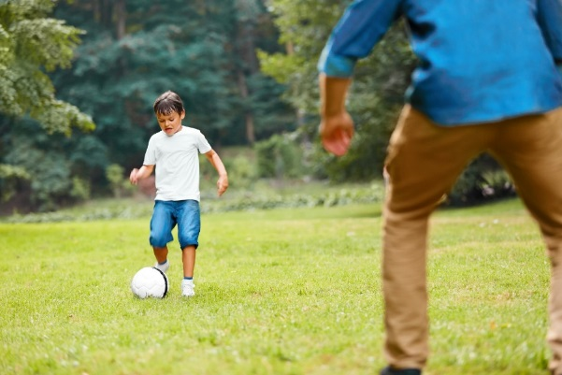
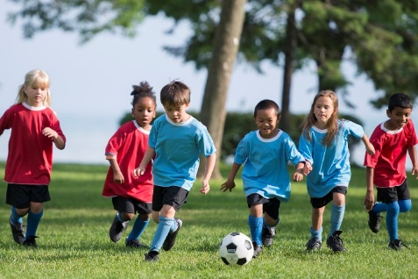
PHYSICAL EDUCATION
Take a picture!! To Turn In…
Appetizer, Main Course, or Dessert
Warm-Up
“Appetizer”
Light jog, stretch
Activity
“Main Course”
Like:
Cool-Down
“Dessert”
Short walk, stretch
Module 01: Lesson 2
Module 01: Lesson 02
Notes:
Students will drag and drop various activities into the categories of “Warm-Up,” “Main Activity,” and “Cool-Down.”
The teacher will remind students about dynamic and static stretching and the importance of warming up and cooling down before and after activity.
PE.3.C.2.7 Identify the reasons for warm-up and cool-down activities.

Slide 14
Assignment…..
PHYSICAL EDUCATION
Let’s turn in our assignment together!
Take a picture of your assignment or download slide 13 to turn in by clicking file, download, pdf
Go to www.flvs.net and log in (use student credentials to log in)
Go to gradebook
Click 1.02 fitness assessment
Click add file
When the dialog box opens go to your download folder, click on the file, click open
Put the checkmark in the box above the “Save for Later” blue button
Click the blue “Submit for Grading” Button
You should get a thank you for submitting message and the assignment should show blue in the gradebook

Slide 15
All Done!!! Together We Can!
PHYSICAL EDUCATION

Slide 16
Today we will learned/reviewed:
PHYSICAL EDUCATION
I can
Identify the importance of warm-up and cool-down activities and how they help me perform
Use specific measurements to assess my performance in formal and informal fitness test
Relate formal and informal assessments to how they help my body

Slide 17
Rate My Self Lesson Check In
PHYSICAL EDUCATION
What Do You Know About Being Fit?
I AM A 1 | I AM A 2 | I AM A 3 | I AM A 4
I don’t understand much about being fit! | I understand the concept of being fit a little bit, but I need more help! | I understand how to practice being fit and understand why being fit is important! | I understand how to practice safety and being fit all while having fun!

Slide 18
Bye See You Next Week At Our Regularly Scheduled Time!
PHYSICAL EDUCATION
Next week we will be discussing Locomotor Movement!!
Be Prepared To Get Fit With Us!!!
K- 9:30-10:00 PE
1st- 11:15-11:45 PE
2nd- 10:15-10:45 PE
3rd- 1:00-1:30 PE
4th- 1:45-2:15 PE
5th- 2:30-3:00 PE
Don’t Forget To Join….. By clicking on the remind link for your class on the class announcement page!

