Slide 1
PHYSICAL EDUCATION
3rd, & 4th Grade
02
04
Nutrition-Project Based Assessment

Slide 2
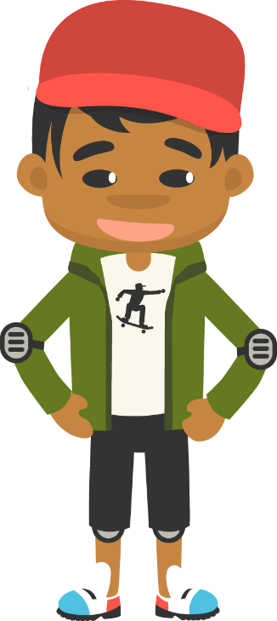
Making Healthy Food Choices……
PHYSICAL EDUCATION
What’s In Your Belly?
Is your tummy grumbling, but you are unsure of what to eat? Should you have some of your favorite potato chips or a pancake with fruit? One of these snacks gives you more energy to play all day. But which one could it be? You will find out! There are so many foods for you to pick from, but they are not all healthy options. It is important to know what kinds of foods you are putting into your body. This will help to maintain a healthy you. There are four fabulous food groups to learn about.

Slide 3
Today we will learn/review: 1st, 3rd, and 4th
PHYSICAL EDUCATION
I can 1st grade:
identify at least two foods that are sometimes foods
identify at least two foods that are everyday foods
name each of the four food groups
sort foods into the four food groups
match a variety of foods that belong to each food group
identify sometimes snacks
suggest everyday alternatives
recognize that sometimes foods and everyday foods give me different amounts of energy
recognize that healthy meals contain three of the four food groups
state that unhealthy foods can be enjoyed in small portions
state that you must wash your hands before eating a meal
draw pictures to show a healthy mealI can 3rd grade:
summarize how muscular endurance helps my performance in various physical activities
recognize that different activities and exercises impact my fitness in different ways
use different personal characteristics to overcome physical activity related challenges
use a log to keep track of my activity and fitness levels

Slide 4
Today we will learn/review: 1st, 3rd, and 4th
PHYSICAL EDUCATION
I can 3rd grade:
read food labels and pick out information that is most important to me
make safe health-related lifestyle changes to increase my fitness and well-being
identify patterns of healthy living
create a personal health goal and track it to completion, to combat the effects of a common health-related illness
I can 4th grade:
identify recommended serving sizes and explain how they promote personal health
identify the recommended daily portions for the different food groups
identify the recommended portions of healthy snacks
explain how much water is needed in a day, identify the impact of bottled water on the environment, and choose more friendly alternatives

Slide 5
Rate My Self SEL Learning Check In
PHYSICAL EDUCATION
Show Me How You Are Feeling??
Sad | Okay | Happy
I feel Sad today. | I feel OKAY today. | I feel HAPPY today.
SAD-THUMBS DOWN
OKAY-THUMB IN THE MIDDLE
HAPPY-THUMBS UP

Slide 6
Rate My Self Lesson Check In
PHYSICAL EDUCATION
What Do You Know About Nutrition?
I AM A 1 | I AM A 2 | I AM A 3 | I AM A 4
I don’t understand much about healthy foods! | I understand the concept of healthy foods, but I need more help! | I understand how to create a healthy meal and can make sure my meal has different food groups! | I understand how to create a healthy meal and can identify healthy foods in my refrigerator, and I can teach a friend/partner/family member about healthy food choices.

Slide 7
3rd Grade Standards
PHYSICAL EDUCATION
1st Grade Standards
PE.1.L.4.7 - Identify the food groups.
HE.1.P.8.1 - Encourage others to make positive health choices. (Define many good snack choices.)
.
PE.3.L.4.7 Read food labels for specific nutrition facts.
PE.3.L.3.6 Identify lifestyle changes that can be made to increase the level of physical activity.
PE.3.L.4.8 Identify the principles of physical fitness.
HE.3.B.5.2 List healthy options to health-related issues or problems.
HE.3.B.6.1 Select a personal health goal and track progress toward achievement.
4th Grade Standards
PE.4.L.4.7 Understand serving sizes

Slide 8
Get a Jump Start…..
PHYSICAL EDUCATION
Our lesson covered a lot this week:
We learned we about everyday food-foods that give you the right kind of energy to help you play and grow. We should eat these foods every single day. And sometime foods-food that do not give you the right kind of energy to help you play and grow. We should not eat these foods everyday. Our meals are the most important part of your day.
We learned about our Fab Food Groups: Fruits &Veggies-made from parts of plants, Grains-make from seeds and grass plants, Dairy-made from the milk of an animal, Protein-helps your muscle grow such as beef, poultry, fish, eggs, nuts, seeds, and legumes-like beans. 4th grade your food groups are the fab 5 (fruits & veggies are separate).
We learned some foods will ruin our appetite and we will not have room for power foods. An appetite is the feeling that make you want to eat. Remember it is important to eat from at least 3 of the 4 food groups!
We learned about balanced meals are both tasty and healthy for you to eat. You can even treat yourself with a small portion of sometimes foods once in a while and still keep a balance meal.
We learned before we eat we must remember to wash our hands with soap and water. This helps wash away the germs. 3th grade, make sure the food is cooked all the way through to help get rid of more germs and your food is safe.
We learned that must remember to always warm up our body and cool down our body with a good stretch.
3-4th grade: We learned reading the label allows us to screen the foods we eat so we know what is going into your body, remember to look at the calories and other parts of the label like vitamins, protein, fat.
Your diet is simply the foods you eat everyday; when we are dieting we are watching/changing what we eat in our diet! Its best to aim for lifestyle changes and make healthy food choices that will last a lifetime. When we do this, we are creating healthy habits.
4th Grade: Remember your portion is the amount of food you choose to eat, and a serving is a measured amount of food or drink. Servings sizes ex: cups, pieces or weight.
Last we learned 60% of our body is made up of water. We need water to live. Drinking water helps keep you from becoming dehydrated, so make sure to drink up during the day. Remember you are what you eat & drink!
Let’s Practice And Have Some Fun!

Slide 9
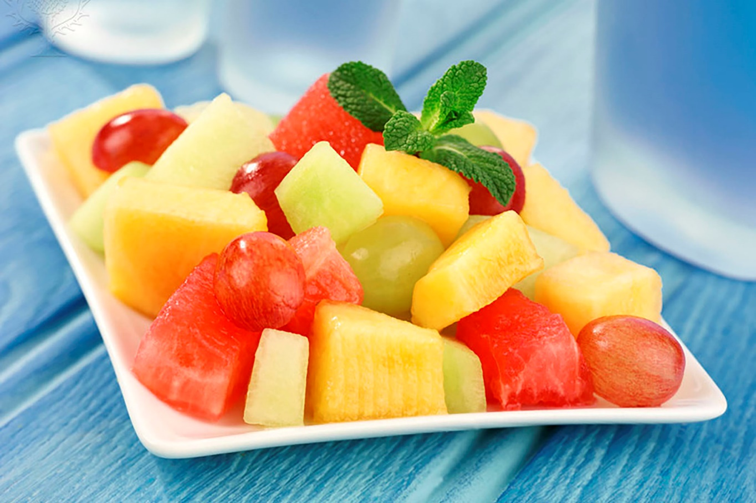
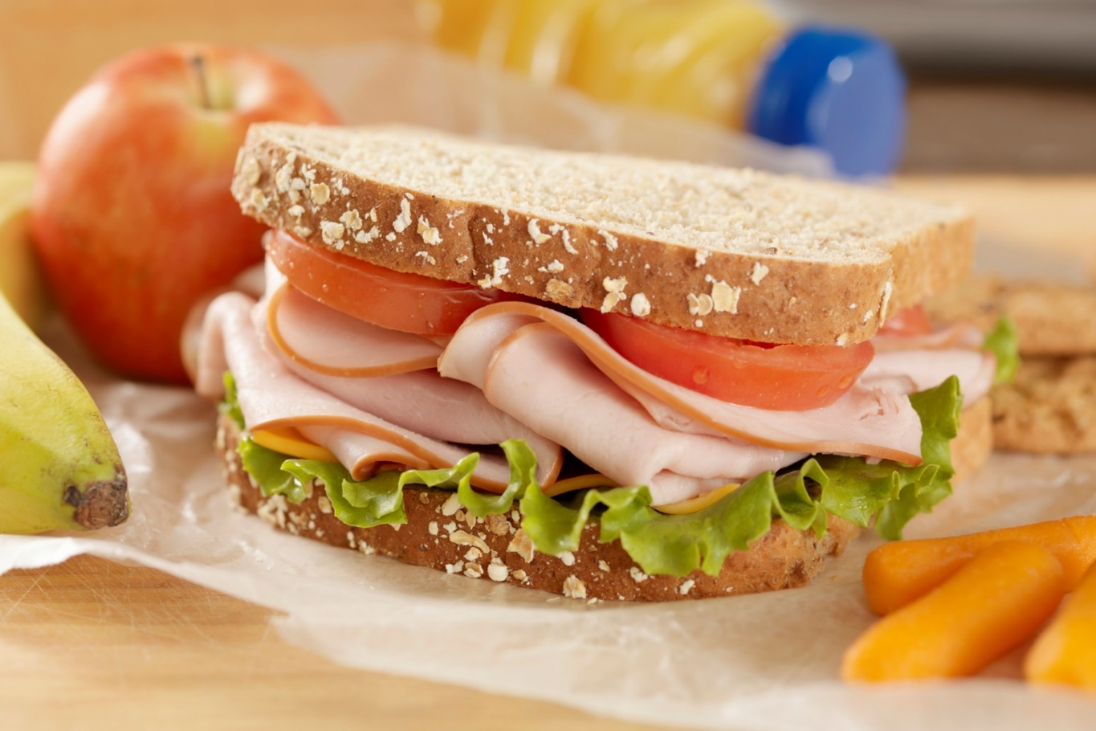
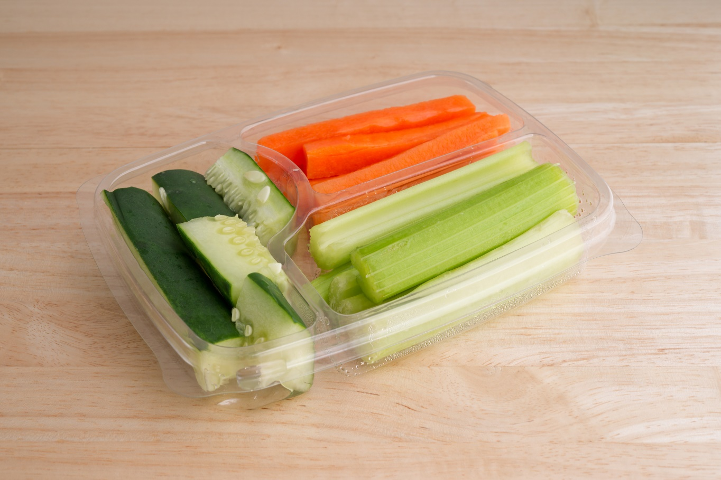
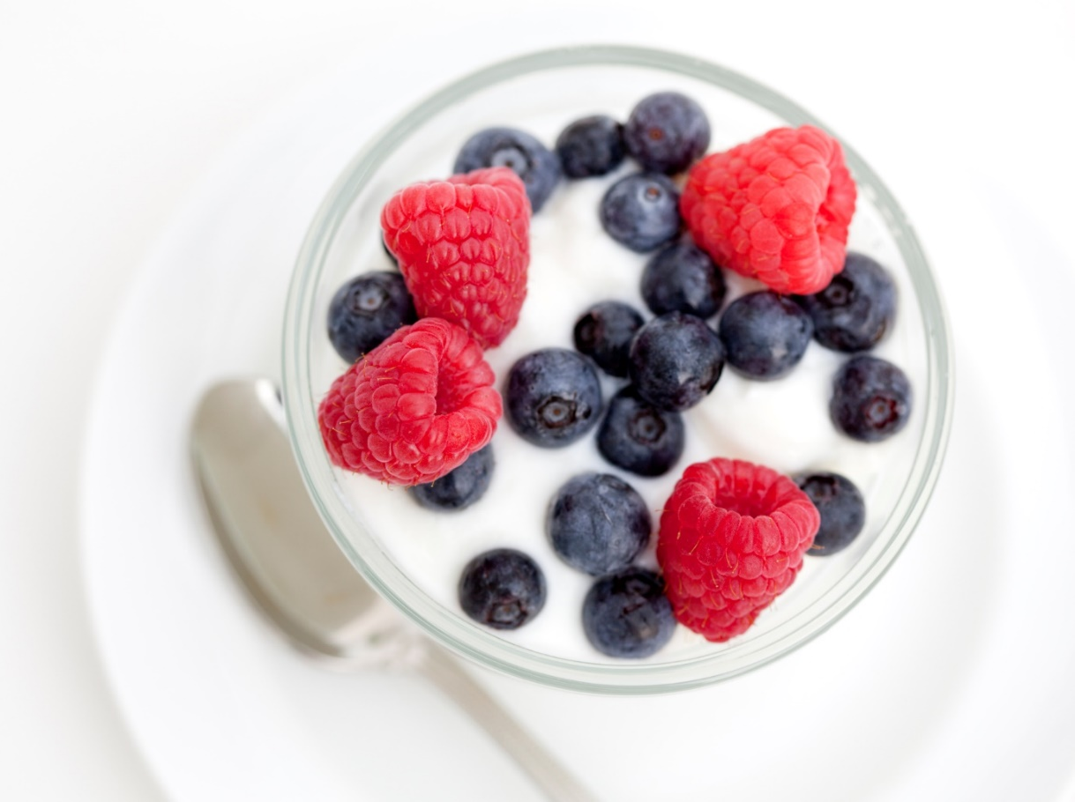
PHYSICAL EDUCATION
Nutrition…. 1st grade
Which is your favorite everyday food snack?
Module 02: Lesson 04
Notes:
Students will: vote on their favorite healthy snack! (This could either be done with the voting tool or a stamp on the image they think is their favorite.)
Teacher will: facilitate discussion further to allow the students to hear more options for healthy snacks from their peers.
HE.1.B.8.1 - Encourage others to make positive health choices.

Slide 10
PHYSICAL EDUCATION
Nutrition…. 1st grade
Sort the foods into the “everyday” and “sometimes” baskets.
Everyday Foods
Sometimes Foods
Module 02: Lesson 04
Notes:
Students will: Sort the food objects into the two separate baskets, categorizing them as everyday (healthy) or sometimes (unhealthy).
Teacher will: Briefly review the concepts of Sometimes Foods and Everyday Foods.
Sometimes Foods: are foods that we can only have sometimes to still eat healthy. These are treats like candy, cakes, pie, soda, ice cream, and chocolate.
Everyday Foods: are foods that we can eat every day and be healthy, mixing foods from the four good groups.
S3.E6.1 - Differentiates between healthy and unhealthy foods.
LAFS.1.SL.2.5 - Add drawings or other visual displays to descriptions when appropriate to clarify ideas, thoughts, and feelings.

Slide 11
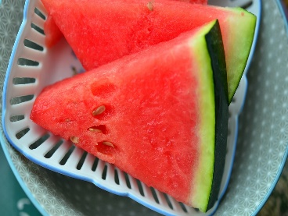
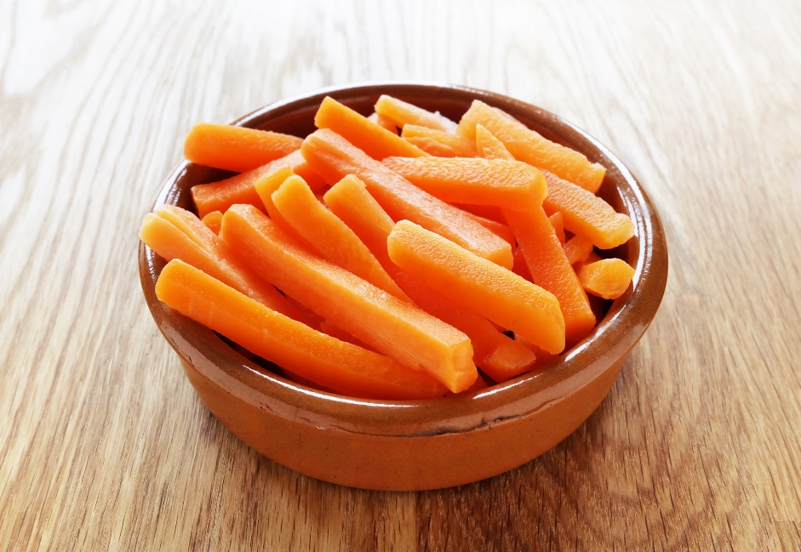
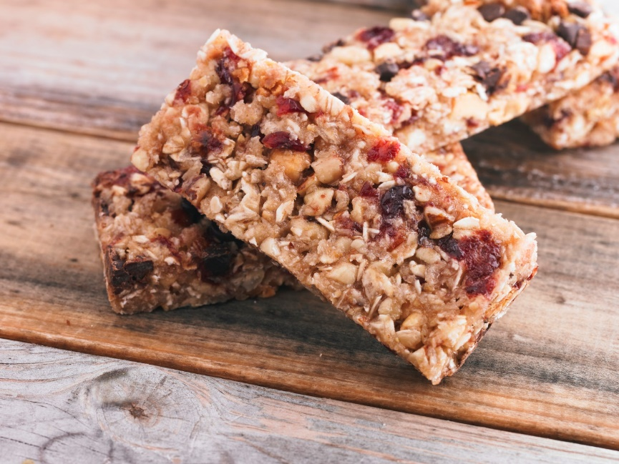
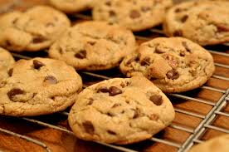
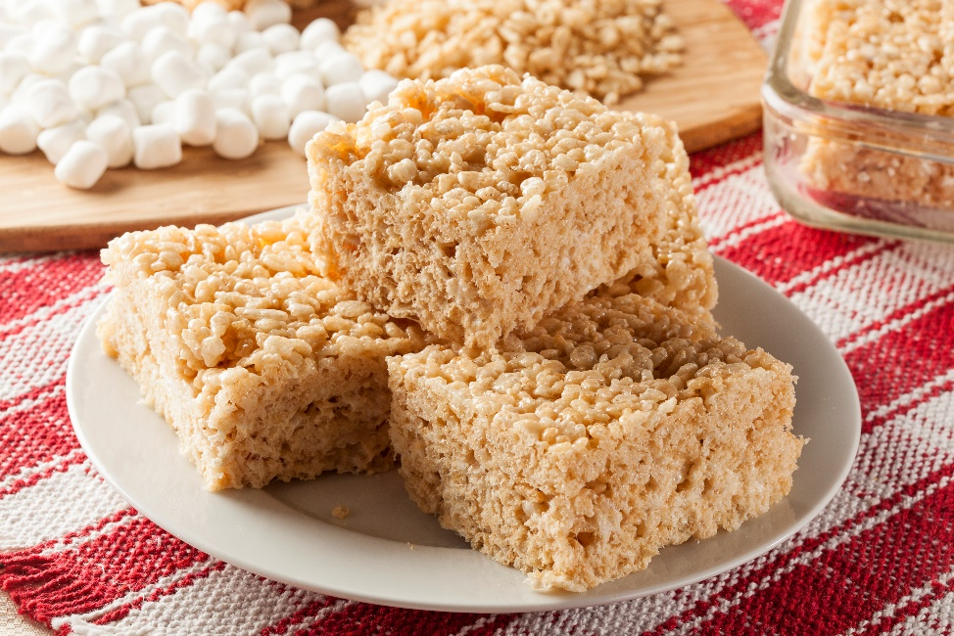
PHYSICAL EDUCATION
Nutrition…. 1st grade
Let’s Take A Look At Healthy Snack Alternatives
Module 02: Lesson 04
Notes:
Students will: offer ideas for healthier alternative snacks that they could have instead of Sometimes Foods.
HE.1.B.8.1 - Encourage others to make positive health choices.

Slide 12
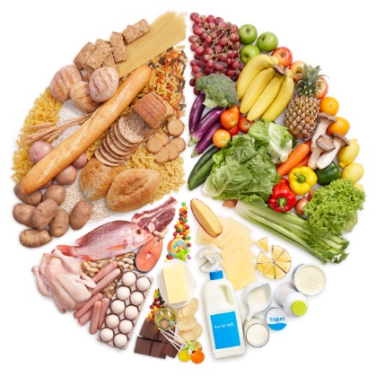
PHYSICAL EDUCATION
Nutrition…. 1st grade
Label each of the food groups and then select which one is your favorite.
Grains
Protein
Dairy
Fruits and Vegetables
Sometimes Foods
Module 02: Lesson 04
Notes:
Students will: Place the word on (or near) the examples of the foods in the food group.
Teacher will: guide by offering examples of the foods in each group and offering support.
PE.1.L.4.7 - Identify the food groups.

Slide 13
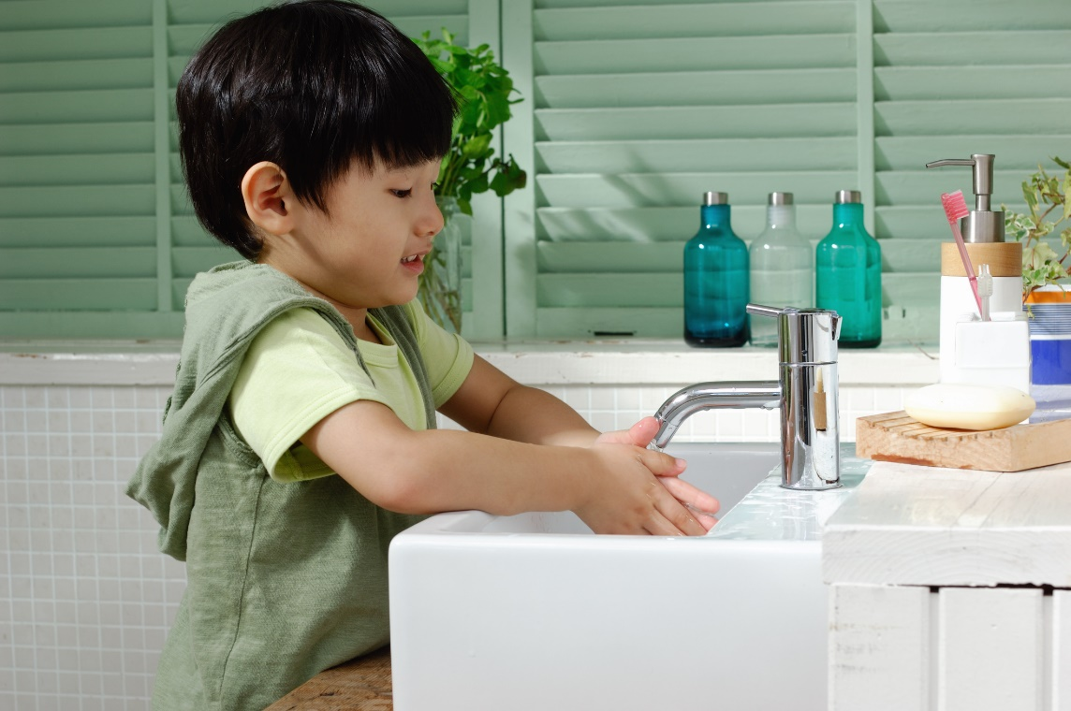
PHYSICAL EDUCATION
Nutrition…. 1st grade
Handwashing Rules
It is important to wash my hands _____________ I eat.
I use ___________ and ___________ to wash my hands.
before
water
soap
Module 02: Lesson 04
Notes:
Students will: Place the words into the correct blanks.
HE.1.B.8.1 - Encourage others to make positive health choices.

Slide 14
Your Turn!! The next few slides will cover your 2.04 Nutrition. You will NEED To turn in YOUR ASSIGNMENT IN TODAY for a GRADE!!! YAY….
PHYSICAL EDUCATION
Nutrition…. 1st grade
You Will Need….
This assignment is on slide 24.
Let’s create our meal together!
Have mom or dad available to take a picture of the screen at the end!

Slide 15
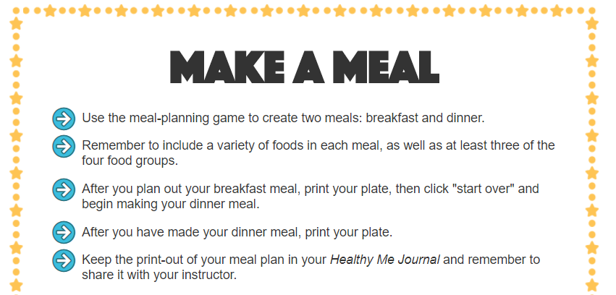
PHYSICAL EDUCATION
Nutrition…. 1st grade
Ready…Make A Meal..

Slide 16
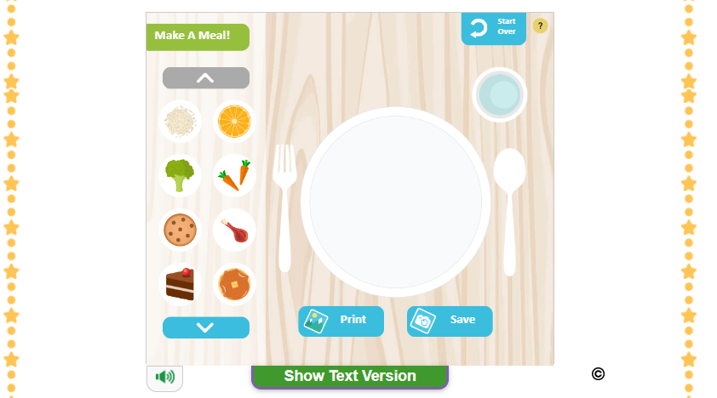
PHYSICAL EDUCATION
Nutrition…. 1st grade
Ready…Let’s Make A Meal...

Slide 17
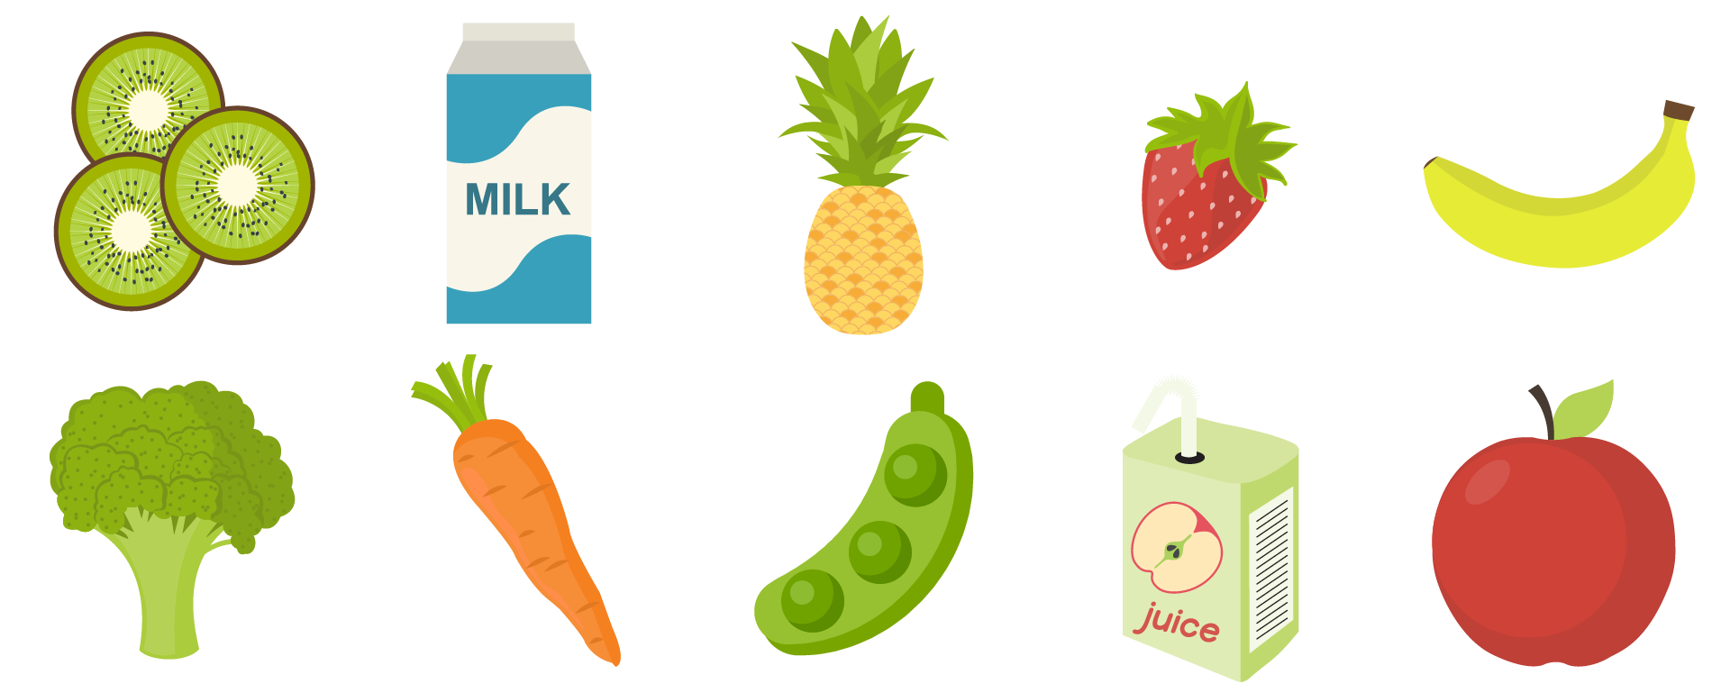
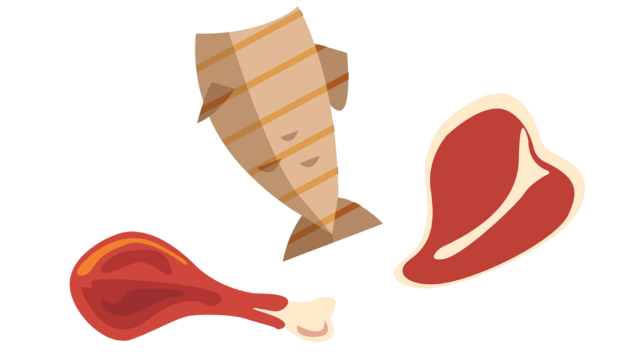
PHYSICAL EDUCATION
Nutrition…. 3rd grade...
Are any of these foods apart of your diet?
Module 02: Lesson 04
Notes:
Students will use the circle shape to circle the items that they regularly incorporate into their diet.
The teacher will explain that their “diet” means the food they consistently eat. The teacher will facilitate discussion about how culture may influence the foods students regularly eat. The teacher will get the students to list any other foods that are part of their diet that are not shown.
The teacher can also discuss why some people may have dietary restrictions due to allergies or other personal reasons.
PE.3.L.3.6 Identify lifestyle changes that can be made to increase the level of physical activity.
PE.3.L.4.8 Identify the principles of physical fitness.
HE.3.B.5.2 List healthy options to health-related issues or problems.

Slide 18
PHYSICAL EDUCATION
Nutrition…. 3rd grade...
Everyday or Sometimes
Everyday | Sometimes
Module 02: Lesson 04
Notes:
Students will sort the food items into the Everyday or Sometimes columns depending on whether that food item is part of the five food groups and whether it is a healthy option or a treat.
The teacher will help identify the different foods, review the major food groups, and explain why some foods are considered “sometimes” foods even if they contain foods from the food groups (i.e., hamburger, potato chips, etc.)
PE.3.L.3.6 Identify lifestyle changes that can be made to increase the level of physical activity.
HE.3.B.5.2 List healthy options to health-related issues or problems.

Slide 19
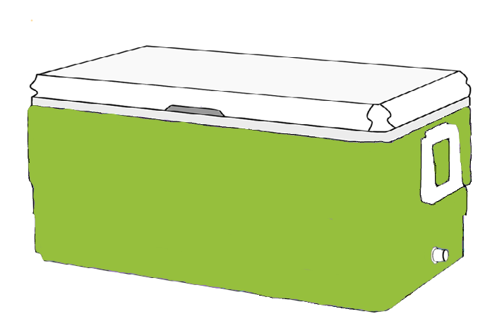
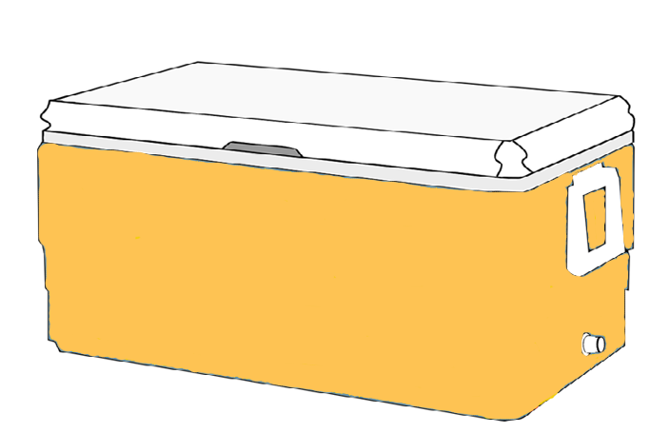
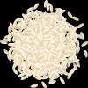
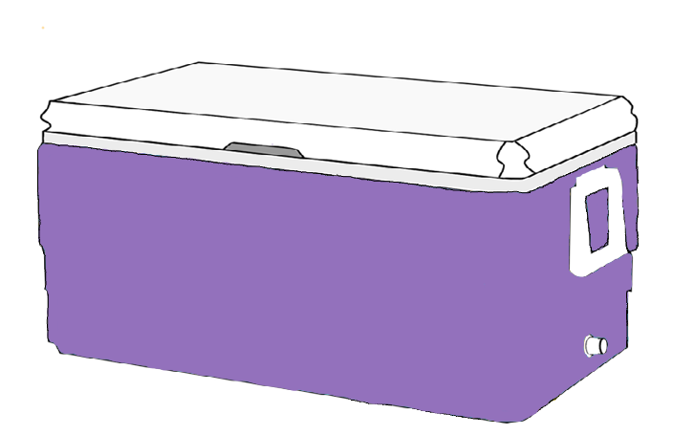
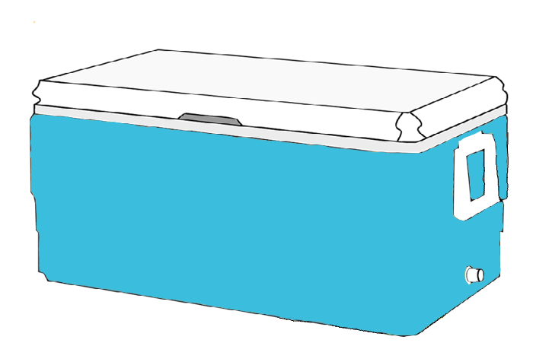
PHYSICAL EDUCATION
Nutrition…. 3rd grade...
Label the Coolers with the Correct Food Group!
Fruits and Vegetables
Protein
Grains
Dairy
Module 02: Lesson 04
Notes:
Students will: Sort the food items to the different food group coolers.
PE.1.L.4.7 - Identify the food groups.

Slide 20
PHYSICAL EDUCATION
Nutrition…. 3rd grade...
Skipping meals
What is being healthy?
Staying safe
Drinking plenty of water
Getting enough sleep
Eating healthy foods
Being physically active
Eating junk food every day
Module 02: Lesson 04
Notes:
Students will drag the healthy lifestyle choices into a section of the pie chart and throw unhealthy ideas into the trash can.
The teacher will expand on each choice and get the students’ opinions on why they threw some choices out.
HE.3.B.5.2 List healthy options to health-related issues or problems.
PE.3.L.3.6 Identify lifestyle changes that can be made to increase the level of physical activity.

Slide 21
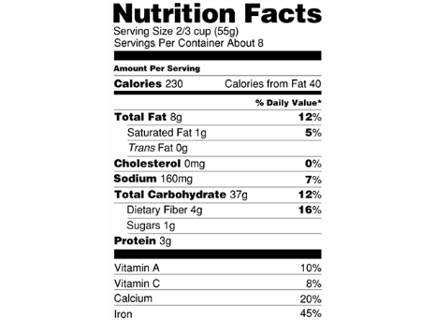
PHYSICAL EDUCATION
Nutrition…. 3rd grade...
Identify the serving size with the orange box.
Identify the protein with the blue box.
Identify the calcium with the green box.
Identify the calories with the red box.
Module 02: Lesson 04
Notes:
Students will identify specific parts of a food nutrition facts label.
The teacher will remind students about the breakdown of food label facts called the “Amount Per Serving” breakdown.
PE.3.L.4.7 Read food labels for specific nutrition facts.

Slide 22
Your Turn!! The next few slides will cover your 2.04 Nutrition. You will NEED To turn in YOUR ASSIGNMENT IN TODAY for a GRADE!!! YAY….
PHYSICAL EDUCATION
Nutrition…. 3rd grade
You Will Need….
This assignment is on slide 24!
Download your Nutrition Worksheet
Go find 3 items out of your kitchen
Camera
Colored Pencil Markers

Slide 23
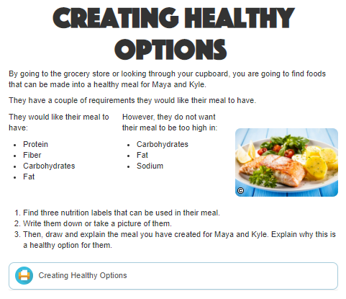
Nutrition…. 3rd grade...
PHYSICAL EDUCATION
Ready…Set…Go….

Slide 24
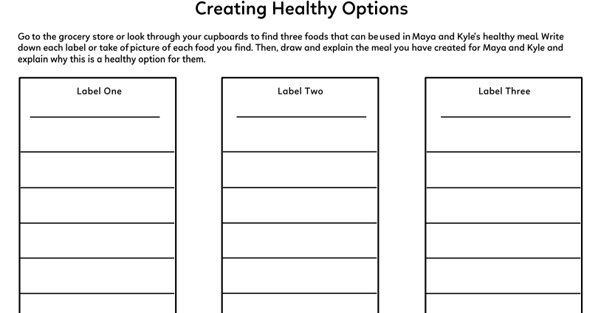
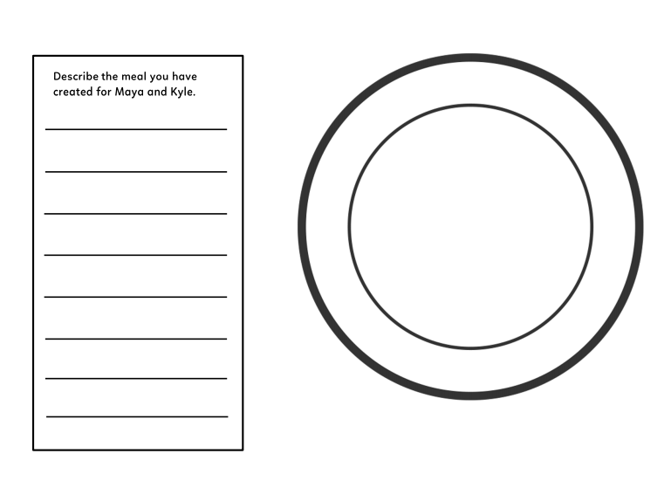
Nutrition…. 3rd grade...
PHYSICAL EDUCATION
Take A Picture Of Each Label….
Part 1… upload 3 pictures
No camera, its okay write out the label
Part 2..Create our meal using our 3 healthy food options and draw a picture
Take A Picture Of Each Label….
Take A Picture Of Each Label….
Take A Picture Of Each Label….

Slide 25
Nutrition…. 3rd grade...
PHYSICAL EDUCATION
Take A Picture or Scan this Page…Set…Go….
Part 2..Create our meal using our 3 healthy food options and draw a picture
My meal for Mya and Kyle is……
It is healthy because…..
Live Lesson: Share your creation

Slide 26
PHYSICAL EDUCATION
Nutrition…. 4th grade
Sort the Foods into Their Food Group
Fruits
Vegetables
Grains
Protein
Dairy
Module 02: Lesson 04
Notes:
Students will: Sort the food items to the different food group coolers.
PE.1.L.4.7 - Identify the food groups.

Slide 27
PHYSICAL EDUCATION
Nutrition…. 4th grade
1. F_______
Name the Fab Five….
2. V_________
3. G_________
4. P__________
5. D__________
Module 02: Lesson 04
Notes:
Students will name the five food groups and a food that belongs in each.
Teacher will answer any questions the students have and prompt them with foods as hints for the food groups.
PE.4.L.4.7 Understand serving sizes

Slide 28
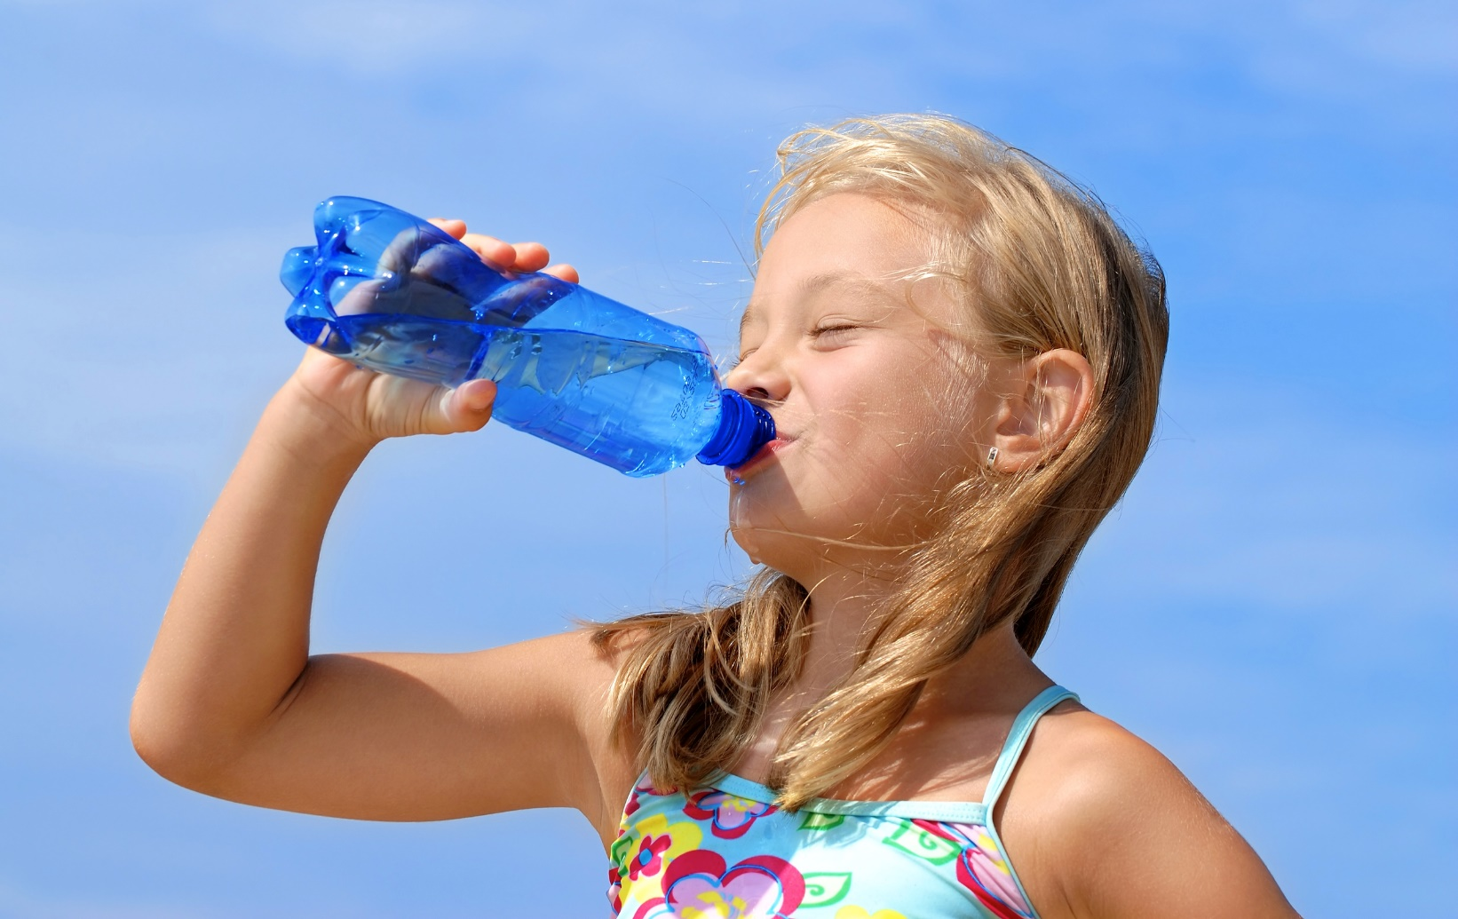
PHYSICAL EDUCATION
Nutrition…. 4th grade
Lots Of Water
How much of your body is made up of water?
About
%
20
40
60
Module 02: Lesson 04
Notes:
Students will reflect to remember what percentage of their body is water. 60%
Teacher will support and answer questions.
PE.4.L.4.7 Understand serving sizes

Slide 29
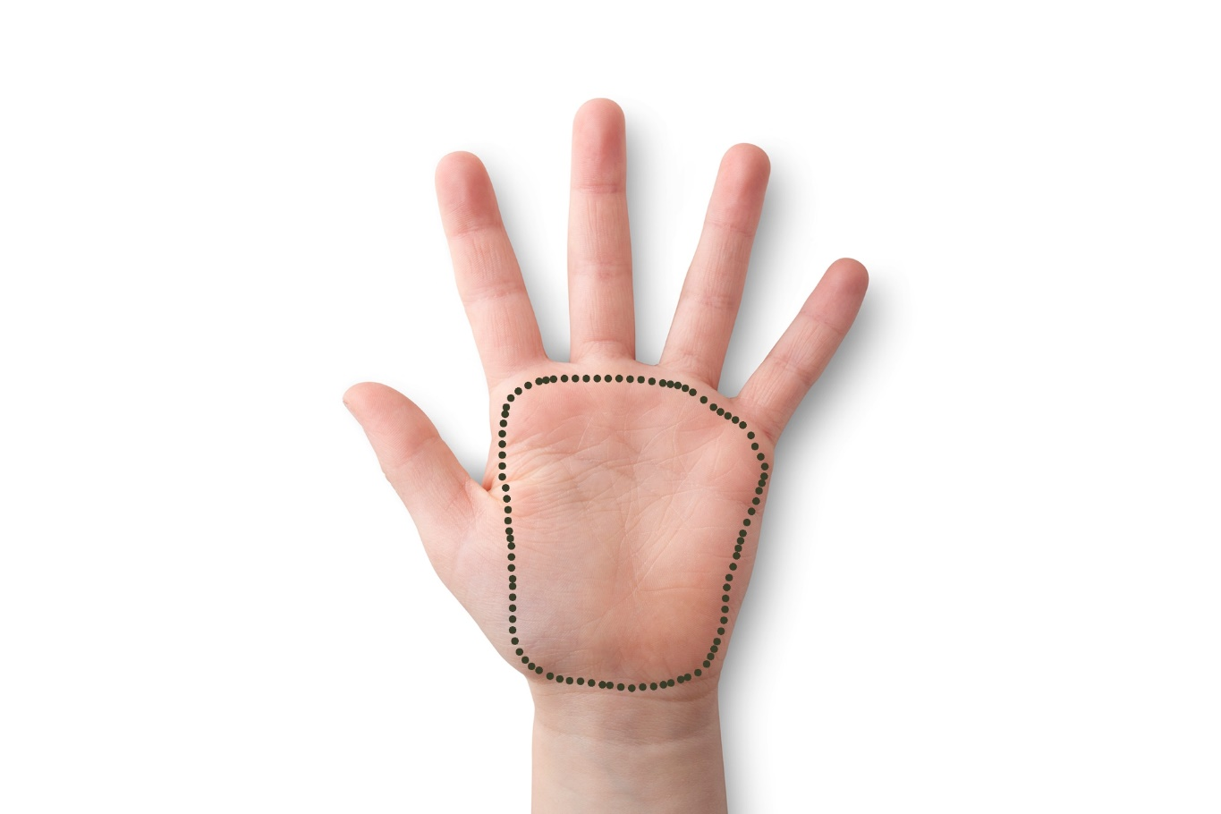
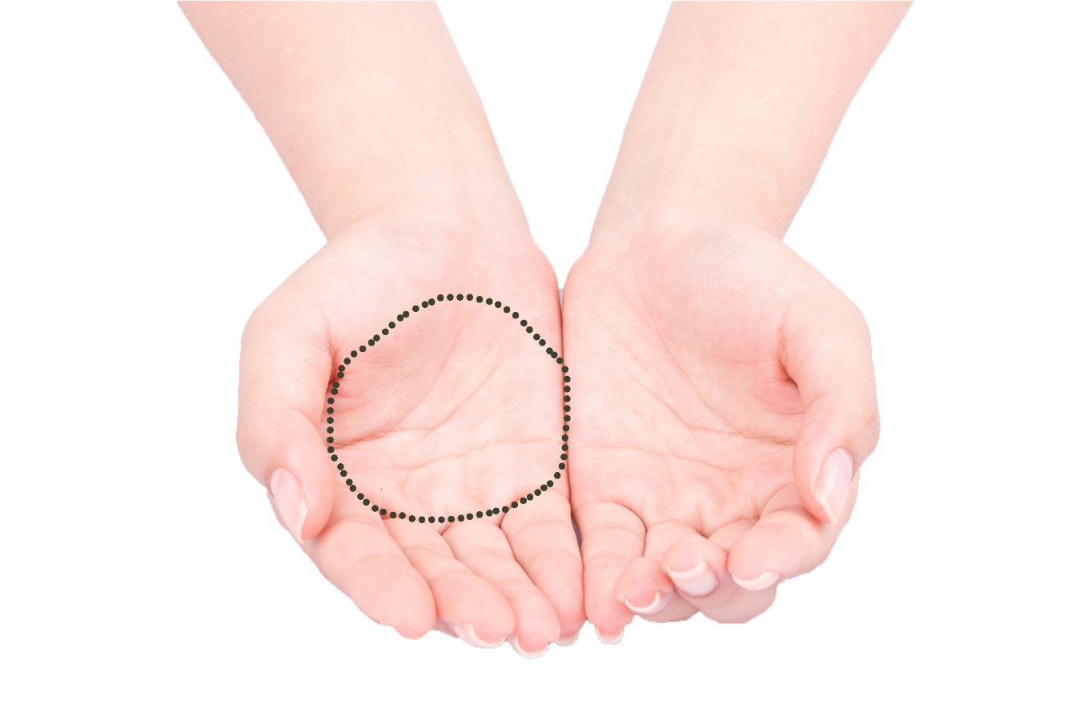
PHYSICAL EDUCATION
Nutrition…. 4th grade
Servings a Plenty
Label the correct amount
One serving of meat
One serving of pasta, or rice
One serving of soup, cereal, casserole, fruit, or salad
Module 02: Lesson 04
Notes:
Students will place the food serving size under the correct hand that represents that serving.
Teacher will ask prompting questions and support students.
Flat hand-meat, palms-pasta or rice, fist-soap, cereal, casserole, fruit or salad.
PE.4.L.4.7 Understand serving sizes

Slide 30
Your Turn!! The next few slides will cover your 2.04 Nutrition. You will NEED To turn in YOUR ASSIGNMENT IN TODAY for a GRADE!!! YAY….
PHYSICAL EDUCATION
Nutrition…. 4th grade
You Will Need….
This assignment is on slide 22.
Let’s create our meals together!
3 Breakfast, 3 Lunch, & 3 Dinner
Have mom or dad available to take a picture of the screen at the end!

Slide 31
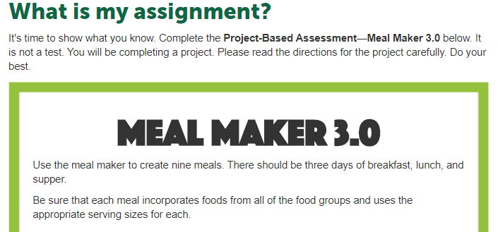
PHYSICAL EDUCATION
Nutrition…. 4th grade
Ready…Make A Meal..

Slide 32
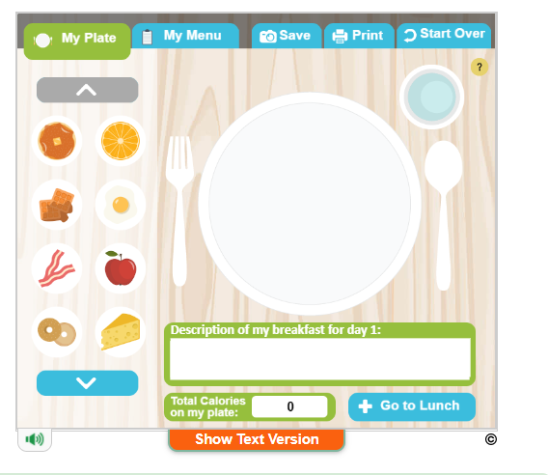
PHYSICAL EDUCATION
Nutrition…. 4th grade
Ready…Let’s Make A Meal...
Live Lesson We Will Do Together!

Slide 33
Assignment…..
PHYSICAL EDUCATION
Let’s turn in our assignment together!
Go to www.flvs.net and log in (use student credentials to log in) on the device you recorded the video on (phone or computer)
Go to gradebook
Click 2.04 Strength and click add files upload your pictures. …IN STUDENT COMMENTS TYPE: DID IN LIVE WITH COACH JONES!
When the dialog box opens go to your photo library if on your phone, or video/pic on computer and, click on the file/video, click open, 1 video/pic/pdf should be qued
Put the checkmark in the box above the “Save for Later” blue button
Click the blue “Submit for Grading” Button
You should get a thank you for submitting message and the assignment should show blue in the gradebook

Slide 34
All Done!!! Together We Can!
PHYSICAL EDUCATION

Slide 35
Today we will learn/review: 1st, 3rd, and 4th
PHYSICAL EDUCATION
I can 1st grade:
identify at least two foods that are sometimes foods
identify at least two foods that are everyday foods
name each of the four food groups
sort foods into the four food groups
match a variety of foods that belong to each food group
identify sometimes snacks
suggest everyday alternatives
recognize that sometimes foods and everyday foods give me different amounts of energy
recognize that healthy meals contain three of the four food groups
state that unhealthy foods can be enjoyed in small portions
state that you must wash your hands before eating a meal
draw pictures to show a healthy mealI can 3rd grade:
summarize how muscular endurance helps my performance in various physical activities
recognize that different activities and exercises impact my fitness in different ways
use different personal characteristics to overcome physical activity related challenges
use a log to keep track of my activity and fitness levels

Slide 36
Today we will learn/review: 1st, 3rd, and 4th
PHYSICAL EDUCATION
I can 3rd grade:
read food labels and pick out information that is most important to me
make safe health-related lifestyle changes to increase my fitness and well-being
identify patterns of healthy living
create a personal health goal and track it to completion, to combat the effects of a common health-related illness
I can 4th grade:
identify recommended serving sizes and explain how they promote personal health
identify the recommended daily portions for the different food groups
identify the recommended portions of healthy snacks
explain how much water is needed in a day, identify the impact of bottled water on the environment, and choose more friendly alternatives

Slide 37
Rate My Self Lesson Check In
PHYSICAL EDUCATION
What Do You Know About Nutrition?
I AM A 1 | I AM A 2 | I AM A 3 | I AM A 4
I don’t understand much about healthy foods! | I understand the concept of healthy foods, but I need more help! | I understand how to create a healthy meal and can make sure my meal has different food groups! | I understand how to create a healthy meal and can identify healthy foods in my refrigerator, and I can teach a friend/partner/family member about healthy food choices.

Slide 38
Bye See You Next Week Tuesday! Same Time, Same Place Time!
PHYSICAL EDUCATION
Next week we will be doing the 2.04 Nutrition mini lesson during class time!!
Be Prepared To Get Ready To Let Me See What you have learned!!!
K- 9:30-10:00 PE
1st- 11:15-11:45 PE
2nd- 10:15-10:45 PE
3rd- 1:00-1:30 PE
4th- 1:45-2:15 PE
5th- 2:30-3:00 PE
Don’t Forget To Join….. By clicking on the remind link for your class on the class announcement page!

