Slide 1
PHYSICAL EDUCATION
3rd, & 4th Grade
02
03
Strength

Slide 2
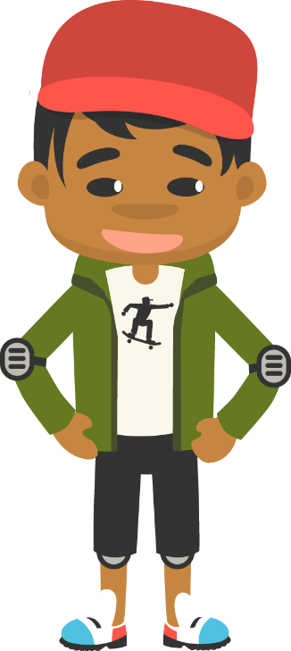
Muscle-Making Moves……
PHYSICAL EDUCATION
Time For A Tune-Up!!
Do you ever wish you could be as strong as your favorite superhero? When you play, you use your muscles. That makes them grow stronger. Find out how you can build your leg, arm, and core muscles and why this is important. Strength does not come from winning. It comes from working hard and trying new things. Your body is always changing, and making healthy choices is a first important step toward increasing your muscular strength and abilities.

Slide 3
Today we will learn/review: 1st, 3rd, and 4th
PHYSICAL EDUCATION
I can 1st grade:
recognize that building my muscles will help me in different ways
recognize that building my leg muscles will help me with certain tasks
recognize that building my arm muscles will help me with certain tasks
recognize that building my core muscles will help me with many different tasks
I can 3rd grade:
summarize how muscular endurance helps my performance in various physical activities
recognize that different activities and exercises impact my fitness in different ways
use different personal characteristics to overcome physical activity related challenges
use a log to keep track of my activity and fitness levels
I can 4th grade:
identify the muscles that are being used during physical activity
develop short- and long-term goals as they relate to my fitness needs
name the five parts of a workout and the equipment used to train specific muscles
identify what muscles are being strengthened during certain activities

Slide 4
Rate My Self SEL Learning Check In
PHYSICAL EDUCATION
Show Me How You Are Feeling??
Sad | Okay | Happy
I feel Sad today. | I feel OKAY today. | I feel HAPPY today.
SAD-THUMBS DOWN
OKAY-THUMB IN THE MIDDLE
HAPPY-THUMBS UP

Slide 5
Rate My Self Lesson Check In
PHYSICAL EDUCATION
What Do You Know About Muscular Strength?
I AM A 1 | I AM A 2 | I AM A 3 | I AM A 4
I don’t understand much about muscle strength! | I understand the concept of muscle strength, but I need more help! | I understand my own strength and can practice strength building exercises! | I understand my own strength and can practice strength building exercises, and can get a friend/partner to do it with me!

Slide 6
3rd Grade Standards
PHYSICAL EDUCATION
1st Grade Standards
PE.1.L.4.1 - Identify a benefit of strengthening muscles.
PE.3.L.4.1 Describe how muscular strength and endurance enhances performance in physical activities.
PE.3.L.4.4 Match physical fitness assessment events to the associated fitness component.
PE.3.R.6.1 List personally challenging physical-activity experiences.
PE.3.L.3.5 Use an activity log to maintain a personal record of participation in physical activity during a period of time.
HE.3.B.6.1 Select a personal health goal and track progress toward achievement.
4th Grade Standards
PE.4.L.4.1 Identify the muscles being strengthened during the performance of specific activities.
PE.4.L.4.9 Develop short-term and long-term goals.

Slide 7
Get a Jump Start…..
PHYSICAL EDUCATION
Our lesson covered a lot this week:
We learned we can grow, shrink, flex, extend, and pull our muscles. They even heat, protect, and move your body.
We learned our muscles attach to bones, when a muscle pulls on a bone, your bone moves. When your bone moves, your whole body moves. We have muscles all over our bodies. Did you know we have 206 bone!!!
We learned some muscles are built for endurance and some for strength. Your eye muscle are built for endurance we blink 28,200 times a day or walking all day; and your leg muscles are build for strength, we jump, run, kick and stand with them.
We learned about our legs, arms, and core muscle. Your core muscles are some of the most important muscles in your body. They help keep good posture when walking and sitting, help you keep your balance, sit up in the bed and lie down at night .
We learned your heart will speed up and slow down without you having to think about it, just like your car does! Vigorous Activities makes your heart go faster and moderate activity makes your heart bit slower.
We learned that must remember to always warm up our body and cool down our body with a good stretch.
3-4th grade: We learned barriers are obstacles that prevent us from doing something. This can be a mental barrier that stops us us from participating or something else
We must make time for fitness in order to stay healthy and happy.
4th Grade: The skeletal system is made up of all our bones and protects important organs like your skulls protects your brain.
Last we learned to flex, show our power-strength, make long term and short term goals that are SMART-specific, measurable, attainable, realistic, and timely
Let’s Practice And Have Some Fun!

Slide 8
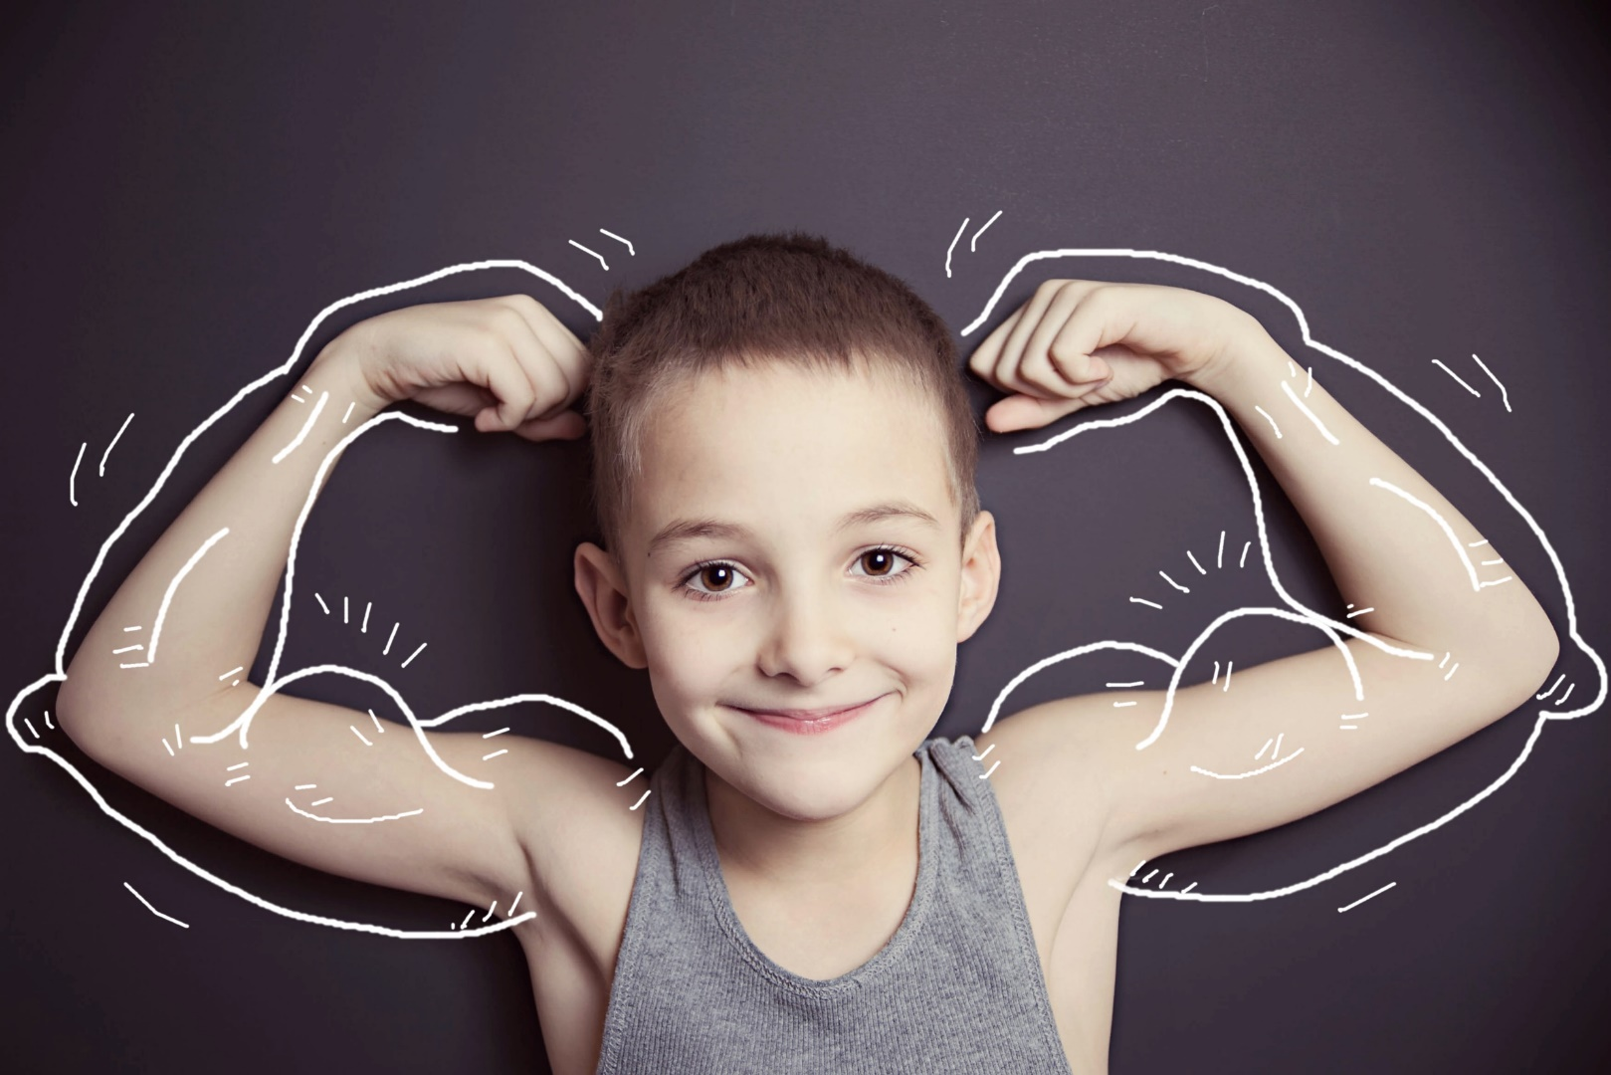
PHYSICAL EDUCATION
Strength…. 1st grade
What is muscle?
Our muscles help us to ________________.
Muscles attach to ______________.
Muscle make us _____________.
Move
Strong
Bone
Module: 02 Lesson: 03
Notes:
Students will: Drag the words to fill in the blanks.
PE.1.L.4.1 - Identify a benefit of strengthening muscles.

Slide 9
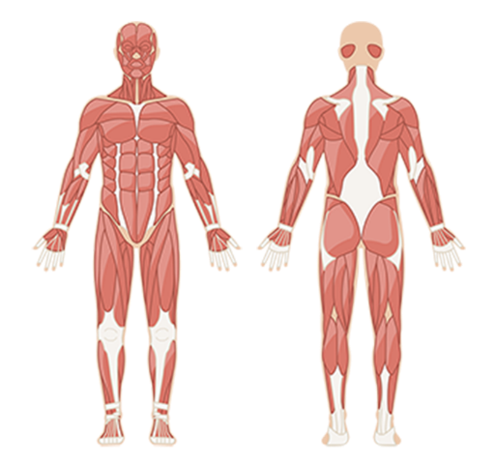
PHYSICAL EDUCATION
Strength…. 1st grade
Muscle Madness
Core
The muscles in our stomach and lower back are called our __________ muscles.
Stamp your core muscles on these two pictures!
Module: 02 Lesson: 03
Notes:
Students will: Drag the word to fill in the blank, and then indicate where the core muscles are located by dragging a stamp onto the diagram.
PE.1.L.4.1 - Identify a benefit of strengthening muscles.

Slide 10
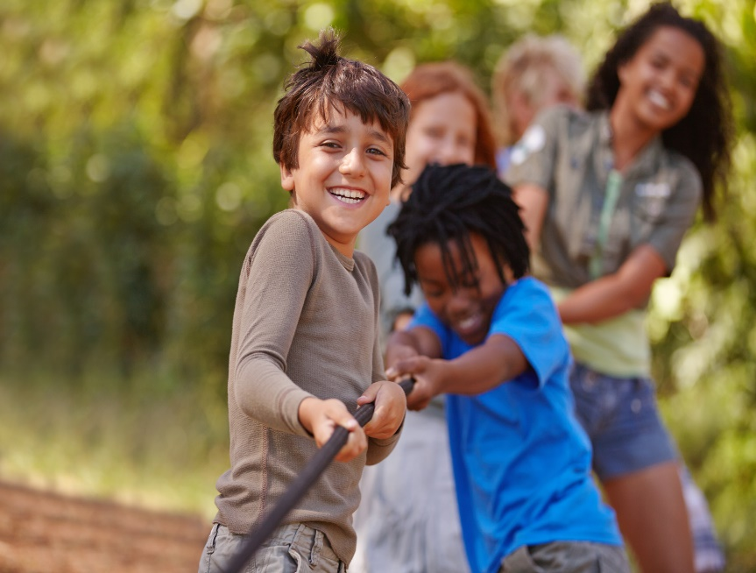
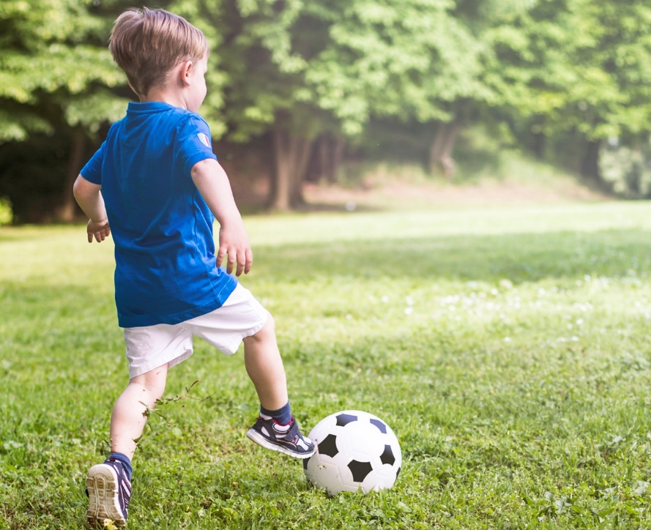
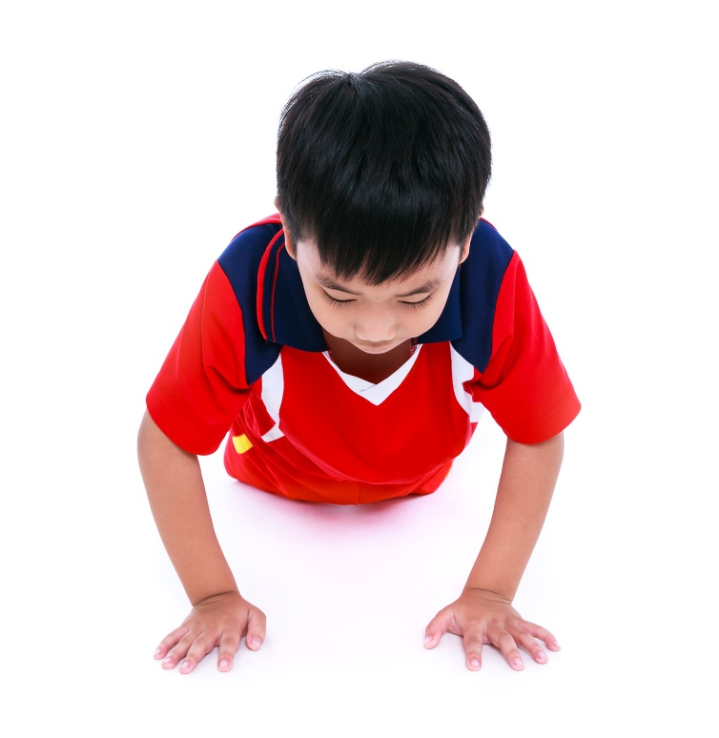
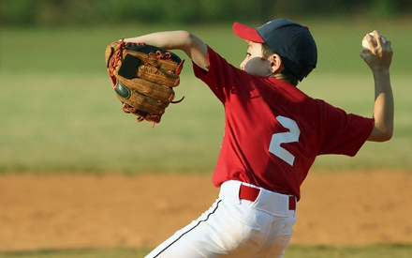
PHYSICAL EDUCATION
Strength…. 1st grade
Stamp the activities that you need strong arms for:
Tug-of-war
Reading
Jumping
Throwing
Kicking
Push-ups
Module: 02 Lesson: 03
Notes:
Students will: circle the activities that they think they need strong arms to do (focus on activities that use arms).
PE.1.L.4.1 - Identify a benefit of strengthening muscles.

Slide 11
Your Turn!! The next few slides will cover your 2.03 Strength. You will NEED To turn in YOUR ASSIGNMENT IN TODAY for a GRADE!!! YAY….
PHYSICAL EDUCATION
Strength…. 1st grade
You Will Need….
Your parents to take a picture at the end
This assignment is on slide 27

Slide 12
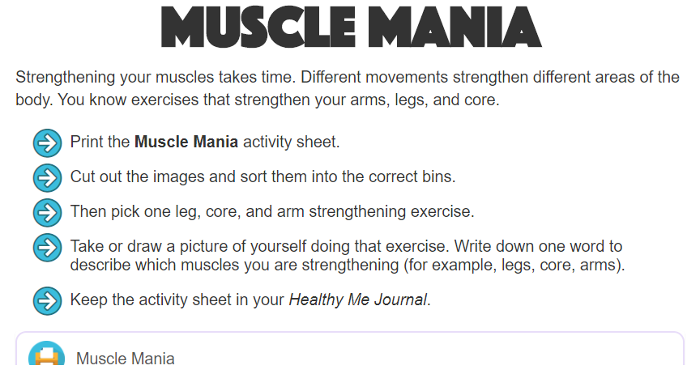
PHYSICAL EDUCATION
Strength…. 1st grade
Ready…Let’s Get This Done..

Slide 13
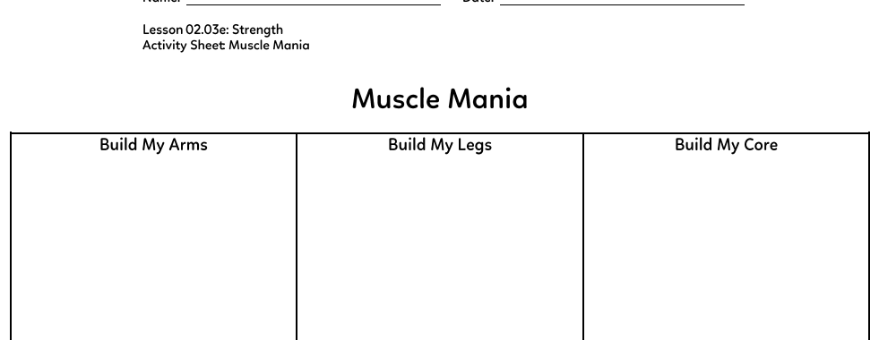
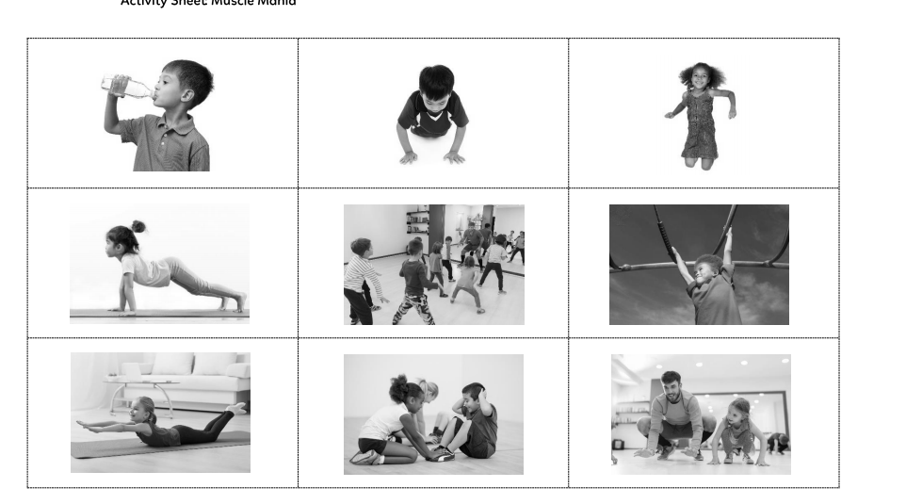
PHYSICAL EDUCATION
Strength…. 1st grade
Ready…Let’s Get This Done..

Slide 14
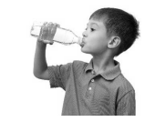
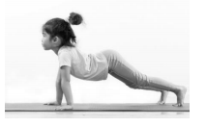
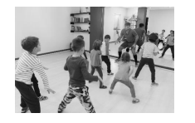
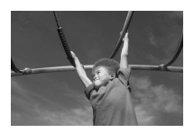
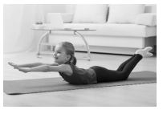
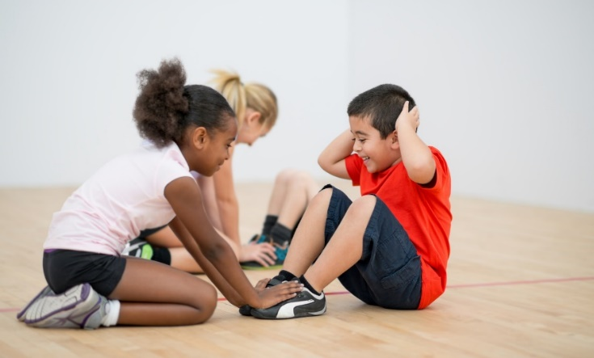
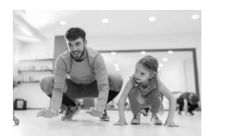
PHYSICAL EDUCATION
Strength…. 1st grade
Drag the exercises into the column they belong in.
Think about what muscles you use when you do these things!
Legs
Arms
Core
Module 02: Lesson 03
Notes:
Students will: Drag the labelled pictures into the correct columns on the chart.
PE.1.L.4.1 - Identify a benefit of strengthening muscles.

Slide 15
PHYSICAL EDUCATION
Strength…. 1st grade
Your Turn….. Camera Time…Have Mom/Dad Take A Picture Of You Doing, or Draw me a picture of you doing these exercises
1 leg…. 1 arms…. 1 core exercise
Legs
Arms
Core
My Pic Here
My Pic Here
My Pic Here
Module 02: Lesson 03
Notes:
Students will: Drag the labelled pictures into the correct columns on the chart.
PE.1.L.4.1 - Identify a benefit of strengthening muscles.

Slide 16
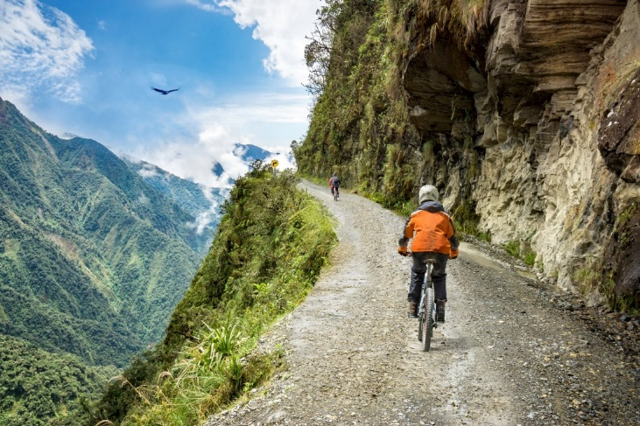
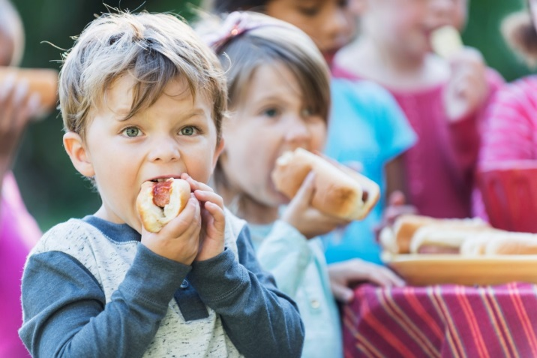
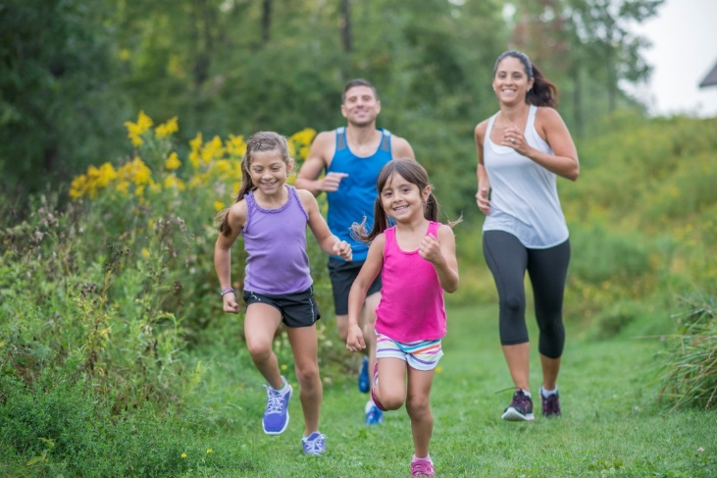
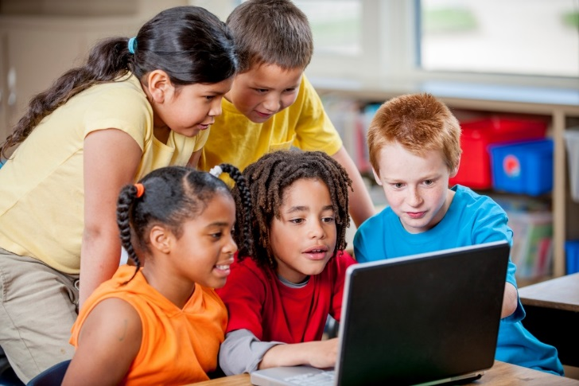
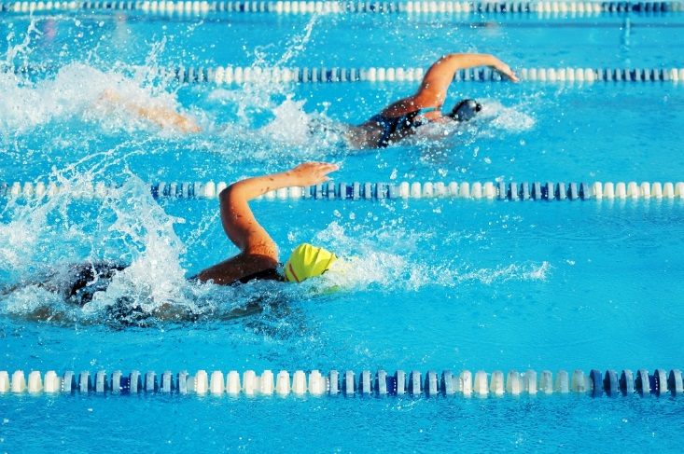
PHYSICAL EDUCATION
Strength... 3rd grade
Muscular Endurance
Stamp the activities
Module 02: Lesson 03
Notes:
Students will use the stamp tool to mark which activities require good muscular endurance.
The teacher will describe the importance of muscular endurance for optimum performance and make connections between muscular endurance and performance.
PE.3.L.4.1 Describe how muscular strength and endurance enhances performance in physical activities.

Slide 17
PHYSICAL EDUCATION
Strength…3rd grade
Break Down Barriers
I can make time.
I’m nervous.
I can do this.
I’m too tired.
I will learn something new.
I can try my best.
I don’t know the rules.
I’m too busy.
This will give my body what it needs.
I don’t want to look silly.
Module 02: Lesson 03
Notes:
Students will highlight or change the color of the phrases on the right hand side of the page to match the color from the phrase on the left. What can you think or say when you find a barrier to participating in physical activity?
The teacher will guide students and give them other helpful strategies for overcoming barriers.
PE.3.R.6.1 List personally challenging physical-activity experiences.
HE.3.B.6.1 Select a personal health goal and track progress toward achievement.

Slide 18
Your Turn!! The next few slides will cover your 2.03 Strength. You will NEED To turn in YOUR ASSIGNMENT IN TODAY for a GRADE!!! YAY….
PHYSICAL EDUCATION
Strength…. 3rd grade
You Will Need….
1 Sheet Of Computer Paper!
Markers or Colored Pencils
This assignment is on slide 22

Slide 19
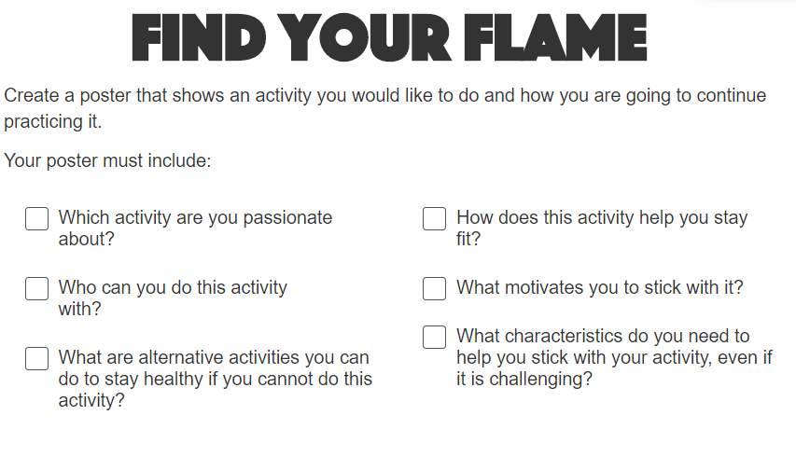
Strength…. 3rd grade...
PHYSICAL EDUCATION
Let’s Workout..

Slide 20
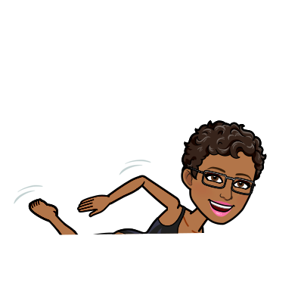
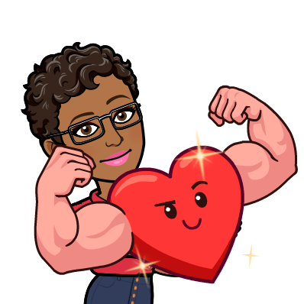
I Love To Go Walking
PHYSICAL EDUCATION
Strength…. 3rd grade...
Example:
I can do this activity with: my mom and son!
What motivates me to stick with it: I want to be healthy and not have to take diabetes medicine like my mom so I try to make sure to exercise.
__Walking______ helps me stay fit because it get my heart working and I burn fat too!
Characteristic I need to stick with it, even if it is challenging: Dedication, Strengthen, Mental Toughness To Not Give Up
If I can’t walk: I can swim, or do muscle exercises with my resistance bands too!!

Slide 21
I Love To _____________
PHYSICAL EDUCATION
Strength…. 3rd grade...
Your turn/done share what you submitted ☺
I can do this activity with: ______________________________
What motivates me to stick with it: _______________________________________________________________.
_______ helps me stay fit because it _________________________________________________________.
Draw a picture of your favorite activity!
Characteristic I need to stick with it, even if it is challenging: ____________________________________________________________
If I can’t _______: I can __________________________________________________________________________!!

Slide 22
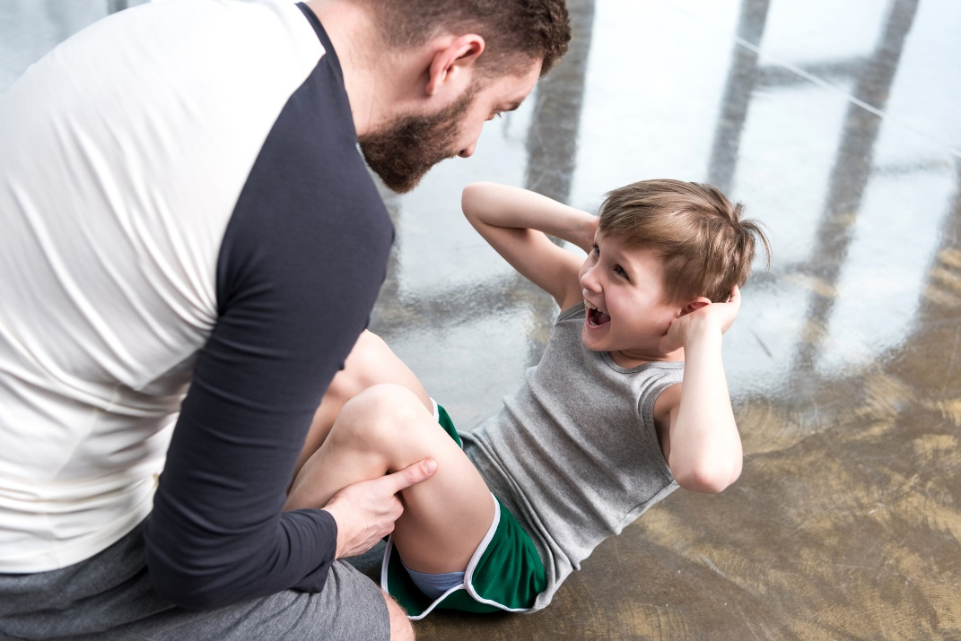
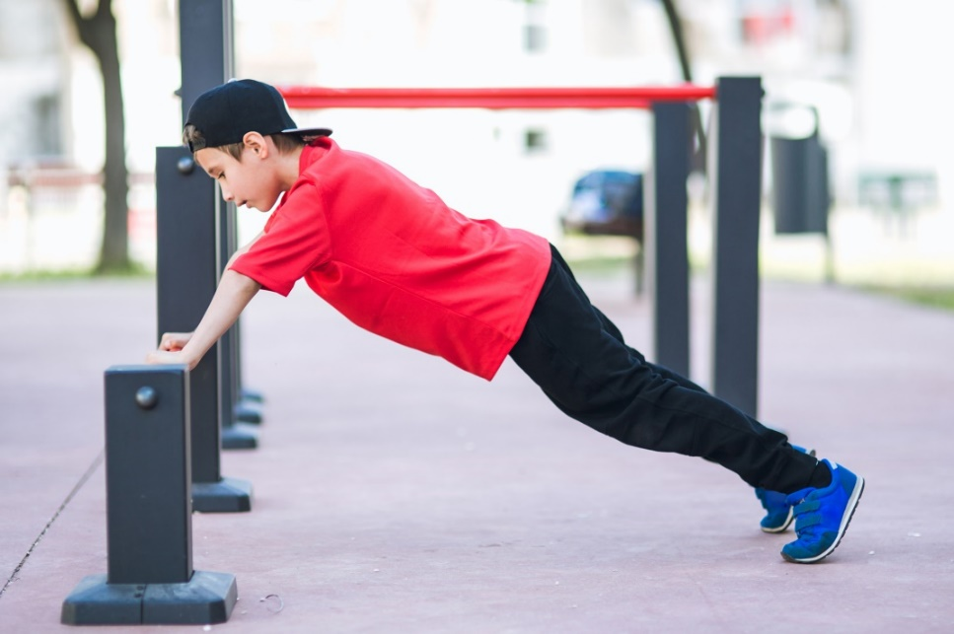
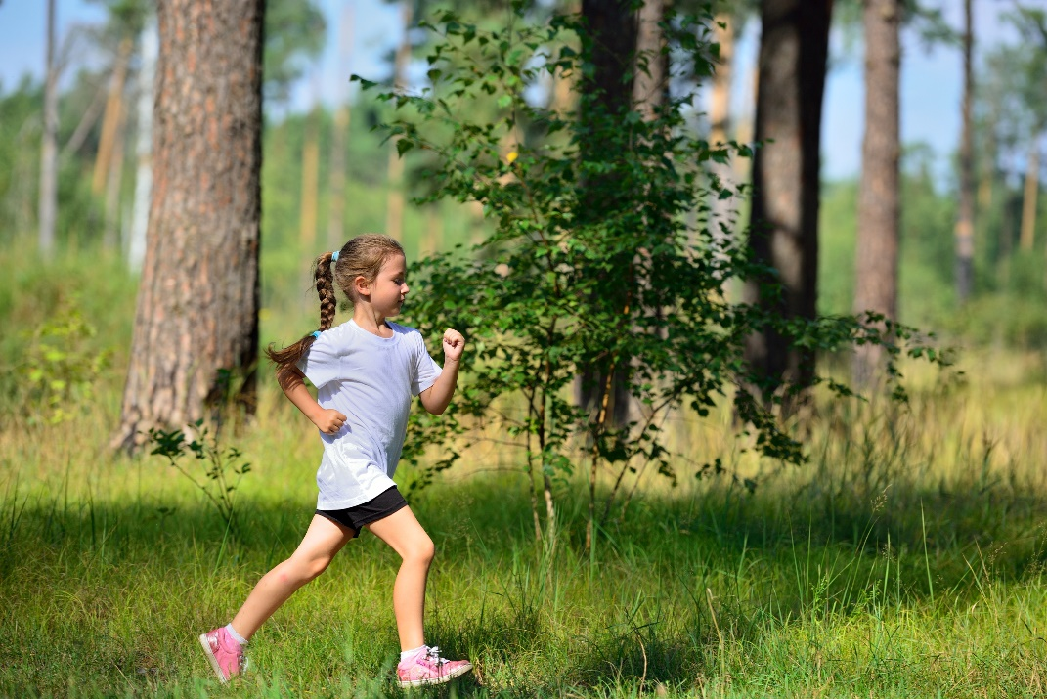
PHYSICAL EDUCATION
Strength…. 4th grade...
Find the Group
Arms
Legs
Core
Whole-body
Module 02: Lesson 03
Notes:
Students will organize the exercises into the correct muscle group that is used.
The teacher will answer questions and give guiding questions to students.
PE.4.L.4.1 Identify the muscles being strengthened during the performance of specific activities.

Slide 23
PHYSICAL EDUCATION
Strength…. 4th grade...
Is it SMART?
Strengthening
Achievable
Specific
Teachable
Measurable
Attainable
Realistic
Type
Timely
Recovery
Module 02: Lesson 03
Notes:
Students will determine what SMART stands for when it comes to goal setting.
The teacher will ask prompting questions.
PE.4.L.4.9 Develop short-term and long-term goals.

Slide 24
Your Turn!! The next few slides will cover your 2.03 Strength. You will NEED To turn in YOUR ASSIGNMENT IN TODAY for a GRADE!!! YAY….
PHYSICAL EDUCATION
Strength…. 4th grade
But First….
Make sure mom/or dad has downloaded the Help Ralph Meet His Goal Activity Sheet! Or have your Camera Ready!

Slide 25
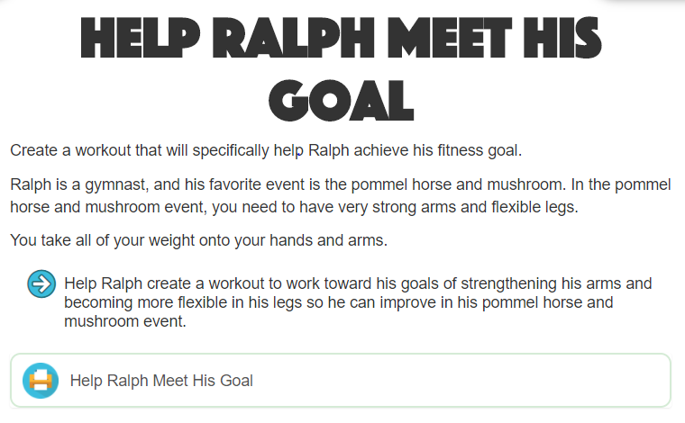
Strength…. 4th grade...
PHYSICAL EDUCATION
Ready…Set GO.. Let’s Get This Done….

Slide 26
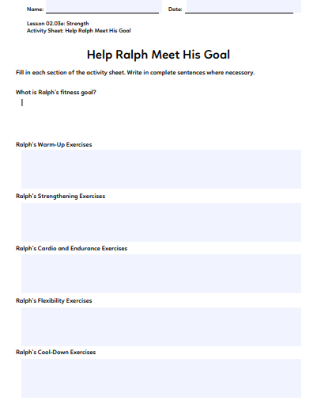
Strength…. 4th grade...
PHYSICAL EDUCATION
Let’s Help Ralph

Slide 27
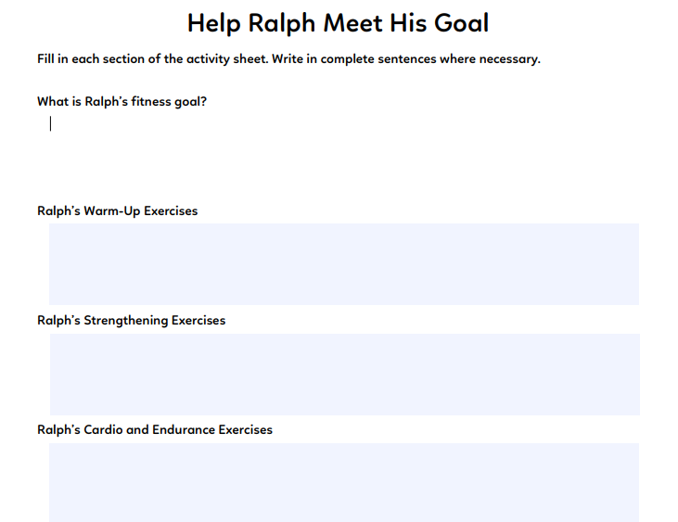
Strength…. 4th grade...
PHYSICAL EDUCATION
Put our answer here:
Put our answer here:
Put our answer here:
Put our answer here:

Slide 28
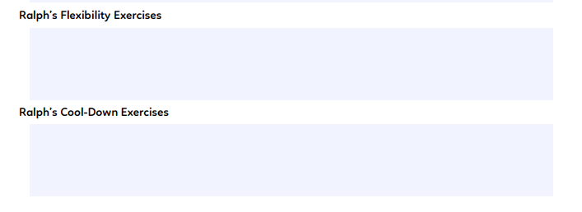
Strength…. 4th grade...
PHYSICAL EDUCATION
Put our answer here:
Put our answer here:
Picture Time…

Slide 29
Assignment…..
PHYSICAL EDUCATION
Let’s turn in our assignment together!
Go to www.flvs.net and log in (use student credentials to log in) on the device you recorded the video on (phone or computer)
Go to gradebook
Click 2.03 Strength and click add files upload your pictures. …IN STUDENT COMMENTS TYPE: DID IN LIVE WITH COACH JONES!
When the dialog box opens go to your photo library if on your phone, or video/pic on computer and, click on the file/video, click open, 1 video/pic/pdf should be qued
Put the checkmark in the box above the “Save for Later” blue button
Click the blue “Submit for Grading” Button
You should get a thank you for submitting message and the assignment should show blue in the gradebook

Slide 30
All Done!!! Together We Can!
PHYSICAL EDUCATION

Slide 31
Today we will learn/review: 1st, 3rd, and 4th
PHYSICAL EDUCATION
I can 1st grade:
recognize that building my muscles will help me in different ways
recognize that building my leg muscles will help me with certain tasks
recognize that building my arm muscles will help me with certain tasks
recognize that building my core muscles will help me with many different tasks
I can 3rd grade:
summarize how muscular endurance helps my performance in various physical activities
recognize that different activities and exercises impact my fitness in different ways
use different personal characteristics to overcome physical activity related challenges
use a log to keep track of my activity and fitness levels
I can 4th grade:
identify the muscles that are being used during physical activity
develop short- and long-term goals as they relate to my fitness needs
name the five parts of a workout and the equipment used to train specific muscles
identify what muscles are being strengthened during certain activities

Slide 32
Rate My Self Lesson Check In
PHYSICAL EDUCATION
What Do You Know About Muscular Strength?
I AM A 1 | I AM A 2 | I AM A 3 | I AM A 4
I don’t understand much about muscle strength! | I understand the concept of muscle strength, but I need more help! | I understand my own strength and can practice strength building exercises! | I understand my own strength and can practice strength building exercises, and can get a friend/partner to do it with me!

Slide 33
Bye See You Next Week Tuesday! Same Time, Same Place Time!
PHYSICAL EDUCATION
Next week we will be doing the 2.03 Strength mini lesson during class time!!
Be Prepared To Get Ready To Let Me See What you have learned!!!
K- 9:30-10:00 PE
1st- 11:15-11:45 PE
2nd- 10:15-10:45 PE
3rd- 1:00-1:30 PE
4th- 1:45-2:15 PE
5th- 2:30-3:00 PE
Don’t Forget To Join….. By clicking on the remind link for your class on the class announcement page!

