Slide 1
PHYSICAL EDUCATION
3rd, & 4th Grade
02
02
Cardiovascular Health

Slide 2
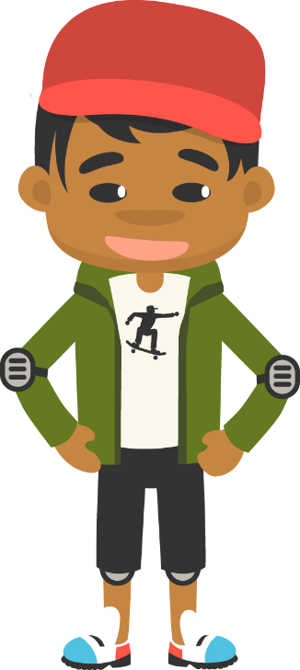
What Does Your Heart Do?……
PHYSICAL EDUCATION
Pump It Up!!
Is your heart beating fast or is it beating slow? Do a number of different activities and soon you will know. Feel how many times it beats in a row and then see if you can make it go. Your heart and lungs are two of the most important organs that you have. These organs rely on each other and work together to make sure your body is working to its full potential when doing moderate and vigorous activities.

Slide 3
Today we will learn/review: 1st, 3rd, and 4th
PHYSICAL EDUCATION
I can 1st grade:
notice that my heart rate is different before, during, and after physical activity
name a moderate and a vigorous physical activity
name warm-up and cool-down activities that help warm up different parts of my body
recognize the health benefits of being physically active
I can 3rd grade:
describe the role of my heart and lungs while I am active, and how they rely on each other
use various activities to work and improve my cardiovascular endurance
identify the difference between moderate and vigorous physical activity
recognize how different activities impact different aspects of my fitness

Slide 4
Today we will learn/review: 1st, 3rd, and 4th
PHYSICAL EDUCATION
I can 4th grade:
increase my heart rate to a target range and maintain that rate during activity
jog using an effective pattern for an extended period of time
calculate in beats per minute my heart rate and maximum heart rate
identify at least one moderately intense physical activity, and at least one vigorously intense physical activity
listen to the messages my body sends so that I can plan my movements
reasonably estimate and calculate a target heart rate zone before and during moderately and vigorously intense activities
match important principles of fitness to their correct meaning
connect the number of reps and sets needed to meet my fitness principles while working toward fitness goals
show how different principles of fitness are part of my workout
use my heart rate measurements to make personal connections to the fitness principles

Slide 5
Rate My Self SEL Learning Check In
PHYSICAL EDUCATION
Show Me How You Are Feeling??
Sad | Okay | Happy
I feel Sad today. | I feel OKAY today. | I feel HAPPY today.
SAD-THUMBS DOWN
OKAY-THUMB IN THE MIDDLE
HAPPY-THUMBS UP

Slide 6
Rate My Self Lesson Check In
PHYSICAL EDUCATION
What Do You Know About Cardiovascular Fitness?
I AM A 1 | I AM A 2 | I AM A 3 | I AM A 4
I don’t understand much about cardiovascular fitness! | I understand the concept of cardiovascular fitness, but I need more help! | I understand my heart and can practice cardiovascular fitness exercises! | I understand why we should exercise, how this effects my heart, and can get a friend/partner to do it with me!

Slide 7
3rd Grade Standards
PHYSICAL EDUCATION
1st Grade Standards
PE.1.L.4.3 - Identify the changes in heart rate before, during, and after physical activity.
PE 1.L.3.1 - Identify a moderate physical activity.
PE.1.L.3.2 - Identify a vigorous physical activity.
PE.1.C.2.9 - Name examples of warm-up and cool-down exercises.
PE.1.L.4.2 - Identify the components of health-related physical fitness.
PE.3.L.4.2 Describe the relationship between the heart and lungs during physical activity.
PE.3.L.4.3 Identify appropriate physical activities that result in the development of cardiorespiratory endurance.
PE.3.M.1.12 Continuously jump a self-turned rope.
PE.3.L.3.1 Identify a moderate physical activity.
PE.3.L.3.2 Identify a vigorous physical activity.
PE.3.L.4.4 Match physical fitness assessment events to the associated fitness component.
4th Grade Standards
PE.4.L.4.3 Maintain HR within the target HR zone for a specified length of time during an aerobic activity.
PE 4.L.3.1 Identify a moderate physical activity. (How does it affect HR?)
PE.4.L.3.2 Identify a vigorous physical activity. (How does it affect HR?)
PE.4.L.4.8 Explain the principles of physical fitness.

Slide 8
Get a Jump Start…..
PHYSICAL EDUCATION
Our lesson covered a lot this week:
We learned the heart is a very important muscle in the body. It is very important to help us move and play.
We learned the heart muscle is inside your chest that pushes blood to the rest of your body. Everything in your body needs blood to live and work. When your are active, your heart beats faster to pump more blood through your working body. You need to keep a strong and health heart.
We learned the harder you make your body work, the harder your heart works.
We learned cardiovascular activities are physical activities that train your heart, activities like going on a walk, jumping, skipping, and biking are all great cardio activities that will make your heart strong. Whole body activities, like running or swimming are activities that work your heart and muscles all over your body.
We learned your heart will speed up and slow down without you having to think about it, just like your car does! Vigorous Activities makes your heart go faster and moderate activity makes your heart bit slower.
We learned that must remember to always warm up our body and cool down our body with a good stretch.
3-4th grade: We learned your heart and lungs work together to bring oxygen to your muscles. Your respiratory and cardiovascular systems work together to keep you moving. Your blood vessels keep the blood flowing through the body.
Every time your heart beats, it pushes oxygenated blood through your body.
Sitting is a good way to rest your body, but you must get up and get moving.
Let’s Practice And Have Some Fun!

Slide 9
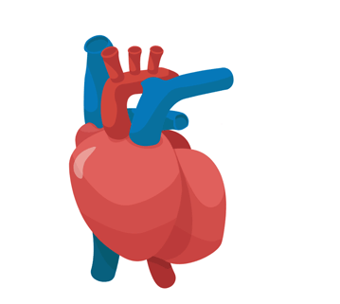
PHYSICAL EDUCATION
Cardiovascular Fitness…. 1st grade
My Heart Is Important
The heart’s job is to ___________ blood to the muscles.
Your heart needs to be ___________ and ____________.
pump
strong
healthy
Module 02: Lesson 02
Notes:
Students will: Fill in the blanks by dragging the correct word into the space.
PE.1.L.4.2 - Identify the components of health-related physical fitness.

Slide 10
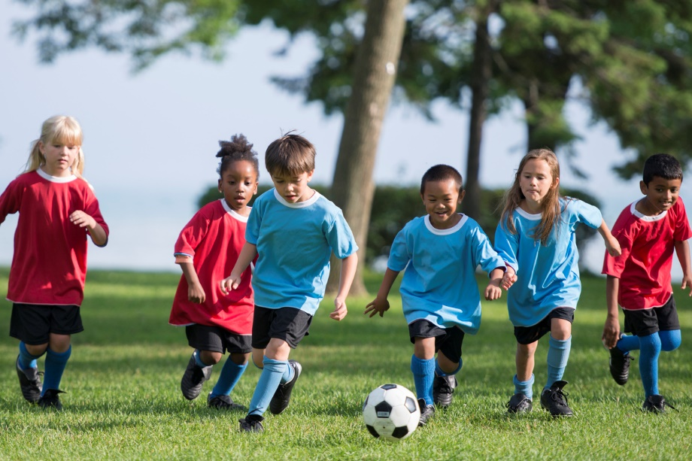
PHYSICAL EDUCATION
Cardiovascular Fitness…. 1st grade
My heart beats…
Heart
Rate
Slow
Fast
Module 02: Lesson 02
Notes:
Students will: Drag the word under the picture that it matches.
PE.1.L.4.3 - Identify the changes in heart rate before, during, and after physical activity.

Slide 11
Your Turn!! The next few slides will cover your 2.02 Cardiovascular Fitness. You will NEED To turn in YOUR ASSIGNMENT IN TODAY for a GRADE!!! YAY….
PHYSICAL EDUCATION
Cardiovascular Fitness…. 1st grade
You Will Need….
5 Sheets Of Computer Paper!
Markers or Colored Pencils
This assignment is on slide 26

Slide 12
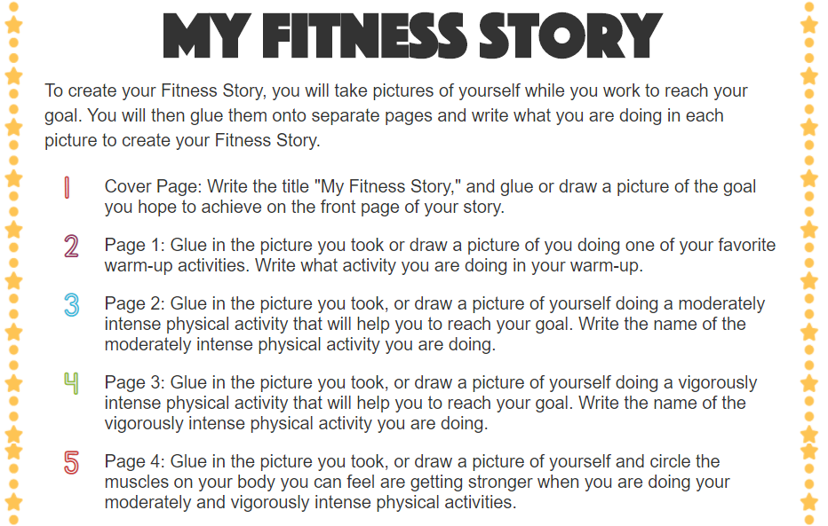
PHYSICAL EDUCATION
Cardiovascular Fitness…. 1st grade
Ready…Let’s Get This Done..

Slide 13
PHYSICAL EDUCATION
Cardiovascular Fitness…. 1st grade
Ready…Let’s Get This Done..

Slide 14
PHYSICAL EDUCATION
Cardiovascular Fitness. 3rd grade
Heart pumps
faster and
breathing gets heavier
The Body Process
Muscles
receive
oxygen
Exercise
begins
Blood brings
oxygen to
the muscles
Module 02: Lesson 02
Notes:
Students will drag each step of the cardiovascular process onto the arrow in the correct order.
The teacher will describe the cardiovascular process of delivering oxygen through the bloodstream to the muscles.
PE.3.L.4.2 Describe the relationship between the heart and lungs during physical activity.

Slide 15
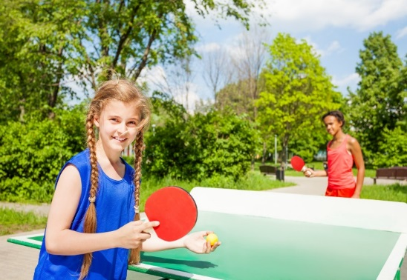
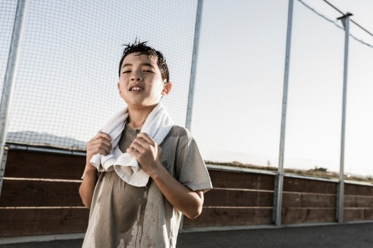
PHYSICAL EDUCATION
Light or Heavy
Cardiovascular Fitness. 3rd grade
Vigorous Activity
Moderate Activity
Breathing heavy
Quick heart rate
Not sweating
Breathing lightly
Slow heart rate
Sweating
Module 02: Lesson 02
Notes:
Students will sort the phrases and pictures into vigorous activity or moderate activity.
The teacher will explain that some moderate activities require strenuous work but for shorter periods of time than vigorous activities.
PE.3.L.4.2 Describe the relationship between the heart and lungs during physical activity.
PE.3.L.4.3 Identify appropriate physical activities that result in the development of cardiorespiratory endurance.
PE.3.L.3.1 Identify a moderate physical activity.
PE.3.L.3.2 Identify a vigorous physical activity.

Slide 16
Your Turn!! The next few slides will cover your 2.02 Cardiovascular Fitness. You will NEED To turn in YOUR ASSIGNMENT IN TODAY for a GRADE!!! YAY…. But first…. Let’s stretch!!
PHYSICAL EDUCATION
Cardiovascular Fitness…. 3rd grade
While we are stretching….
Make sure mom/or dad has downloaded the Ultimate Activity of Slide 24 OR Have A Sheet Of Paper and A Pencil Ready!

Slide 17
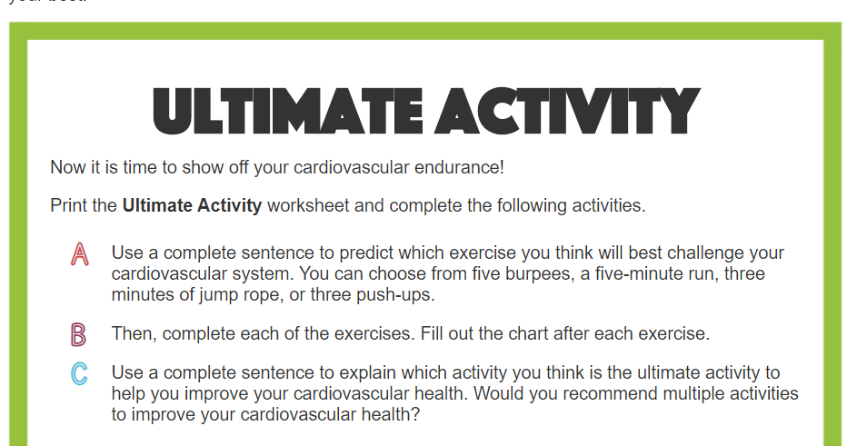
Cardiovascular Fitness…. 3rd grade...
PHYSICAL EDUCATION
Let’s Workout..

Slide 18
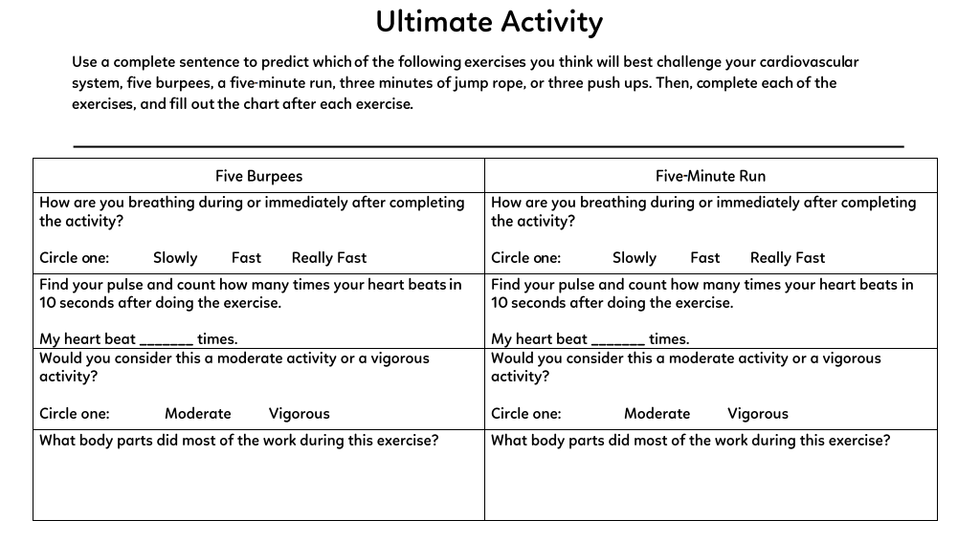
PHYSICAL EDUCATION

Slide 19
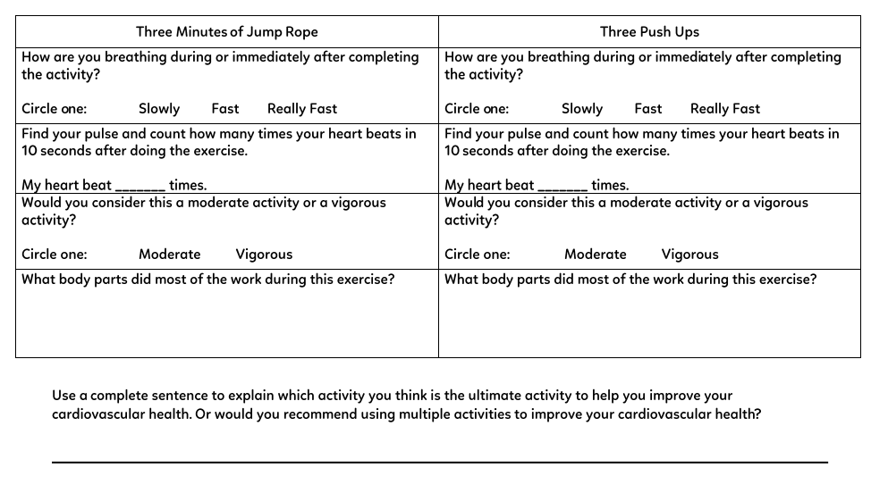
PHYSICAL EDUCATION

Slide 20
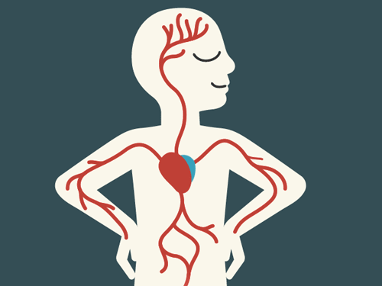
PHYSICAL EDUCATION
Cardiovascular Fitness…. 4th grade...
Find your Pulse
How do you check your pulse?
Place your palm on your wrist.
Place two fingers on the side of your throat.
Place your thumb on the side of your throat.
Module 02: Lesson 02
Notes:
Students will determine how to find their pulse.
Teachers will prompt the students to find their pulses and count them.
PE.4.L.4.3 Maintain HR within the target HR zone for a specified length of time during an aerobic activity.
PE.4.L.4.8 Explain the principles of physical fitness.

Slide 21
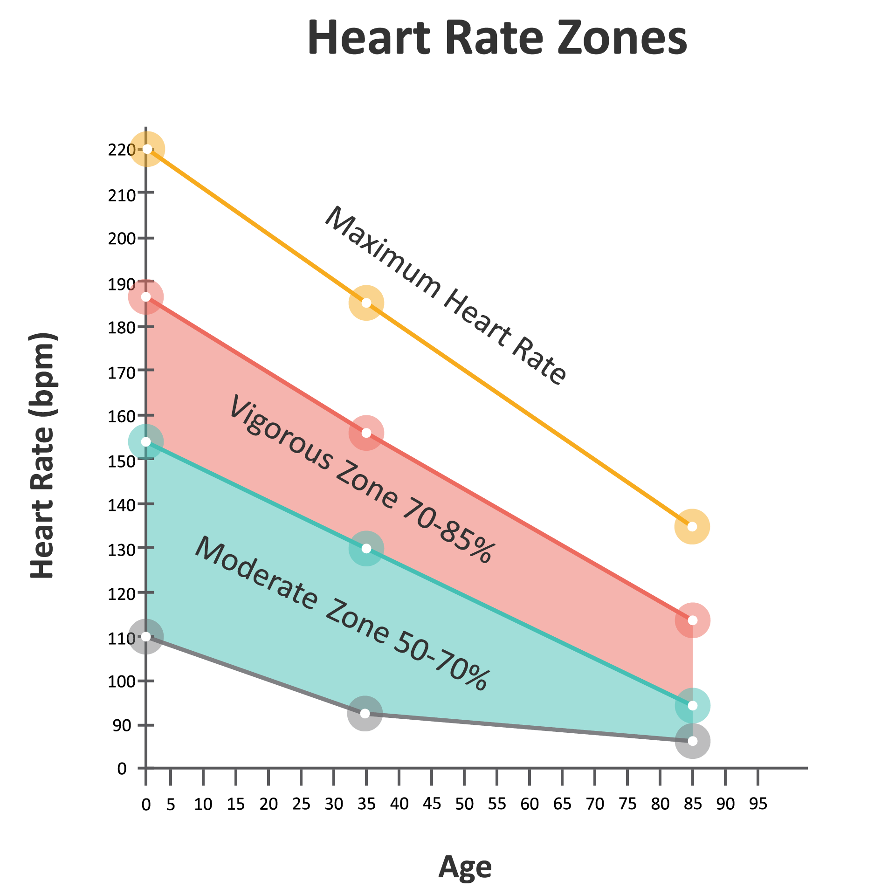
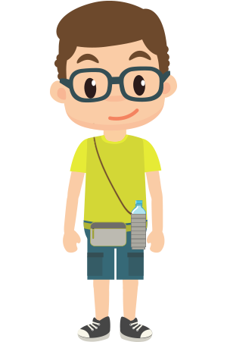
PHYSICAL EDUCATION
Cardiovascular Fitness…. 4th grade...
What zone is Gene in?
You’re right! My heart rate is 144 bpm! What heart rate zone does that mean I was working in?
Module 02: Lesson 02
Notes:
Students will use the information learned from the previous slide to help Gene determine which heart rate zone he was in. They are welcome to mark on the graph where Gene’s heart rate was to determine the heart rate zone.
The teacher will prompt students about how to use the map to gain the information and explain the graph.
PE.4.L.4.3 Maintain HR within the target HR zone for a specified length of time during an aerobic activity.
PE 4.L.3.1 Identify a moderate physical activity. (How does it affect HR?)

Slide 22
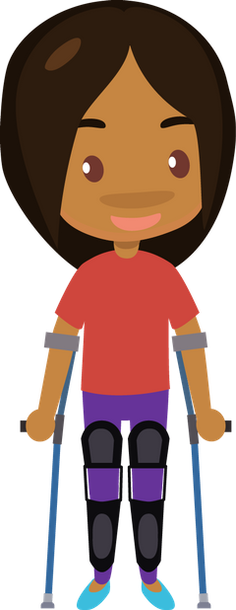
PHYSICAL EDUCATION
Cardiovascular Fitness…. 4th grade...
What’s my max?
220
–
Age
I want to find out what my maximum heart rate is so I can stay within it. I just turned eight!
Can you help me figure it out?
=
Max. HR
-
=
Module 02: Lesson 02
Notes:
The teacher will have the students recall the formula for a maximum heart rate calculation, and then present it for the students to solve for Ava’s question.
Students will determine Ava’s maximum heart rate.
The teacher will answer questions and prompt the students closer to solving the equation.
PE.4.L.4.3 Maintain heart rate within the target heart rate zone for a specified length of time during an aerobic activity.

Slide 23
Your Turn!! The next few slides will cover your 2.02 Cardiovascular Fitness. You will NEED To turn in YOUR ASSIGNMENT IN TODAY for a GRADE!!! YAY…. But first…. Let’s stretch!!
PHYSICAL EDUCATION
Cardiovascular Fitness…. 4th grade
While we are stretching….
Make sure mom/or dad has downloaded the Ultimate Activity of Slide 30 OR Have A Sheet Of Paper and A Pencil Ready!

Slide 24
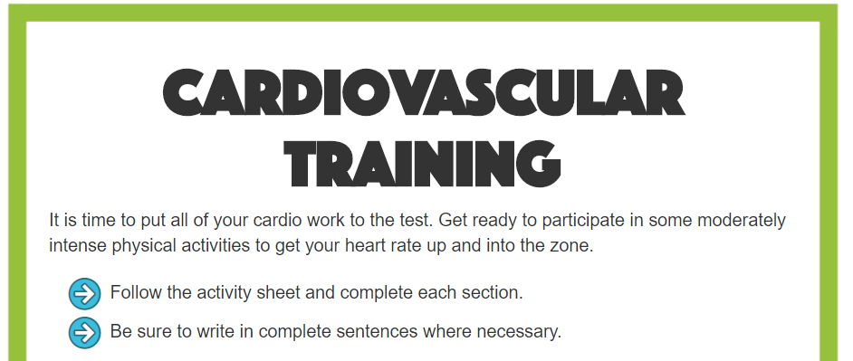
Cardiovascular Fitness…. 4th grade...
PHYSICAL EDUCATION
Ready…Set GO.. Let’s Get This Done….

Slide 25
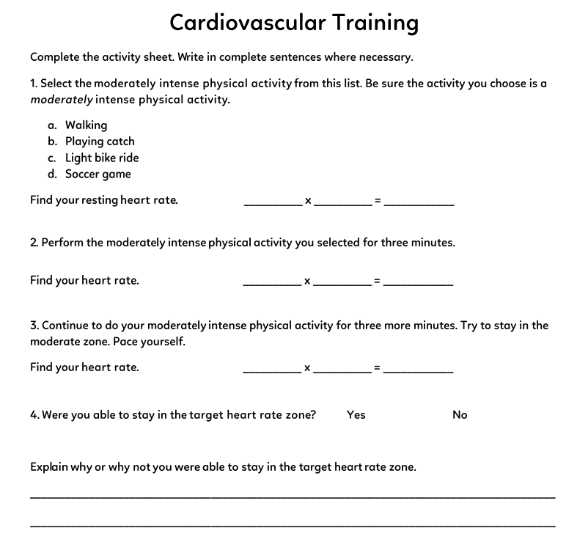
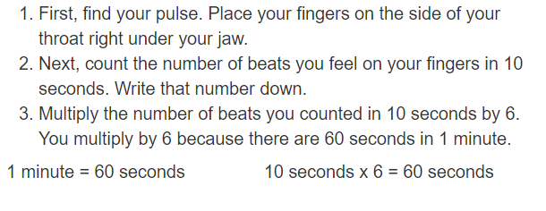
PHYSICAL EDUCATION

Slide 26
Assignment…..
PHYSICAL EDUCATION
Let’s turn in our assignment together!
Go to www.flvs.net and log in (use student credentials to log in) on the device you recorded the video on (phone or computer)
Go to gradebook
Click 2.02 cardiovascular fitness and click add files OR IF YOU TURNED ON YOUR CAMERA…IN STUDENT COMMENTS TYPE: DID IN LIVE WITH COACH JONES AND PARTNER-1st grade!
When the dialog box opens go to your photo library if on your phone, or video/pic on computer and, click on the file/video, click open, 1 video/pic/pdf should be qued
Put the checkmark in the box above the “Save for Later” blue button
Click the blue “Submit for Grading” Button
You should get a thank you for submitting message and the assignment should show blue in the gradebook

Slide 27
All Done!!! Together We Can!
PHYSICAL EDUCATION

Slide 28
Today we will learn/review: 1st, 3rd, and 4th
PHYSICAL EDUCATION
I can 1st grade:
notice that my heart rate is different before, during, and after physical activity
name a moderate and a vigorous physical activity
name warm-up and cool-down activities that help warm up different parts of my body
recognize the health benefits of being physically active
I can 3rd grade:
describe the role of my heart and lungs while I am active, and how they rely on each other
use various activities to work and improve my cardiovascular endurance
identify the difference between moderate and vigorous physical activity
recognize how different activities impact different aspects of my fitness

Slide 29
Today we will learn/review: 1st, 3rd, and 4th
PHYSICAL EDUCATION
I can 4th grade:
increase my heart rate to a target range and maintain that rate during activity
jog using an effective pattern for an extended period of time
calculate in beats per minute my heart rate and maximum heart rate
identify at least one moderately intense physical activity, and at least one vigorously intense physical activity
listen to the messages my body sends so that I can plan my movements
reasonably estimate and calculate a target heart rate zone before and during moderately and vigorously intense activities
match important principles of fitness to their correct meaning
connect the number of reps and sets needed to meet my fitness principles while working toward fitness goals
show how different principles of fitness are part of my workout
use my heart rate measurements to make personal connections to the fitness principles

Slide 30
Rate My Self Lesson Check In
PHYSICAL EDUCATION
What Do You Know About Cardiovascular Fitness?
I AM A 1 | I AM A 2 | I AM A 3 | I AM A 4
I don’t understand much about cardiovascular fitness! | I understand the concept of cardiovascular fitness, but I need more help! | I understand my heart and can practice cardiovascular fitness exercises! | I understand why we should exercise, how this effects my heart, and can get a friend/partner to do it with me!

Slide 31
Bye See You Next Week Tuesday! Same Time, Same Place Time!
PHYSICAL EDUCATION
Next week we will be doing the 2.03 Strength mini lesson during class time!!
Be Prepared To Get Ready To Let Me See What you have learned!!!
K- 9:30-10:00 PE
1st- 11:15-11:45 PE
2nd- 10:15-10:45 PE
3rd- 1:00-1:30 PE
4th- 1:45-2:15 PE
5th- 2:30-3:00 PE
Don’t Forget To Join….. By clicking on the remind link for your class on the class announcement page!

